Slide 1
CORE TRAINING
April 2024

Slide 2

Core Training
PEOPLE CLOSEST TO YOU
Getting Started and Mindset for Success
The ACN Compensation Plan
Customer Acquisition
Team Building
Promoting Training Events

Slide 3

Getting Started &
Mindset for Success

Slide 4

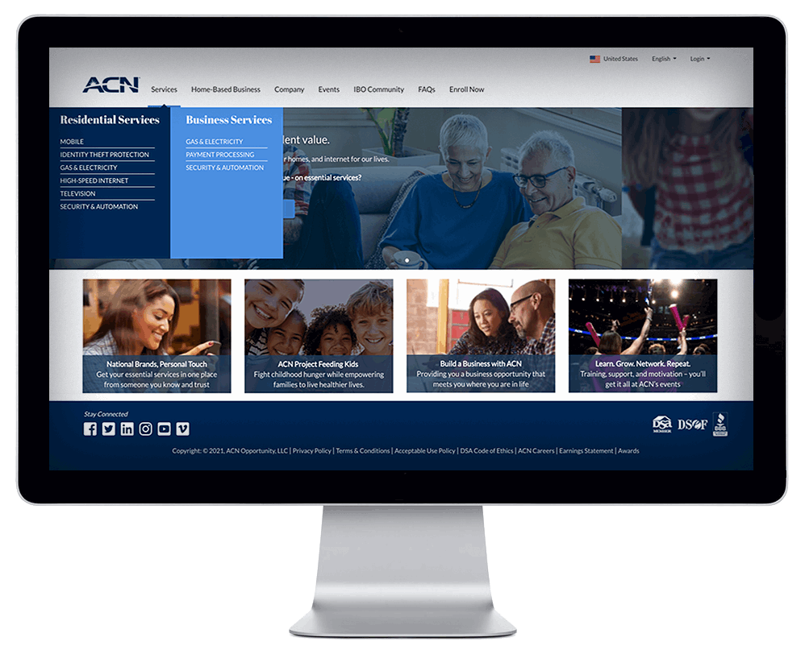
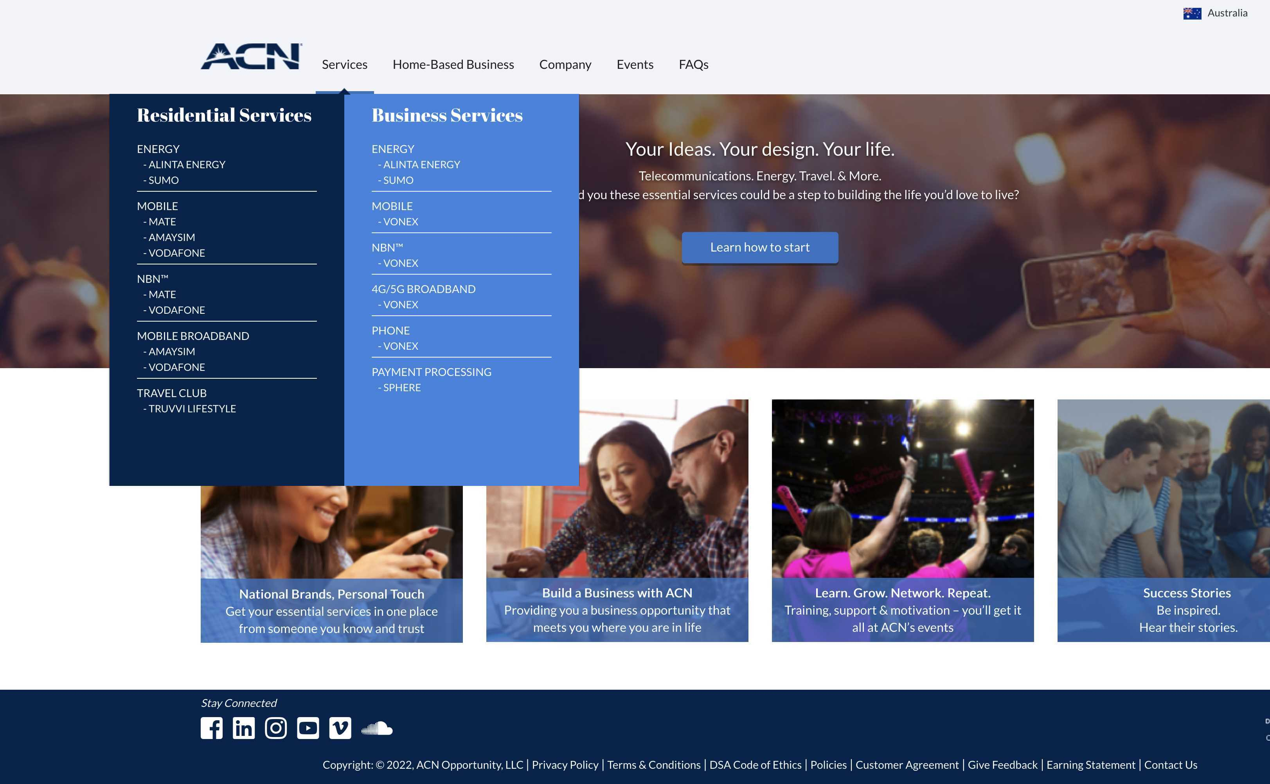
Getting Started
Download Your Launch List
Set up Your ACN Personalised Storefront / Website
  Designed for Acquiring
  Customers & Building a Team
  Log in to your IBO Back Office &
  select “Update Information”
Complete Your Accreditations
YOUR ACN PERSONAL WEBSITE
UPDATE INFORMATION

Slide 5

Mindset for Success!
Develop the Right Mental Attitude
Determine your “WHY”
Make a Decision
Learning Curve
Emotional Roller Coaster
Be Coachable
Have Long Term Thinking
Keep it SIMPLE

Slide 6

Getting Started/Mindset
KISS: Keep It Super Simple
We do TWO things:
  Get Customers
  Get Customer Getters

Slide 7
ACN Core Values
1
2
3
HONESTY
INTEGRITY
CREDIBILITY
Company
Protecting the integrity of the ACN Business Opportunity and the rights of Independent Business Owners and the customer
Honesty, integrity, and credibility underpin everything we do at ACN and why your understanding and application of ACN’s core values matter.
Your Responsibilities
Represent and pursue the ACN Opportunity in an ethical and professional manner
Provide customers with truthful and accurate information regarding ACN’s products and services.

Slide 8

Make your Contact List
Warm Market (People you know)
PEOPLE CLOSEST TO YOU
Friends
Family
Social Media
Work Associates
Place of Worship
School
Places Where you do Business
Sports/Clubs/Associations
Business Owners

Slide 9
Make your Contact List
Warm Market (People you know)
Do not pre-judge
The truth is...
Those you think will, won't
Those you think won't, will
Those you think can, can't
Those you think can't, can

Slide 10
New IBO - Considerations
Has the prospect been involved in ACN before?
Is the prospect’s spouse/de facto already an IBO?
X

Slide 11



We ARE in the SORTING Business
NOT in the SELLING Business!
Red
Apples
Brown Apples
Green Apples
YES
MAYBE
Questions
NO
80% of your time
20% of your time
0% of your time
People typically fall into one of three categories
Your contact's response is all about timing!

Slide 12
SW / SW / SW / SW
NEXT
Some Will / Some Wait / Some Won’t
SO WHAT!

Slide 13

Mastering the ACN
Compensation Plan

Slide 14
Learn it
IT WILL MOTIVATE YOU
It will show you where to focus your efforts

Slide 15


Compensation Plan
Paid Weekly as earned
Customer Bonuses
Personal Monthly Customer Bonuses
Overriding Customer Acquisition Bonuses (CABs)
Paid Monthly
Residual Income
Personal Residual Income
Overriding Residual Income
See ACN Compensation Plan for full details

Slide 16
Compensation Plan – Earned Positions
CQ
ETL
RC
RD
RVP
SVP
IBO
Independent
Business
Owner
Customer Qualified
Executive Team Leader
Regional Coordinator
Regional Director
Regional Vice President
Senior Vice President
Follow the Plan
Think of this as your “Road Map” or “Business Plan"
The higher of an EARNED POSITION you achieve…
Your Business is Growing
You Get Paid More & Better

Slide 17




Compensation Plan – Points System
SERVICES - Range from 1 - 4 Points or more
CUSTOMERS - Can use multiple services
RESIDENTIAL
Energy
Mobile
NBN
Broadband
Travel & Lifestyle
4
Example:
POINTS
Electricity & Gas
6
POINTS
Travel & Lifestyle
BUSINESS
Energy
Mobile
NBN
4G/5G Broadband
VoIP
Phone
Payment Processing
1 Customer
2
5 Services
15 Points
POINTS
Broadband
3
POINTS
Mobile
See ACN Compensation Plan for full details

Slide 18
Compensation Plan – Personal Residual Income
CQ
ETL
RC
RD
RVP
SVP
IBO
You 3%-20%
You can earn up to 20% Residual Income on all the “Commissionable Revenue” generated by YOUR
PERSONAL CUSTOMERS
See ACN Compensation Plan for full details

Slide 19
Compensation Plan – Personal Residual Income
CQ
ETL
RC
RD
RVP
SVP
IBO
You 3%-20%
1 - 39 Personal Customer Points = 3%
40 - 59 Personal Customer Points = 5%
60 - 99 Personal Customer Points = 10%
100 - 149 Personal Customer Points = 14%
150 - 199 Personal Customer Points = 17%
200 + Personal Customer Points = 20%
Each increase in commissions applies to BOTH your
NEW & EXISTING Customers Commissionable Revenue
See ACN Compensation Plan for full details

Slide 20
Compensation Plan – Overriding Residual Income
CQ
ETL
RC
RD
RVP
SVP
IBO
You 3%-20%
You can earn 3%
Overriding Residual Income
through 5 Levels on all the “Commissionable Revenue”
generated by your
TEAM’s CUSTOMERS
1) 3%
2) 3%
3) 3%
4) 3%
5) 3%
See ACN Compensation Plan for full details

Slide 21

Compensation Plan – Overriding Residual Income
CQ
ETL
RC
RD
RVP
SVP
IBO
You 3%-20%
1) 3%
2) 3%
3) 3%
4) 3%
5) 3%
What is a LEVEL?
See ACN Compensation Plan for full details

Slide 22
Compensation Plan – Overriding Residual Income
CQ
ETL
RC
RD
RVP
SVP
IBO
You 3%-20%
The GOAL, BENEFIT & INTENT of
5 Levels & Overriding Residual Commissions is:
Exponential Growth
Definition:
Growth whose rate becomes ever more rapid in proportion to the growing total number or size
1) 3%
2) 3%
3) 3%
4) 3%
5) 3%
See ACN Compensation Plan for full details

Slide 23
Compensation Plan – Overriding Residual Income
CQ
ETL
RC
RD
RVP
SVP
IBO
You 3%-20%
Total 364 IBOs
1) 3%
3 IBOs
Exponential Growth
Example
2) 3%
9 IBOs
3) 3%
27 IBOs
4) 3%
81 IBOs
5) 3%
243 IBOs
See ACN Compensation Plan for full details

Slide 24
Compensation Plan – Overriding Residual Income
CQ
ETL
RC
RD
RVP
SVP
IBO
You 3%-20%
Total 364 IBOs
1) 3%
3 IBOs
Customers
Customers
Customers
Customers
Customers
Customers
Customers
2) 3%
9 IBOs
3) 3%
27 IBOs
4) 3%
81 IBOs
5) 3%
243 IBOs
See ACN Compensation Plan for full details

Slide 25
Compensation Plan – Overriding Residual Income
CQ
ETL
RC
RD
RVP
SVP
IBO
Customers totalling
Services
You 3%-20%
20
1) 3%
3 IBOs
2
18
8
28 Services
2) 3%
5 IBOs
19
1
6
15
7
48 Services
3) 3%
6 IBOs
10
19
8
12
3
15
67 Services
4) 3%
89 Services
17
10
15
9
7
14
10
4
8
9 IBOs
5) 3%
Total: IBOs 24 Services: 252
See ACN Compensation Plan for full details

Slide 26
Compensation Plan – Overriding Residual Income
CQ
ETL
RC
RD
RVP
SVP
IBO
You 3%-20%
QUESTION:
How much can you earn in monthly residual income?
1) 3%
2) 3%
ANSWER…
It's based on the total Commissionable Revenue generated by all the Customers X the Commission %
3) 3%
4) 3%
The more customers acquired; the more revenue generated, the more you can earn
5) 3%
See ACN Compensation Plan for full details

Slide 27
Compensation Plan – Overriding Residual Income
CQ
ETL
RC
RD
RVP
SVP
IBO
You 3%-20%
1) 3%
There is a requirement to acquire & maintain a certain number of Personal Customer Points
2) 3%
40 Personal Customer Points
3) 3%
60 Personal Customer Points
4) 3%
5) 3%
75 Personal Customer Points
See ACN Compensation Plan for full details

Slide 28
Compensation Plan – Earned Positions
CQ
ETL
RC
RD
RVP
SVP
IBO
7
Personal Customer Points
(3 Services)
30
Personal Customer Points
(3 Services)
200
Personal Customer Points
(3 Services)
600
Personal Customer Points
(3 Services)
RVP & SVP
See ACN Compensation Plan Document for Details
You 3%-20%
1) 3%
2) 3%
3) 3%
4) 3%
5) 3%
See ACN Compensation Plan for full details

Slide 29
Compensation Plan – Earned Positions
CQ
ETL
RC
RD
RVP
SVP
IBO
7
Personal Customer Points
(3 Services)
30
Personal Customer Points
(3 Services)
200
Personal Customer Points
(3 Services)
600
Personal Customer Points
(3 Services)
RVP & SVP
See ACN Compensation Plan Document for Details
You 3%-20%
1) 3%
CQs must maintain a minimum of 7 Points &
3 Services (Personal).
2) 3%
3) 3%
4) 3%
5) 3%
See ACN Compensation Plan for full details

Slide 30
Compensation Plan – Earned Positions
CQ
ETL
RC
RD
RVP
SVP
IBO
7
Personal Customer Points
(3 Services)
30
Personal Customer Points
(3 Services)
200
Personal Customer Points
(3 Services)
600
Personal Customer Points
(3 Services)
RVP & SVP
See ACN Compensation Plan Document for Details
You 3%-20%
1) 3%
CQs must maintain a minimum of 7 Points &
3 Services (Personal).
ETLs must maintain CQ & a minimum of 30 Points in your Team (Personal and Downline).
A minimum of 15 Downline Customer Points.
2) 3%
3) 3%
4) 3%
5) 3%
See ACN Compensation Plan for full details

Slide 31
Compensation Plan – Earned Positions
CQ
ETL
RC
RD
RVP
SVP
IBO
7
Personal Customer Points
(3 Services)
30
Personal Customer Points
(3 Services)
200
Personal Customer Points
(3 Services)
600
Personal Customer Points
(3 Services)
RVP & SVP
See ACN Compensation Plan Document for Details
You 3%-20%
1) 3%
CQs must maintain a minimum of 7 Points &
3 Services (Personal).
ETLs must maintain CQ & a minimum of 30 Points in your Team (Personal and Downline).
A minimum of 15 Downline Customer Points.
RCs must maintain CQ & a minimum of 200 Points in your Team (Personal and Downline) with a maximum of 75 Customer Points per leg.
2) 3%
3) 3%
4) 3%
5) 3%
See ACN Compensation Plan for full details

Slide 32
Compensation Plan – Earned Positions
CQ
ETL
RC
RD
RVP
SVP
IBO
7
Personal Customer Points
(3 Services)
30
Personal Customer Points
(3 Services)
200
Personal Customer Points
(3 Services)
600
Personal Customer Points
(3 Services)
RVP & SVP
See ACN Compensation Plan Document for Details
You 3%-20%
1) 3%
CQs must maintain a minimum of 7 Points &
3 Services (Personal).
ETLs must maintain CQ & a minimum of 30 Points in your Team (Personal and Downline).
A minimum of 15 Downline Customer Points.
RCs must maintain CQ & a minimum of 200 Points in your Team (Personal and Downline) with a maximum of 75 Customer Points per leg.
RDs must maintain CQ & a minimum of 600 Points in your Team (Personal and Downline) with a maximum of 200 Customer Points per leg.
2) 3%
3) 3%
4) 3%
5) 3%
See ACN Compensation Plan for full details

Slide 33
Compensation Plan – Personal Customer Bonuses
CQ
ETL
RC
RD
RVP
SVP
IBO
3 Services
7 Points
You 3%-20%
CQ
1) 3%
You
$75
Customers Acquired within 1st 30 days
Personal
Customer Bonuses
2) 3%
Acquire Customers Totaling:
6 Services 12 Points Earn $150
3) 3%
10 Services 20 Points Earn $250
PLUS, for Every Additional
5 Services 10 Points Earn $150
4) 3%
15 Services 30 Points Earn $400
20 Services 40 Points Earn $550
5) 3%
EXISTING IBOs
Customers Acquired within calendar month
See ACN Compensation Plan for full details

Slide 34
Compensation Plan – Customer Acquisition Bonuses CABs
CQ
ETL
RC
RD
RVP
SVP
IBO
3 Services
7 Points
You 3%-20%
ETL & Higher can EARN
OVERRIDING TEAM
Customer Acquisition Bonuses
CABs
CQ
1) 3%
You
$75
2) 3%
CABs are paid weekly as earned when NEW IBOs on your team acquire Customers and become CQ within their 1st 30 days
3) 3%
4) 3%
5) 3%
See ACN Compensation Plan for full details

Slide 35
Compensation Plan – Customer Acquisition Bonuses CABs
CQ
ETL
RC
RD
RVP
SVP
IBO
3 Services
7 Points
You 3%-20%
CQ
1) 3%
You
$75
CQ
2) 3%
IBO
$0
3) 3%
4) 3%
5) 3%
See ACN Compensation Plan for full details

Slide 36
Compensation Plan – Customer Acquisition Bonuses CABs
CQ
ETL
RC
RD
RVP
SVP
IBO
3 Services
7 Points
30 Personal & Team Customer Points
You 3%-20%
CQ
1) 3%
You
$75
CQ
CQ
2) 3%
IBO
$0
IBO
$50
1st Gen
3) 3%
ETL $0
4) 3%
5) 3%
See ACN Compensation Plan for full details

Slide 37
Compensation Plan – Customer Acquisition Bonuses CABs
CQ
ETL
RC
RD
RVP
SVP
IBO
3 Services
7 Points
30 Personal & Team Customer Points
200 Personal & Team Customer Points
You 3%-20%
CQ
1) 3%
You
$75
CQ
CQ
CQ
IBO
$0
IBO
$50
IBO
$100
2) 3%
1st Gen
ETL $50
3) 3%
ETL $0
4) 3%
1st Gen
RC $25
5) 3%
See ACN Compensation Plan for full details

Slide 38
Compensation Plan – Customer Acquisition Bonuses CABs
CQ
ETL
RC
RD
RVP
SVP
IBO
3 Services
7 Points
30 Personal & Team Customer Points
200 Personal & Team Customer Points
600 Personal & Team Customer Points
You 3%-20%
CQ
1) 3%
You
$75
CQ
CQ
CQ
CQ
IBO
$0
IBO
$50
IBO
$100
IBO
$250
2) 3%
1st Gen
ETL $50
ETL $200
3) 3%
ETL $0
4) 3%
1st Gen
RC $25
RC $175
5) 3%
1st Gen
RD $75
See ACN Compensation Plan for full details

Slide 39
Compensation Plan – Customer Acquisition Bonuses CABs
CQ
ETL
RC
RD
RVP
SVP
IBO
3 Services
7 Points
30 Personal & Team Customer Points
200 Personal & Team Customer Points
600 Personal & Team Customer Points
RVP & SVP
You 3%-20%
Increased CAB Bonuses
Incentive Trips
Increased Residual Income RVP up to 3% below 5 levels, SVP up to 2% below 5 levels!
CQ
1) 3%
You
$75
CQ
CQ
CQ
CQ
IBO
$0
IBO
$50
IBO
$100
IBO
$250
2) 3%
1st Gen
ETL $50
ETL $200
3) 3%
ETL $0
4) 3%
1st Gen
RC $25
RC $175
5) 3%
1st Gen
RD $75
See ACN Compensation Plan for full details

Slide 40
Compensation Plan
Paid Weekly as earned
Customer Bonuses
Personal Monthly Customer Bonuses
Overriding Customer Acquisition Bonuses (CABs)
Paid Monthly
Residual Income
Personal Residual Income
Overriding Residual Income
See ACN Compensation Plan for full details

Slide 41
NEW IBO FAST START BONUSES
LIMITED
TIME
OFFER!
New IBOs with a start date in April, can earn even more in their first year at ACN by achieving the following Fast Start Bonuses:
CQ in 30 Days
New IBOs who achieve Customer Qualified in their first 30 days.
ETL in 30 Days
New IBOs who achieve Executive Team Leader in their first 30 days: $400
Extra ETL Bonus
Directly sponsor 2 New IBOs in your first 30 days that become CQ in their first
30 days: $250
RC in 90 Days
New IBOs who achieve Regional Coordinator in their first 90 days.
(50% paid immediately)
RD in 180 Days
New IBOs who achieve Regional Director in their first 180 days and maintain the position for 90 days.
(50% paid immediately)
RVP in 12 Months
New IBOs who achieve Regional Vice President in their first 12 months and maintain the position for 90 days.
$75
$650
$1,000
$5,000
$20,000
TOTAL: $26,725
These bonuses are in addition to the Monthly Personal Customer Bonuses!
Refer to Compensation Plan for terms and conditions and complete details.

Slide 42
NEW IBO FAST START BONUSES
New IBOs with a start date in April, can earn even more in their first 30 days by achieving the ETL in 30 Days Fast Start Bonus
and a Monthly Personal Customer Bonus:
FIRST 30 DAY FAST START BONUSES
MONTHLY CUSTOMER BONUSES
BONUS POTENTIAL
CQ in 30 Days
ETL in 30 Days
ETL Extra Bonus
12
Points
$150
$875
6
Services
+
+
+
=
20
Points
$75
$400
$250
$250
$975
10
Services
30
Points
$400
$1,125
15
Services
Refer to Compensation Plan for terms and conditions and complete details.

Slide 43

CUSTOMER ACQUISITION

Slide 44



2
Essential Residential & Business Services
IBO Incentives
Mobile
Energy
Broadband
Phone
Payment
Processing
Travel & Lifestyle Membership
Home Insurance
COMING SOON!

Slide 45
Customer Acquisition
Customer Sources
Source
3
EVERYONE ELSE (Warm Market, and referrals)
Source
2
PROSPECTS
Who do not become IBOs
Source
1
YOURSELF

Slide 46
Customer Acquisition
Customer Sources
Initially Focus on Source 1 & 2
Become your own Customer on any Services that make sense for you
Schedule your 1st ACN Presentation ASAP & start inviting
Source
2
PROSPECTS
Who do not become IBOs
Source
1
YOURSELF

Slide 47
Customer Acquisition
Customer Source 1
Benefits of Becoming Your Own Customer:
Become a BELIEVER in the SERVICES that you're offering
Learn HOW to SIGN UP other Customers
You can EARN UP TO 20% on your OWN SERVICES
PERSONAL CUSTOMER POINTS count towards:
  CQ 1st 30 Days = $75
  Customer Bonuses
  Promotions to ETL, RC, RD, RVP & SVP
  Fast Start Bonuses
Source
1
YOURSELF

Slide 48
Customer Acquisition
Customer Source 2
Source
2
PROSPECTS
Who do not
become IBOs
Why OFFER the ACN Opportunity First?
You can start Building your Business while you are learning about the services
When you acquire a customer, all you get is ONE CUSTOMER
When you acquire an IBO, imagine how many customers that could lead you to

Slide 49
Customer Acquisition
Customer Source 3
Source
3
EVERYONE ELSE
(Warm Market,
and referrals)
WHEN should you Focus on Everyone Else?
Choose One or Two Services that you would like to focus on first
Participate in all Training specific to those Services
For BEST Results learn & use the ACN "Huge Favour" approach for acquiring Customers
Set a Personal Goal
Acquire 10, 20, 50 or more Personal Customers
LEAD BY EXAMPLE

Slide 50
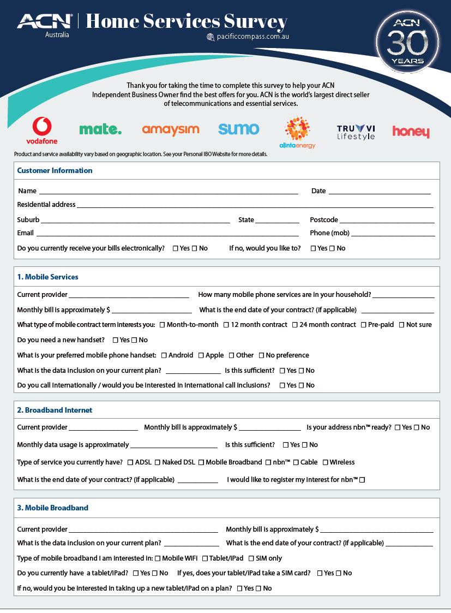
Customer Survey
Customer information
Service information
Contract information
Diarise your appointments

Slide 51
Customer Script
1
2
3
11111
FAVOUR
HELP
TRY
Hi ___________ do you have a minute?
Great, the reason I’m calling you is to ask you for a huge favour and I was wondering if you could help me out?
I’ve just started a part time business from home, helping people save money on their monthly bills.
(Share your reason why)
If I could match or save you money on your Telecommunications, Energy & Essential Services would you give me the opportunity to try? This would really mean a lot to me?
Enthusiasm & Urgency = SUCCESS!

Slide 52

TEAM BUILDING

Slide 53
Team Building
Reminder
We SORT NOT SELL!
YES
MAYBE
NO
20% of your time
0% of your time
80% of your time
20% of your time
0% of your time
Your contact's response is all about timing!

Slide 54

Team Building
Start with your Contact List
YOUR Warm Market (People you know)
PEOPLE CLOSEST TO YOU
Friends
Family
Social Media
Work Associates
Place of Worship
School
Places Where you do Business
Sports/Clubs/Associations
Business Owners

Slide 55



Team Building – 3 steps
How to Build Your Team
3 Steps to Successful Recruiting
1
2
3
Pique Interest
& Invite
SORT
ACN Opportunity Presentation
SORT
CORE Basic
Training
SORT

Slide 56
Team Building – 3 steps
How to Build Your Team
Know your Role
1
2
3
Pique Interest & INVITE
YOU
ACN Opportunity Presentation
EXPERT
CORE Basic
Training
EXPERT

Slide 57
Team Building – Using an Expert Presenter
The Importance of using an Expert Presenter
Trust & Rapport
YOU
PROSPECT
Introduce
Promote the Presenter
Respect
Effective Presentation
EXPERT
Presenter

Slide 58

Team Building – Types of ACN Opportunity Presentations
In-person Private Presentations
Virtual Private Presentations
In-person TEAM Presentations
Virtual TEAM Presentations
PBR Private Business Reception
PBZ Private Business
BOM Business Opportunity Meeting
BOM Business Opportunity
1
2
3
Pique Interest & INVITE
YOU
ACN Opportunity Presentation
EXPERT
CORE Basic
Training
EXPERT

Slide 59

Team Building – Schedule your First Presentation & Start Inviting
Host your First Presentation
#1 Get with your EXPERT & Schedule your 1st Presentation
Date / Time. : _____________________________
#2 Start Inviting:

Slide 60
Team Building – INVITING
Effective WORDS when INVITING:
You
Look
up to
Show Respect
Favour
Opinion
Respect
YOU
Your
Peers
Show Respect
Look
up to
You
Simple & Easy

Slide 61


Team Building – Tips & Expectations
Inviting
Tips & Expectations
Excitement & Urgency (Enthusiasm is Contagious)
Follow the “WORDS that WORK” (BE YOURSELF)
FOCUS on INVITING not EXPLAINING (Creates CURIOUSITY)
If you get Questions: (Promote the PRESENTER not the Business)
Typically, Approx 50% Show-up (This is Normal)
HAVE FUN

Slide 62

Team Building – Words That Work
"Piquing Interest" Examples
Do you look at other ways of making money?
Are you open to looking at something outside of what you are currently doing?
Are you open to diversifying your income?
Yes
Maybe
No
Yes
Maybe
No
Yes
Maybe
No
Invite Green & Red Apple Responses

Slide 63
Team Building – Words That Work
“Opinion Approach”
“Great I would love to get your OPINION on something…”
Yes
Maybe
No
Invite Green & Red Apple Responses

Slide 64
Team Building – Words That Work
Inviting: Words That Work
Hello_____, this is_____ do you have a quick minute?
Let me ask you something… Do you look at other ways of making money?
(Share your “WHY”) So I’m always open to other opportunities & I came across something
I met an individual that is having great success in it & I got (Him/Her) to do a quick
zoom Meeting (Day/Time) to show me & a few key people exactly what they’re doing & I would love to get your opinion on it
Can I count you in on joining the Zoom with me & checking it out?

Slide 65
Team Building – Words That Work
Inviting: Words That Work
ANSWER: YES
Great you may receive a call or text from me or someone the day of the zoom Meeting as a "Friendly Reminder".
ANSWER: QUESTIONS
That's a GREAT Question. I don't have all the details yet & that's exactly why we are doing the zoom. As I mentioned, (Expert's Name) is having great success & (He/She) will explain it and get all our questions answered.
I would really love for you to check it out with me and hear what (He/She) has to say. Can I count you in on Joining the zoom?

Slide 66
Team Building – Words That Work
If They Continue Asking Questions?
It's OK to Be New and say,
"That's a GREAT Question…Again that is exactly what the Zoom is for...”
All I know is that it deals with
  ESSENTIAL SERVICES
  NEW TECHNOLOGY
  The TIMING is PERFECT
  NO ONE ELSE is doing it
  It's a HUGE OPPORTUNITY!!
I would love to get your opinion; can I count you in on joining the Zoom?
If available, you can ALSO do a 3-Way Call with your expert.

Slide 67
Team Building – After Presentation
Sorting After Presentation
ARE YOU READY TO GET STARTED?
YES
QUESTIONS
NO
Sign up as an IBO
That's a GREAT Question!
Thank them!
Promote CORE Training!
Promote CORE Training!
Ask them to be a CUSTOMER!

Slide 68
Get your prospects involved in training
Your success depends on it!
Team Building – After Presentation
After the Presentation
How to answer most questions:
That's a great question, idea, etc…
All of that will be covered in the training.

Slide 69

Team Building – Meeting Etiquette
Meeting Etiquette
Make sure you & your guests are on time
Avoid distractions, dress presentable
Host welcome the guests as they come on
Right before presentation begins…
Host ask guests: silence cell phone and hold all questions until the end
Host introduce the speaker and be upbeat and positive the entire time
Participate & support the presenter
ZOOM Etiquette
Mute yourself
Turn on your Camera
Be aware you're on Camera
No Eating
Raise Hand to Speak
Be Respectful
KEEP IT PROFESSIONAL & HAVE FUN

Slide 70
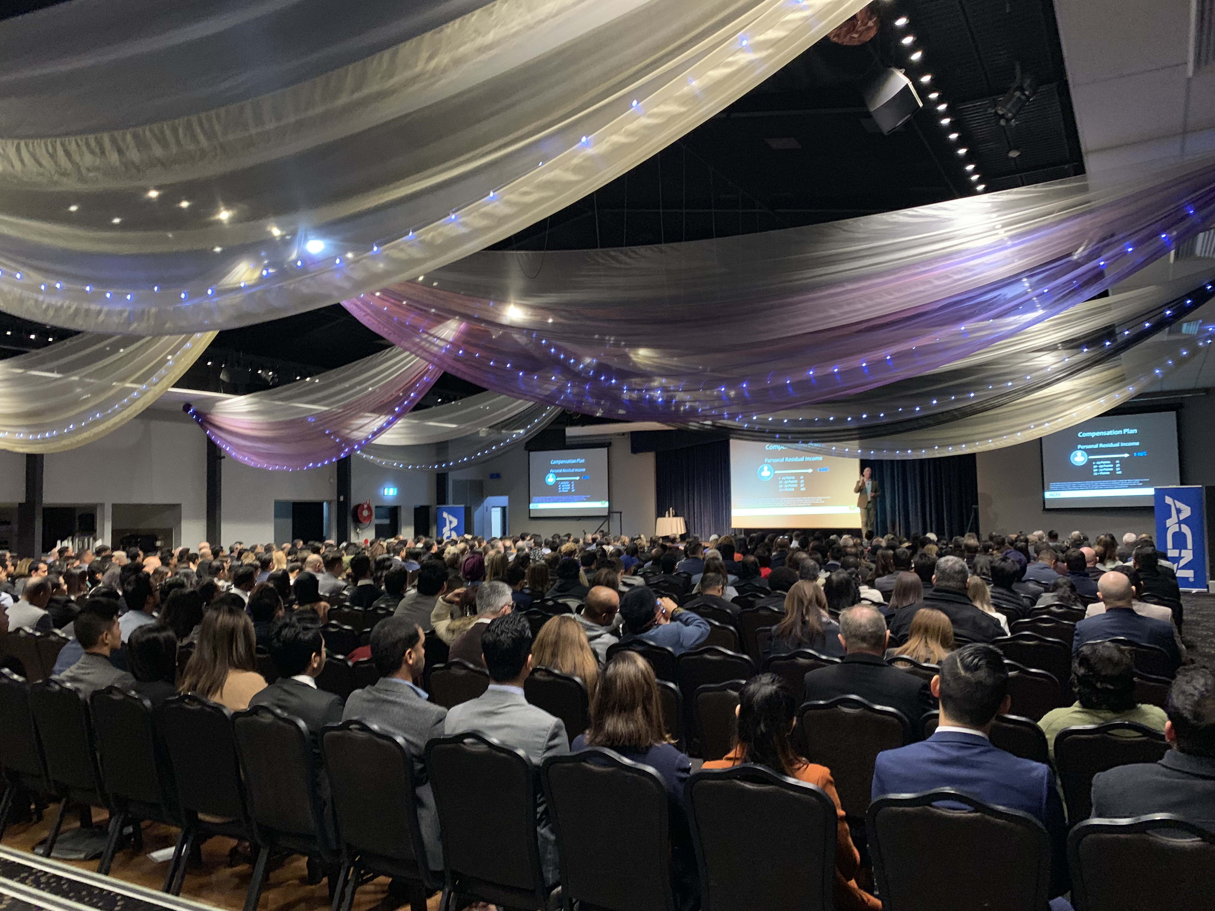
PROMOTING TRAINING EVENTS

Slide 71

Promoting Events
What are Events?
Personal & Team Presentations & Trainings
Leadership Trainings
Customer Acquisition & Product Trainings
ACN COMPANY TRAINING EVENTS

Slide 72
Why Promote Events?
Promoting Events – Value in Events
VISION & BELIEF
Events help you build your team
more effectively than working alone!

Slide 73

Promoting Events
How to Promote:
Training Event highlight videos
Promote the Speakers / Trainers
Testimonials (tell stories, value)

Slide 74

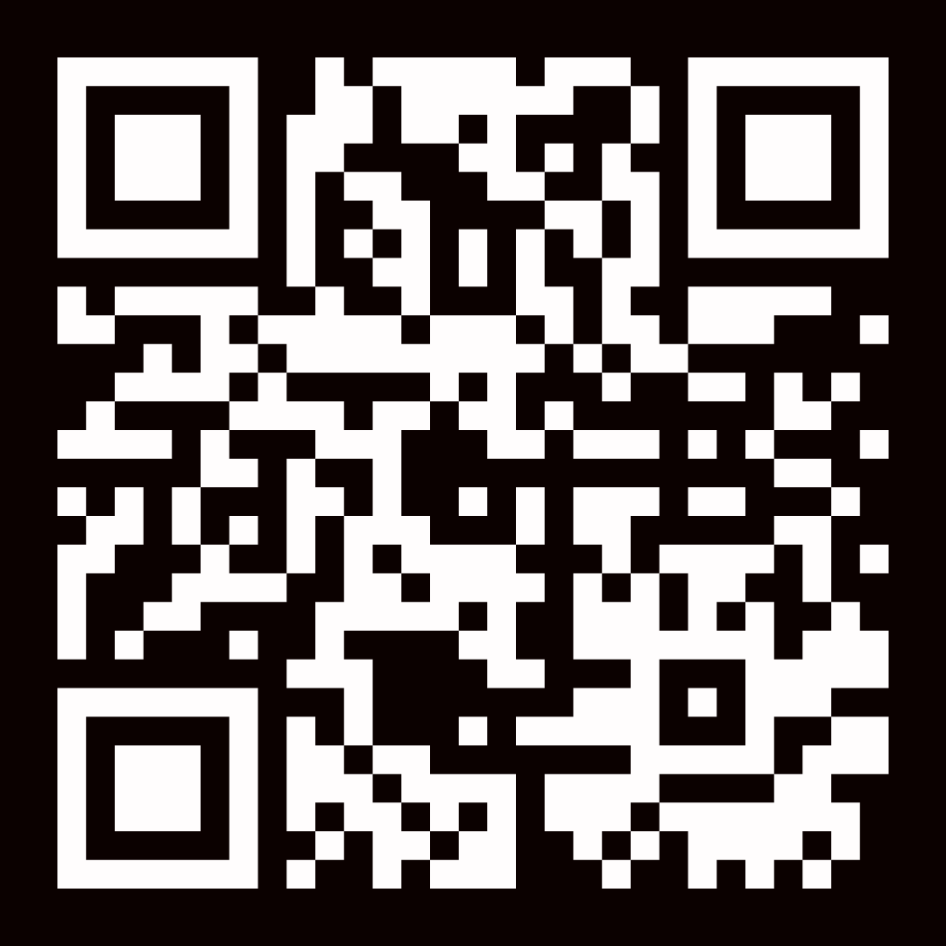
REGISTER NOW
Standard Pricing: $149
Early Bird Special
$99
PROMO CODE: EARLYBIRD

Slide 75

At ACN, you're in business for yourself, never by yourself.

