Slide 1


Business Training
New Zealand
From 1 December 2022

Slide 2

ACN at a Glance
name
RVPs and SVPs earn annual income achieved by fewer than 1% of ACN IBOs. Their success stories and earnings are extraordinary and not typical. Earnings as an ACN IBO are based solely upon the successful sale of products to customers and their usage of those products. Individuals will incur expenses in operating their ACN business, such as the sign-up fee and renewal fee, as well as other possible operating expenses. As with any business, earnings and success at ACN are not guaranteed but depend primarily on the individual’s commitment, persistence and effort. Individuals may not earn income and may lose money as an IBO.

Slide 3
Play the ACN Business Opportunity video here

Slide 4
Our Vision
Largest & fastest growing industries in the world
Exceeding $1.75 trillion revenue annually
Among most sought after by Big Business
Now Imagine…
Earning Income off these industries every month
Getting Paid every month when people pay bills
Going head to head with billion-dollar companies
ACN MAKES IT POSSIBLE!

Slide 5
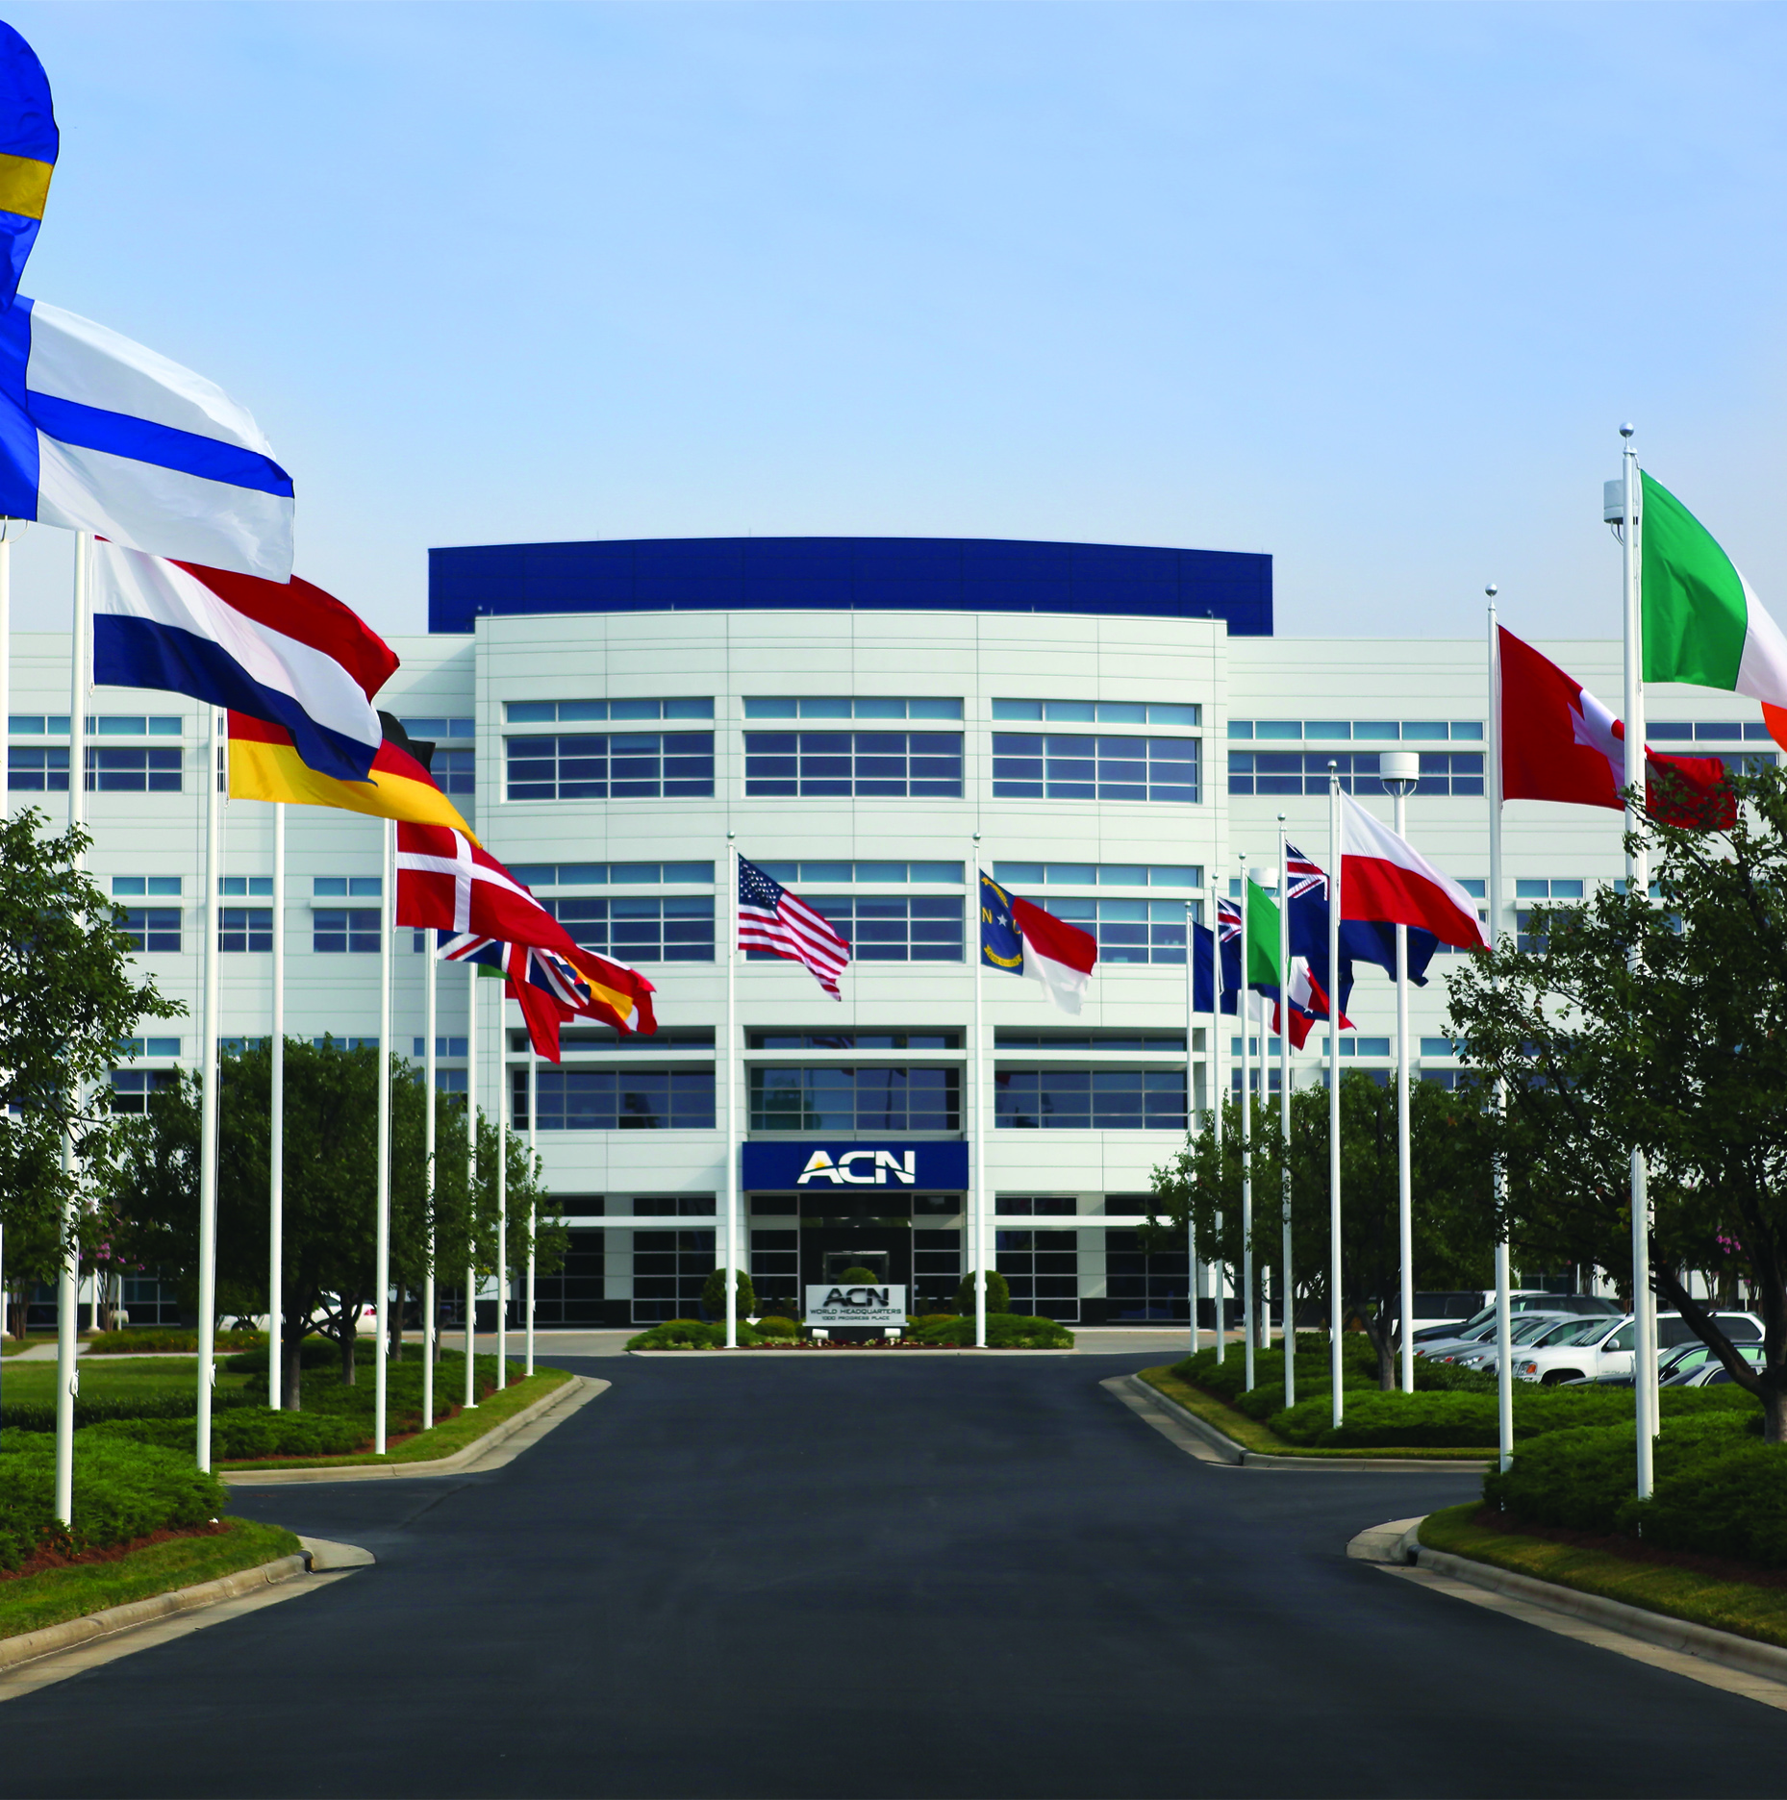






1
Company
WORLD’S LARGEST
Direct Seller of Telecommunications, Energy & Other Essential Services
An Established Track Record
Customer
Acquisition
Company
In business
since 1993
27 Countries,
5 Continents
Over $4 billion (USD)
in sales over last
5 years & growing
Millions of
Customers
Acquired
Proud member of
Direct Selling Association New Zealand

Slide 6

2
Essential Residential & Business Services
Travel & Lifestyle Membership

Slide 7










3
Our Business Model
Most Service Providers
YOU
Media & Digital Marketing
CUSTOMERS

Slide 8





4
Become an Independent Business Owner (IBO)
One off payment
of $287.50
+
$22/month Business Support Fee Temporarily waived
Personalised Website
Complete Customer Support
Complete Business
Tracking & Reporting
Compass Online &
Marketing Tools

Slide 9
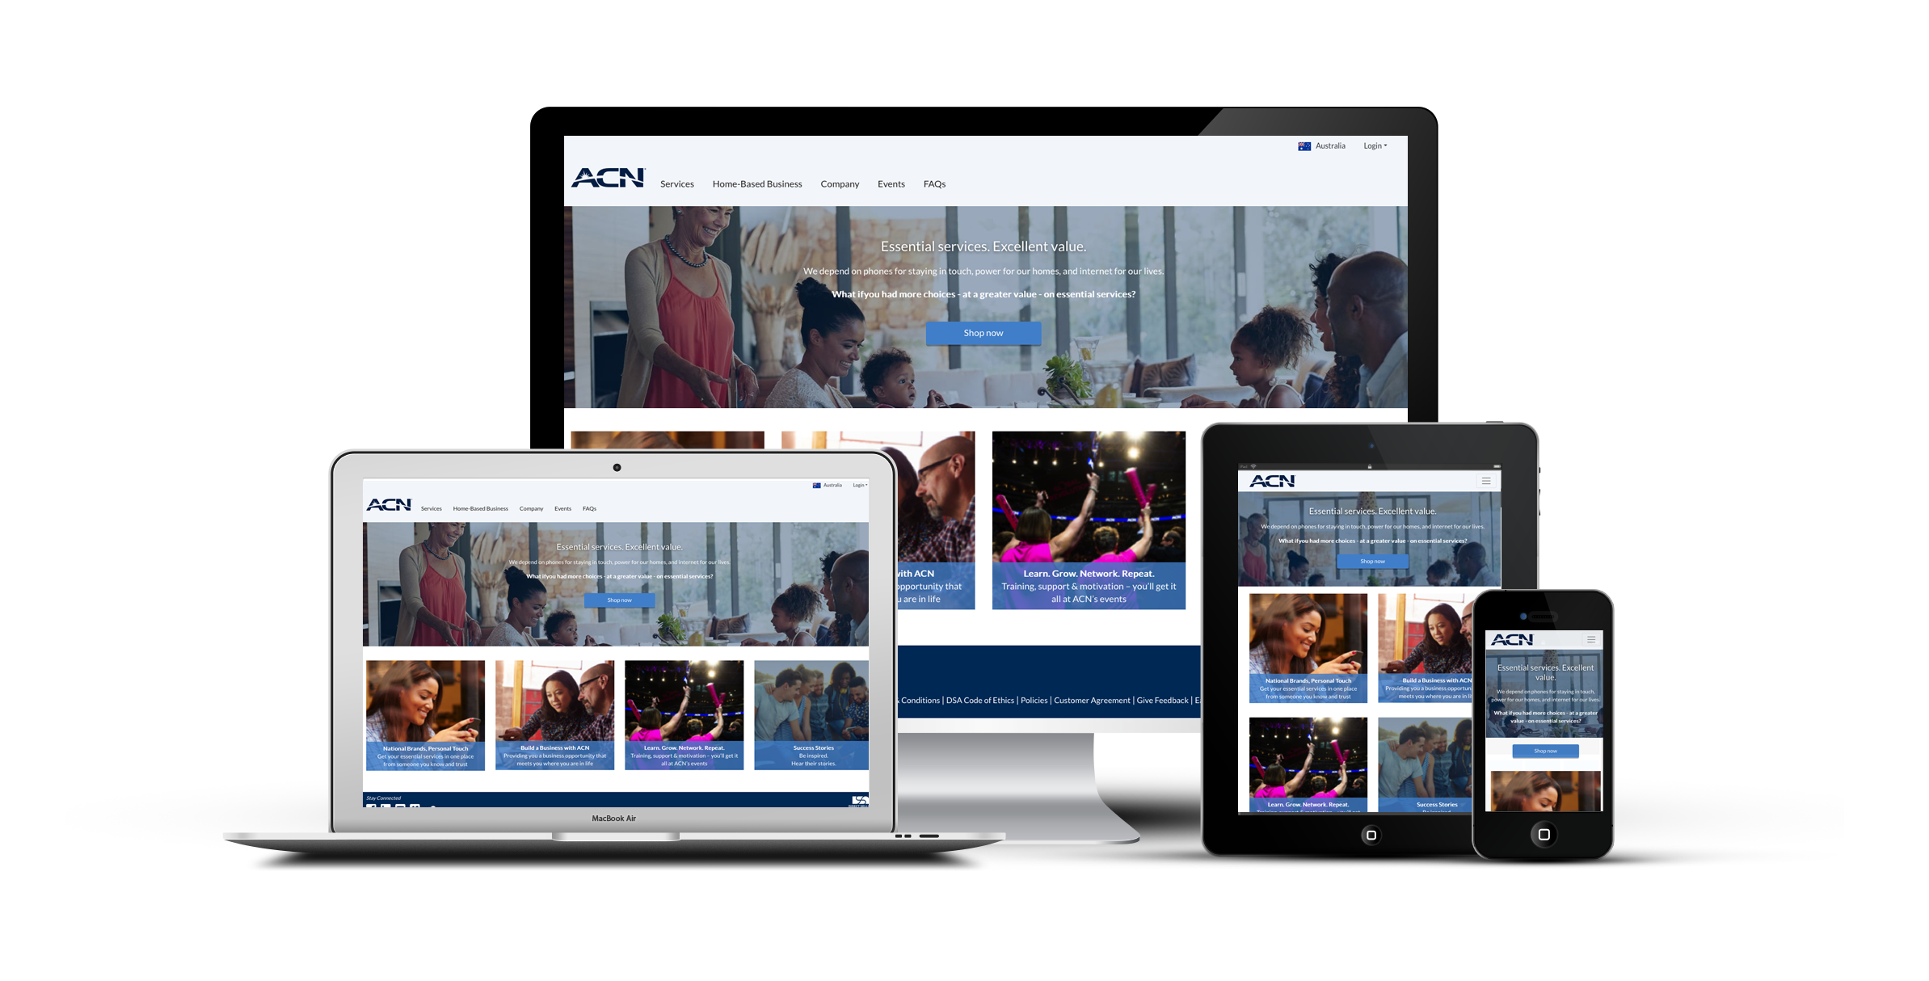

5
You Get Your Own Online Business!

Slide 10

5
Monthly Personal Customer Bonuses
Acquire Customers totaling:
3 Services = $75
5 Services = $150
Plus $100 for every
additional 3 Services
8 Services = $250
11 Services = $350
*Refer to the ACN Compensation Plan for complete details.
Notes:
New IBO earns $100 for every 10 Customer Points AND $100 for becoming CQ
Existing IBOs earn $200 for every 15 Customer Points*
*points for selected services

Slide 11
NEW IBO BONUS POTENTIAL
New IBOs with a start date in February, can earn even more in their first 60 days, by achieving the ETL in 30 Days Fast Start Bonus, the Team Customer Point Bonus AND the Personal Customer Bonuses. By personally acquiring more customers, new IBOs have the following earning potential:
30 DAY FAST START BONUS
TEAM CUSTOMER POINT BONUS
MONTHLY CUSTOMER
BONUS
BONUS POTENTIAL
5 Points
3 Services
$1000
NEW ETL in 30 Days
(with a minimum of 15 downline points)
NEW ETL in 60 Days
(with 60 Customer Points, including a minimum of 45 downline points)
$75
+
+
=
10 Points
5 Services
$1075
$150
16 Points
8 Services
$1175
$425
$500
$250
22 Points
11 Services
$1275
$350
*Refer to the ACN Compensation Plan for complete details.

Slide 12
6
Personal Residual Income
Your Customers
3% to 20%
Monthly Commissionable Revenue*
*Refer to the ACN Compensation Plan for complete details.

Slide 13

7
Overriding Customer Acquisition Bonuses (CABs)
Your TEAM’s Customers
Opportunity to earn bonuses that are paid weekly when you and your TEAM acquires customers.*
$50 - $300
*Refer to the ACN Compensation Plan for complete details.

Slide 14
8
Overriding Residual Income
Your TEAM’s Customers
3%
Monthly Commissionable Revenue*
*Refer to the ACN Compensation Plan for complete details.

Slide 15
9
IBO Earned Positions
CQ
ETL
RD
RVP
SVP
SVP
Increased Customer Acquisition Bonuses (CABs)
Increased Residual
Reaching higher earned positions is based on the number of personal and team customers
Incentive Trips
*Refer to the ACN Compensation Plan for complete details.

Slide 16

10
Next Steps
1
Enrol as an IBO
2
Utilise the ACN support system
3
Participate in training
4
Start acquiring customers
In Business for Yourself, but NEVER By Yourself!

Slide 17
Mastering the ACN
Compensation
Plan
name

Slide 18
1
2
3
RESIDUAL
INCOME
OVERRIDING RESIDUAL
CUSTOMER BONUSES

Slide 19

Compensation Plan
Personal Residual Income
1-20%
You
1 - 39 Points = 3%
40 - 59 Points = 5%
60 - 99 Points = 10%
100 - 149 Points = 14%
150 - 199 Points = 17%
200 + Points = 20%
The hypothetical used in this presentation are for illustrative purposes only and not meant to imply that they are typical. Success as an ACN Independent Business Owner is not guaranteed, but rather influenced by an individual’s specific efforts. Not all Independent Business Owners make a profit and no one can be guaranteed success as an ACN Independent Business Owner. For details on Commissionable Revenue, please refer to the tables in the current ACN Compensation Plan.

Slide 20


Compensation Plan
Overriding Residual Income
You
Level 1
Level 2
Level 3
Level 4
Level 5
3-20%
3 %
3 %
3 %
3 %
3%
1-200+ points
You
40 points
60 points
75 points
For details on Commissionable Revenue, please refer to the tables in the current ACN Compensation Plan.

Slide 21
Qualified in 24 hours
CQ = 5 POINTS
      Truvvi Lifestyle
= up to 6 points
From 3 SERVICES
NOTE: Existing and new, New Zealand IBOs can also earn Customer Points and Commissions from Australian Services.

Slide 22

Earned Positions & Compensation
Customer Qualified (CQ)
Executive Team Leader (ETL)
Regional Director (RD)
Regional Vice President (RVP)
Senior Vice President ( SVP)
Refer to ACN’s Compensation Plan for Qualifications
30
TOTAL CUSTOMER POINTS
5
CUSTOMER
POINTS
From at least 3 services
Monthly Personal Customer Bonuses
600
CUSTOMER POINTS
(Personal & downline)
Residual Income Beyond 5th Level
Residual Income Beyond 5th Level
(Personal & downline)
ETL must maintain Customer Qualified Status
CABS
$50
CABS
Up to $250
CABS
Up to $300
RDs and above must maintain 15 Customer Points and 5 services to receive earned position compensation
MONTHLY PERSONAL CUSTOMER BONUSES
ELIGIBLE FOR ANNUAL RETREAT
CABs are bonuses earned weekly based on customers acquired by new IBOs within their first 30 days. All position qualifications require a minimum amount of personal customers.

Slide 23
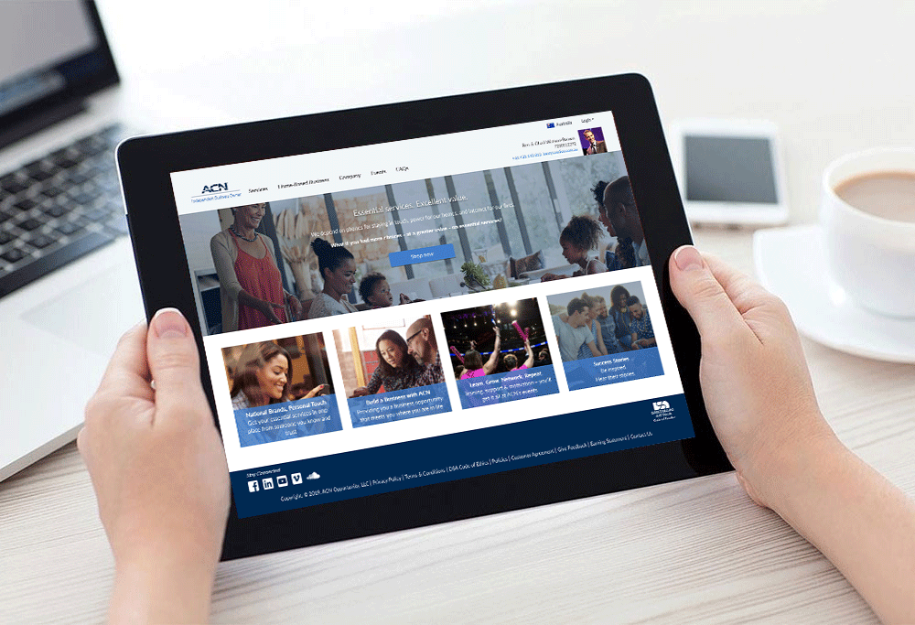
Personal IBO Website
Hosted & updated daily
Product & service updates
27 countries

Slide 24
Accreditation
Make completing your ACN accreditation a priority, within your first 30 days
Accrediting is simple, quick and will add credibility and momentum to your business
Visit Pacific Compass to complete your Accreditation

Slide 25



Customer Sources
1
2
3
You
Prospects who do not become IBOs
Everyone else

Slide 26





New IBO - Considerations
Has the prospect been involved in ACN before?
Is the prospect’s spouse/de facto already an IBO?
Notes:
IBOs who cancel their IBO position outside of their cooling off-period, & those that choose not to renew their existing ACN IBO position, are required to wait 12 months from their cancellation or renewal date before being able to sign-up as a new IBO and re-join ACN under a different sponsor.
IBOs who are married, and choose to operate separate IBO positions, need to make sure that one spouse sponsors the other.

Slide 27
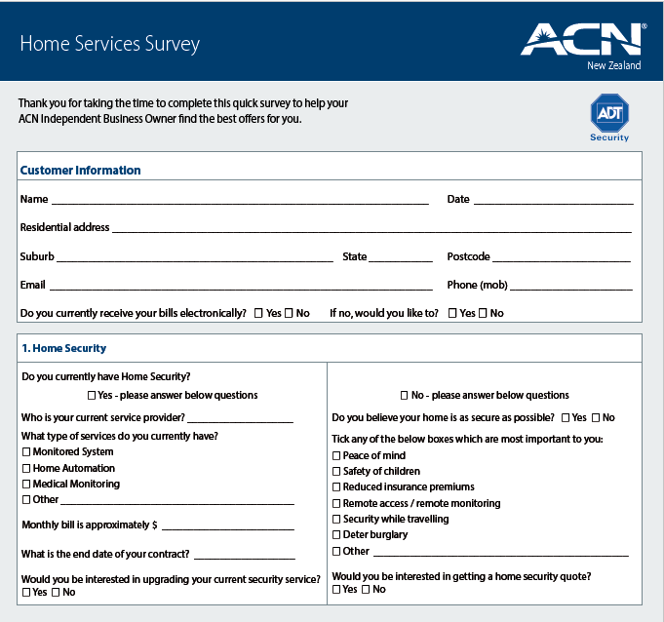
Customer Survey
Customer information
Service information
Contract information
Diarise your appointments

Slide 28
1
2
3
FAVOUR
HELP
TRY

Slide 29
Customer Script
Hi ___________ do you have a minute?
Great, the reason I’m calling you is to ask you for a huge favour and I was wondering if you could help me out?
I’ve just started a part time business from home, helping people save money on their monthly bills. (Share your reason why)
If I could match or save you money on your Telecommunications, Energy & Essential Services would you give me the opportunity to try? This would really mean a lot to me?
Enthusiasm & Urgency = SUCCESS!

Slide 30

7 Day Goal
CUSTOMER QUALIFIED
CQ
15 Total Customer Points

Slide 31

Team
Team Building &
ACN’s Core Values
name

Slide 32
1
2
3
HONESTY
INTEGRITY
CREDIBILITY

Slide 33

Company
Protecting the integrity of the ACN Business Opportunity and the rights of Independent Business Owners and the customer
Honesty, integrity, and credibility underpin everything we do at ACN and why your understanding and application of ACN’s core values matter.

Slide 34

Your
Responsibilities
Represent and pursue the ACN Opportunity in an ethical and professional manner
Provide customers with truthful and accurate information regarding ACN’s products and services

Slide 35

Definition: The term is used to attract people by alerting them about the opening of your new Business!

Slide 36
1
2
3
SET
A DATE
MAKE
A LIST
INVITE,
INVITE,
INVITE!

Slide 37

Set a Date
Have Your Meeting at your home
4:30pm, 6:30pm and 8:30pm Weekdays / Weekends on the Hour
We never cancel home meetings

Slide 38

Make a List
100 Names & numbers. Do not pre-judge.
A-list your top 10
Business Owners
Network marketing experience
Already successful
Happy people
Everyone else

Slide 39

Invite, Invite, Invite
Invite, Invite, Invite!
Your goal 10-20 guests (invite 50+)
50% will not show up
The size of your PBR will duplicate, good or bad

Slide 40
Inviting Script
Do you look at other ways of making money?
Share your ‘WHY’
New technology
Edify speaker
Set up confirmation call
Enthusiasm & Urgency = SUCCESS!

Slide 41
72 Hour Coaching Call
Builds your belief and confidence
Practicing the script helps you build your list
Prepares you for more success

Slide 42
Role of the Host
Welcome guests – turn off phones & hold all questions to the end
Do not apologise for ‘no shows’
Edify the speaker by speaking about their past, present, future
Sit through the presentation & take notes
Do not interrupt the speaker
Sort guests after the presentation

Slide 43
Ready to get Started?
Yes
Questions
No
Sign up as an
IBO
Promote training
Thank them
Pencil in Home
Meeting date
Promote training
Customer survey
Promote Saturday
Training
Promote training
Sign up as a customer
Video & Customer Survey
Video & Customer Survey
Get a referral

Slide 44
Mindset & Events
Mindset
& Events
name

Slide 45

Determine your ‘Why’
Time with family
Pay off some bills
Help with college education for children
Help parents
Family holidays
Charity
Why are YOU
doing this business?

Slide 46

Getting Started
Mindset
Learning curve
Emotional roller coaster
Develop the right mental attitude
Long term vision short term
memory
Prepare for issues and challenges
Never quit

Slide 47



Professionals Sort, Amateurs Sell
Very
interested
Want to
think about it
Not
interested
90% of
your time
10% of
your time
0% of
your time

Slide 48
Next
SW
SW
SW
Some Will / Some Won’t / So What

Slide 49
Event Cycle to Financial Freedom
Action
Results
Energy
Belief
Don’t break the cycle of Momentum
Events
Events

Slide 50

What are Training Events?
Everything is a Training Event!
Conference calls
3-way calls, 2-on-1 meetings, PBRs
Weekly BOMs, Regional Trainings
Leadership Trainings
Product Trainings
International Training Events

Slide 51
Always Promote the Next Event
International Event
CQ+ Training
Saturday Training
Home Meetings
Events Build Your Business
Events Build Your Belief
Events Build YOU

Slide 52
Registration Price:
$249*
Sydney International Convention Centre, Darling Harbour
Pre-registration price:
Ends 11:59pm AEDT Sunday 26 February
$199*
REGISTER AT: ACNPACIFIC.COM/2023SYD
New IBO Price:
Available to New IBOs in their first 30 days
$149*
* includes GST. No refunds, exchanges, cancellations, or transfers.

Slide 53



Work on You
The
Company
The
Services
YOU

