Slide 1






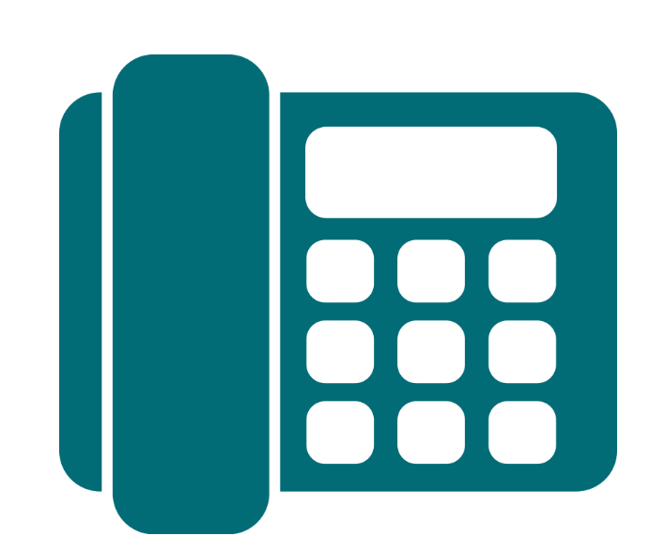
Product Overview ^{(AU)}
Stepping into a meeting with your customer? Read up on our Product Partners’ Unique Selling Points and their plans/products on offer for a quick refresher.
January 2025
Home and Content Insurance
Electricity / Gas
Mobile Service
nbn™ Broadband
Merchant Services
Cloud Phone System

Slide 2

Honey Insurance
Home, Contents and Landlord insurance

Slide 3
Why Honey?
Aussie-based support
$250 invested in your safety from day dot
Lower premium for being smarter
Award winning
Insured in 3 minutes
Get up to 8% off every year with Honey’s sensors*
* T&Cs apply.

Slide 4



Honey Insurance Products
Homeowners Insurance
Renters Insurance
Landlord Insurance
Protecting the essentials of your castle, big or small
Protecting your essentials and those things you can’t bear to live without
Protecting your investments, big or small

Slide 5

Honey Strive For 5
Refer 5 customers to get a quote with Honey in a calendar month, and you’ll receive a $50 Prezzee Gift Card!*
*T&Cs apply. Download the Strive For Flyer for full Terms and Conditions.

Slide 6

Sweet Rewards Program
Reach 25, 50, 100 or 150 active customers with Honey, you'll earn Bronze, Silver, Gold or Platinum Status and unlock Exclusive Rewards!*
*T&Cs apply. Click here for full T&Cs.

Slide 7


Alinta Energy
Electricity & Gas

Slide 8







Why Alinta Energy?
Aussie-based support
Access to Alinta Energy Rewards
No credit card fees
Award winning
Switch in minutes
No lock-in contracts

Slide 9


SUMO
Electricity & Gas

Slide 10
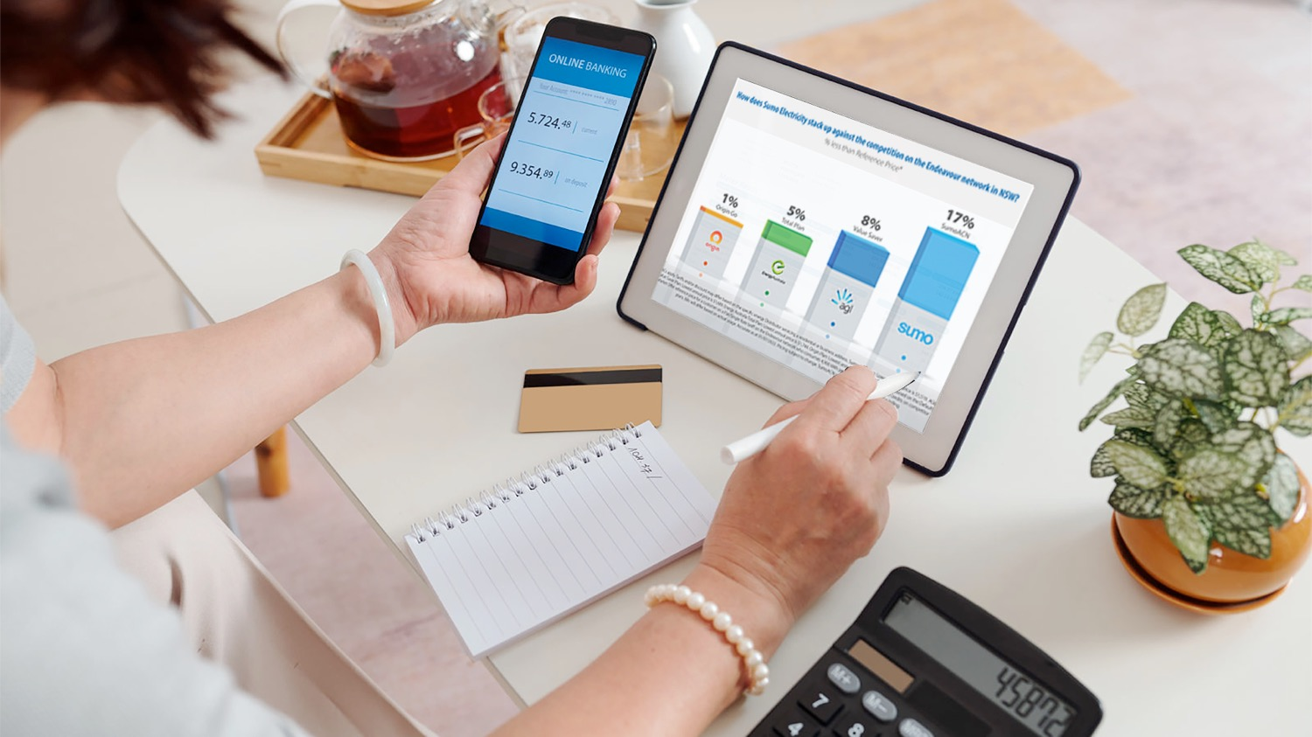
Why Sumo?
Refer your residential or small business customers in NSW, QLD and SA to Sumo’s competitive energy plans!
Sumo is local – Australian-owned and operated
Sumo is flexible – No lock-in contracts and no exit fees
Sumo is highly rated – Rated ‘Excellent’ by customers on Trustpilot
Sumo is all about choice – Choose e-billing or paper billing

Slide 11

MATE
Internet and Mobile

Slide 12





Why MATE?
AWARD-WINNING company – Winner of the 2020 International Service Excellence Award for Customer Service Team of the Year!
Best in class process for switching customers – check out what MATE customers are saying here!
The official GOLD WINNER of the 'Best Value Premium nbn™ Broadband Plan' in Money Magazine Australia’s Best of the Best 2021 Awards
100% Aussie customer service
No lock-in contracts
Uses parts of the Telstra Mobile Network, which covers more than 98.8% of the Australian population with 4G and provides coverage to at least 75% with 5G.
Bundle internet with mobile and get $10 off every month!
Some of the most competitive pricing available

Slide 13
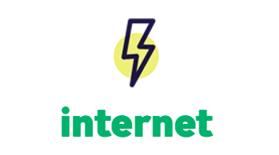
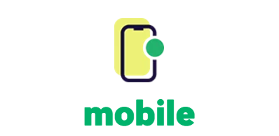
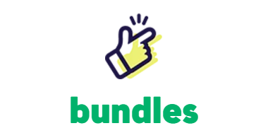


MATE Products
unlimited nbn from $40*
from $25 with eSIM
Save $10/month
*$40/month for the first 6 months, then reverts to $70/month
Notes:
Highlight save $10 a month

Slide 14


Offers
Conxxion Exclusive Mobile Offers
1
POINT
2
POINTS
5G network speeds
500GB data banking
Unlimited talk and text to standard Aussie numbers
Unlimited international calls and SMS to 15 selected countries
On the Telstra Wholesale network
eSIM available
Voice over LTE and Wi-Fi calling included
5G network speeds
1000GB data banking
Unlimited talk and text to standard Aussie numbers
Unlimited international calls and SMS to 15 selected countries
On the Telstra Wholesale network
eSIM available
Voice over LTE and Wi-Fi calling included
See full terms and conditions at www.letsbemates.com.au

Slide 15



Offers
Current Promotions
Mobile Plans
NBN Plans
See full terms and conditions at www.letsbemates.com.au

Slide 16


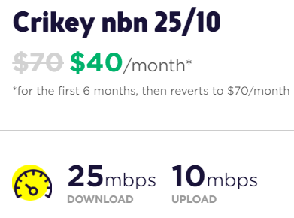
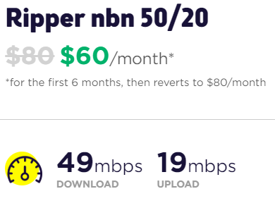
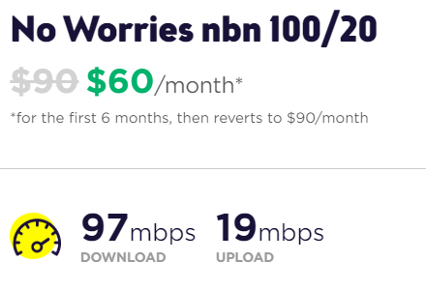
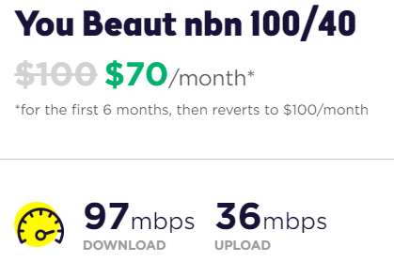
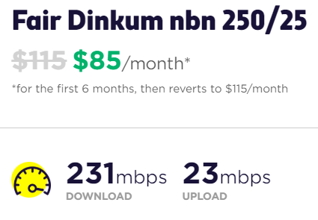






NBN Plans
2
POINTS
2
POINTS
2
POINTS
2
POINTS
2
POINTS
Typical busy period speeds
(7pm to 11pm)
Monthly Data | Unlimited | Unlimited | Unlimited | Unlimited | Unlimited
Recommended Users | 1-4 | 4-6 | 6+ | 6+ | 6+
Video Streaming | Standard Definition (SD) | High Definition (HD) | High Definition (4K) | High Definition (4K) | Concurrent 4K
Playing Online Games
BUNDLE WITH A MOBILE PLAN TO SAVE $10/MONTH

Slide 17
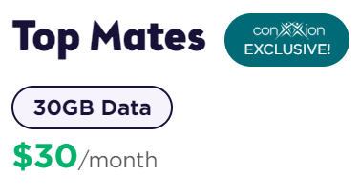
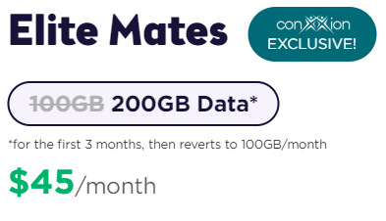
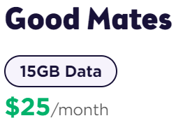
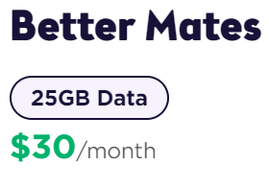
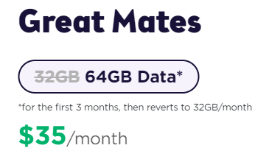
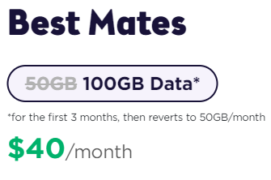
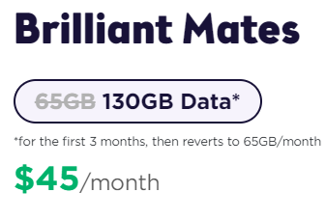
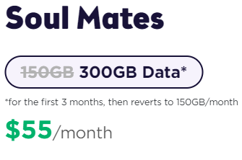
Mobile Plans
DOUBLE DATA FOR 3 MONTHS
PROMO CODE: DOUBLEDATA
1
POINT
2
POINTS
1
POINT
1
POINT
1
POINT
2
POINTS
2
POINTS
2
POINTS
Regular Monthly Data | 15GB | 25GB | 30GB | 32GB | 50GB | 65GB | 100GB | 150GB
Data Bank | 500GB | 500GB | 500GB | 500GB | 500GB | 1000GB | 1000GB | 1000GB
Unlimited National Calls + SMS
Unlimited International Calls + SMS | Not Included | 15 selected countries¹ | 15 selected countries¹ | 15 selected countries¹ | 15 selected countries¹ | 15 selected countries¹ | 15 selected countries¹ | 15 selected countries¹
5G Enabled | Not Included | Not Included | Download speed capped at 100Mbps | Download speed capped at 100Mbps | Download speed capped at 100Mbps | Download speed capped at 100Mbps | Download speed capped at 100Mbps | Download speed capped at 250Mbps
1. 15 countries are not interchangeable and include Canada, China, Germany, Greece, Hong Kong, India, Ireland, Malaysia, New Zealand, Singapore, South Korea, Thailand, United Kingdom, USA and Vietnam.
See full terms and conditions at www.letsbemates.com.au

Slide 18
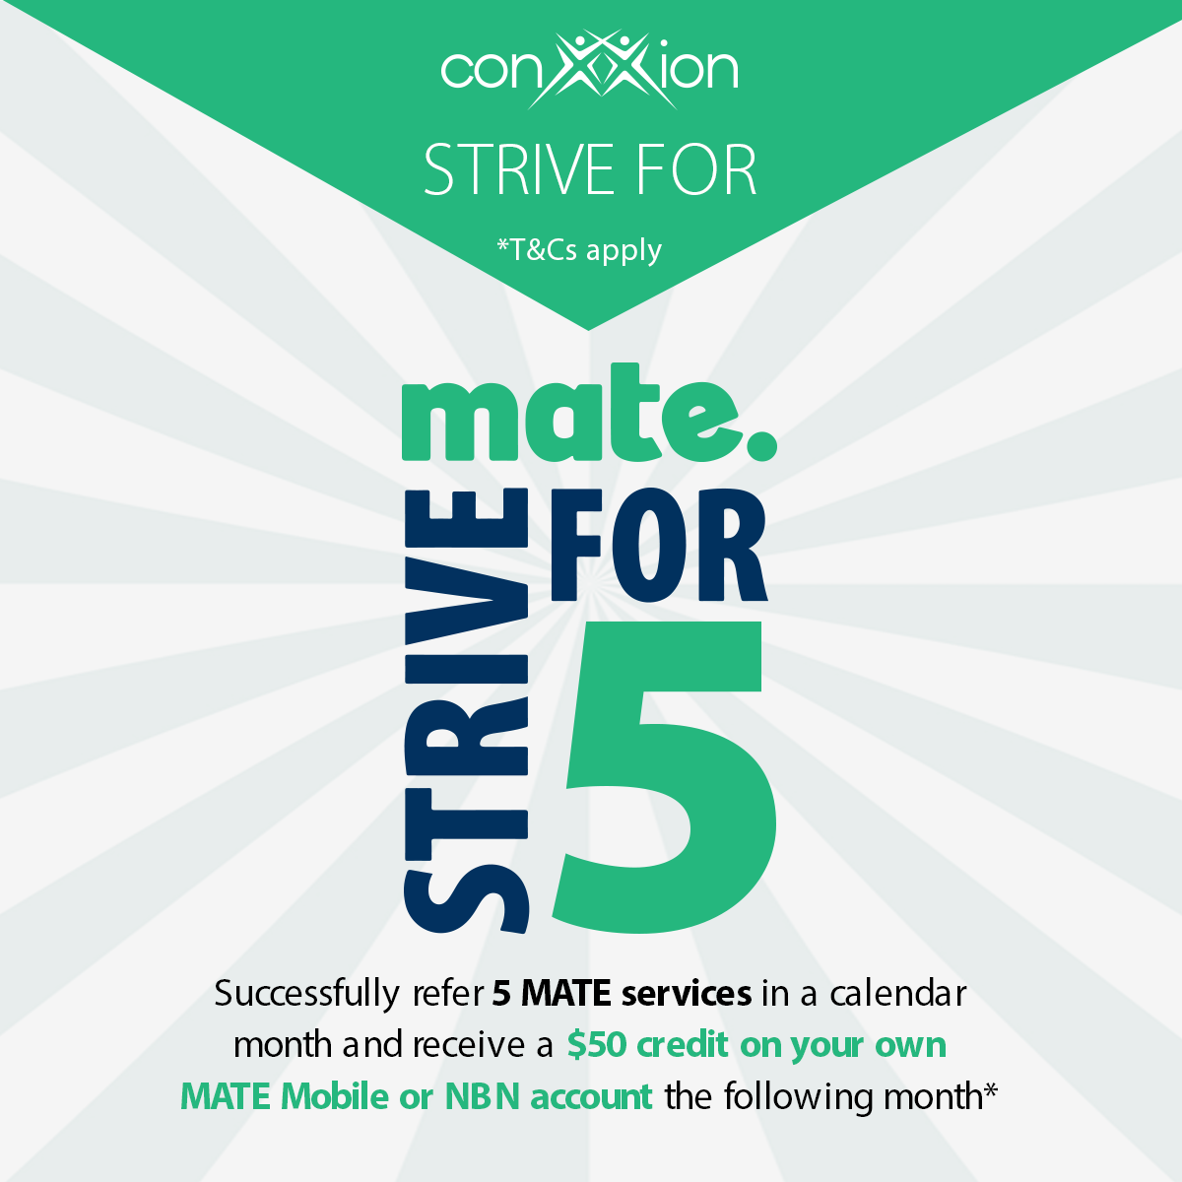
MATE Strive For 5
Successfully refer 5 MATE services in a calendar month and you’ll receive a $50 credit on your own MATE Mobile or nbn™ account the following month!*
*T&Cs apply. Download the Strive For Flyer for full Terms and Conditions.

Slide 19

amaysim Mobile
Affordable Prepaid Plans

Slide 20




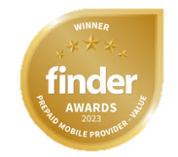
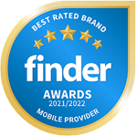





Great value for money and amazingly simple!
SIM Only Mobile Plans
Data Only SIM Plans
Handsets available
Unlimited Data Banking
eSIM & 5G on selected plans
International Roaming
No credit checks OR lock in contracts
Powered by the Optus 4G/5G network, covering 98.5% of population
Unlimited talk, text, & data banking
International Calls up to 42 countries on selected plans!
28 Day Plans
12 Month Plans
7 Day Plans

Slide 21
amaysim Products
SIM Only Plans
28 Days Plans
12 Month Plans
7 Days Plans
Data Only Plans
Handset Plans
(Mobile Phone + SIM Plan)
On eligible SIM Plans

Slide 22
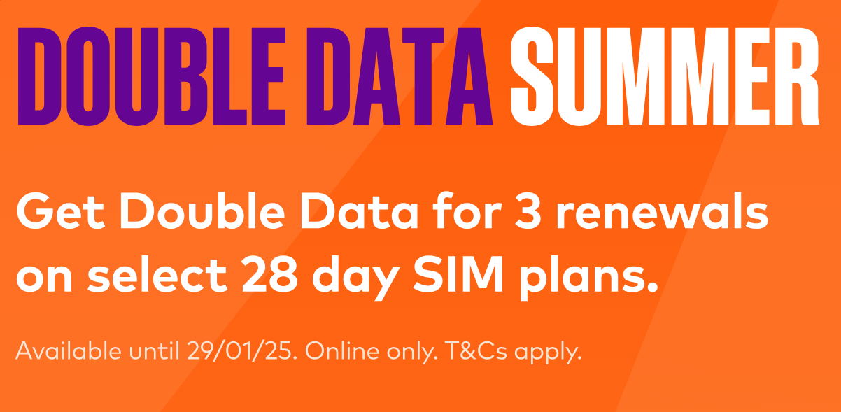

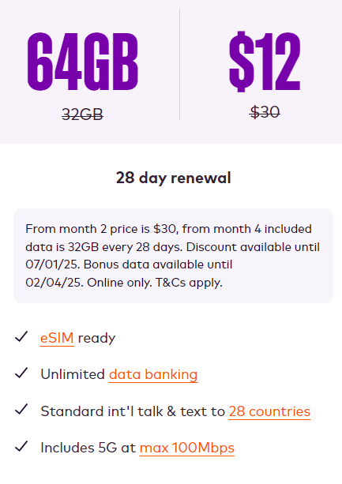
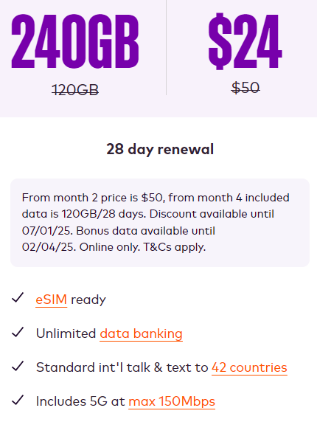
Offers
SIM ONLY MOBILE PLANS
1
POINT
2
POINTS
Selected Plans
See full terms and conditions at www.amaysim.com.au

Slide 23
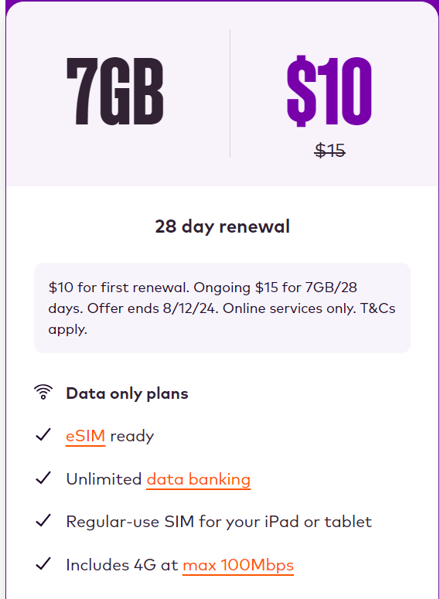
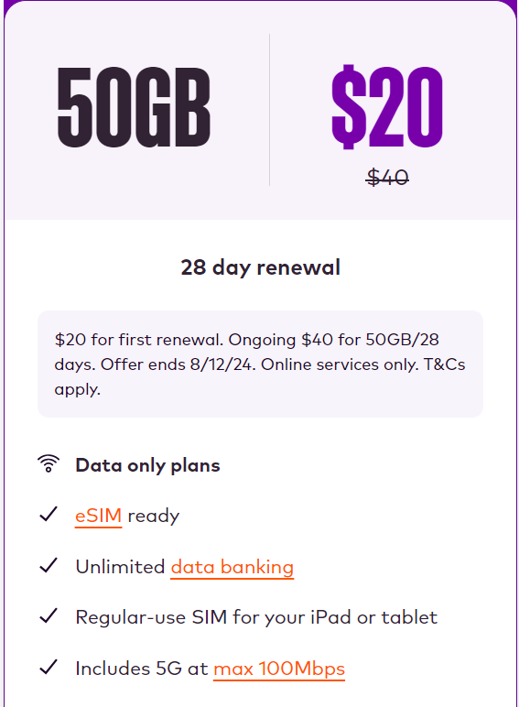
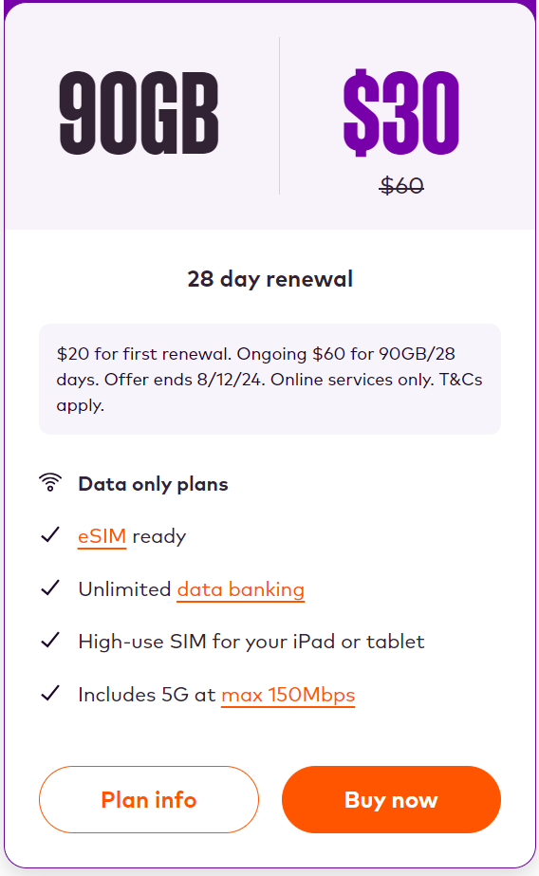
Offers
DATA ONLY SIM PLANS
$5 OFF
50 % OFF
0
POINTS
2
POINTS
2
POINTS
See full terms and conditions at www.amaysim.com.au

Slide 24
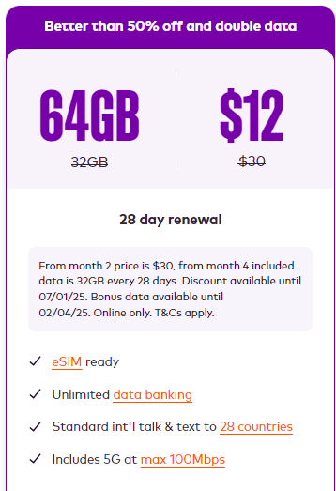
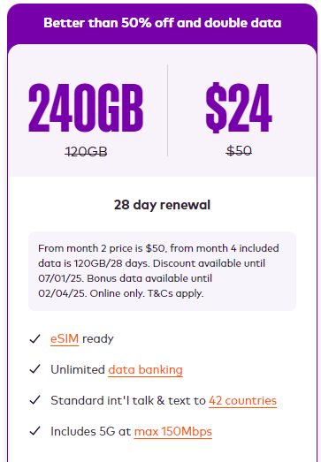
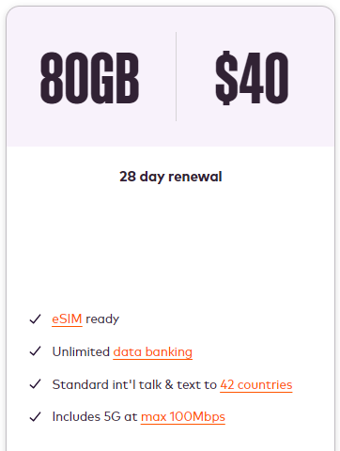
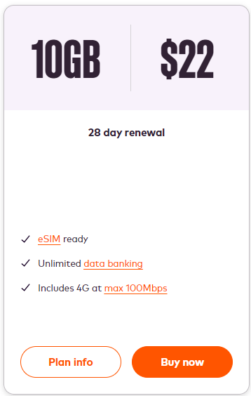
28 Days SIM Plans
5G Included
1
POINT
1
POINT
2
POINTS
2
POINTS
4G Included
See full terms and conditions at www.amaysim.com.au

Slide 25
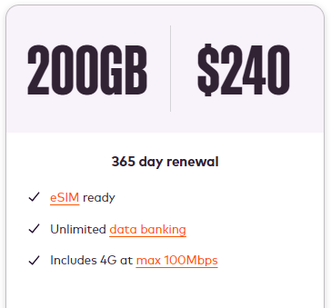
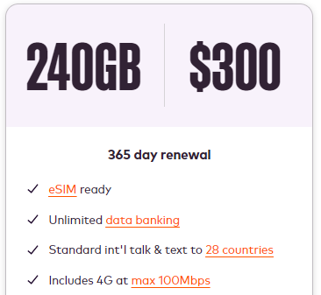
12 Month SIM Plans
4G Included
1
POINT
1
POINT
See full terms and conditions at www.amaysim.com.au

Slide 26
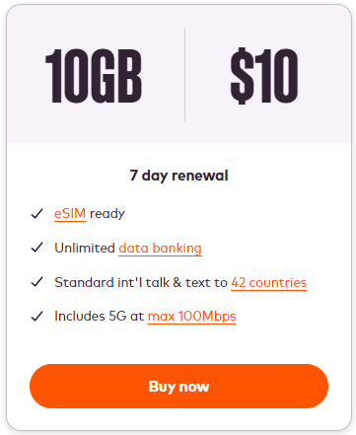
7 Days SIM Plans
5G Included
1
POINT
See full terms and conditions at www.amaysim.com.au

Slide 27
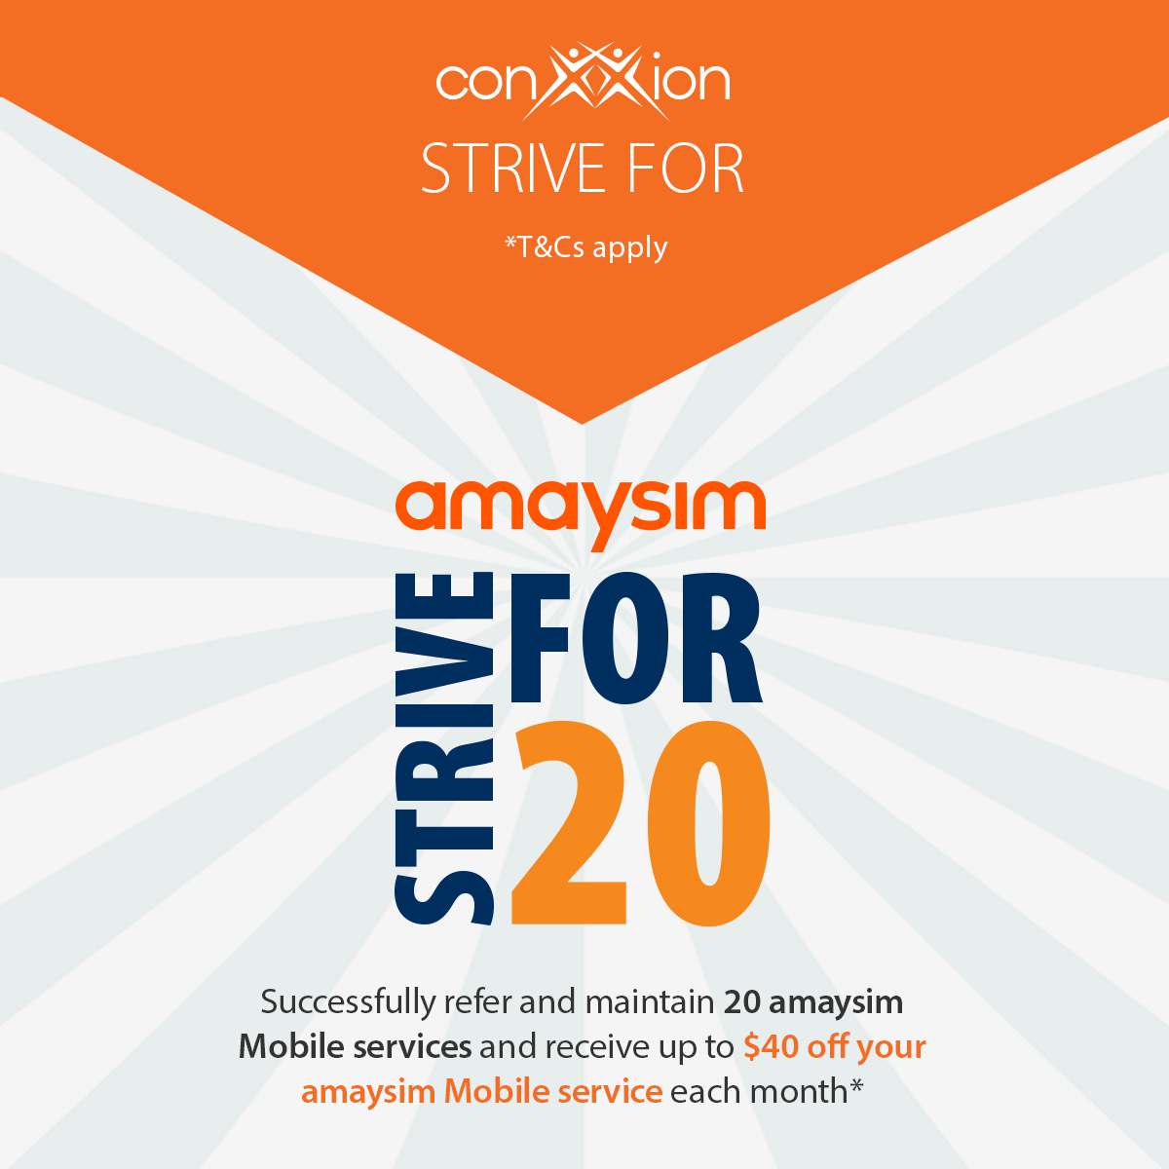
amaysim Strive for 20
Successfully refer and maintain 20 amaysim Mobile services and receive up to $40 off your amaysim Mobile service each month!*
*T&Cs apply. Download the Strive For Flyer for full Terms and Conditions.

Slide 28

Vodafone
Internet and Mobile

Slide 29





Why Choose Vodafone?
5G Network
5G network is rolling out to selected areas of major Australian cities.
Network Satisfaction Guarantee
30-day money back guarantee.
$5 Roaming
Use included data, calls and texts in over 100 countries for $5 extra a day. Excludes speed capped data.
Interest Free Handsets
Interest-free handset repayments over 12, 24 or 36 months
Concerts
Vodafone customers enjoy presale tickets access to local and global artists touring Australia.

Slide 30


Vodafone Products
SIM Only Plans
If data allocated runs out, customers can keep using data in Australia at slower speeds.
Home Internet
Save on 4G and 5G plans or get a speed upgrade on nbn® plans when you have a mobile plan with Vodafone
Handset Plans
Pay for your new phone, iPad or tablet interest free over 12, 24 or 36 months.
Notes:
Remove prepaid

Slide 31
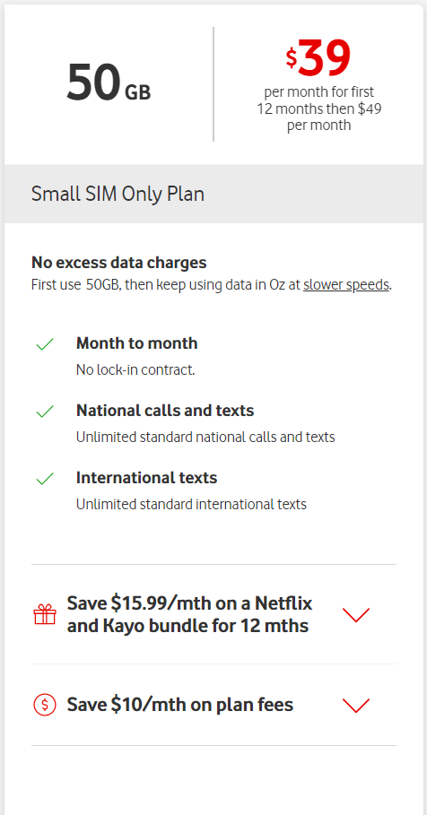
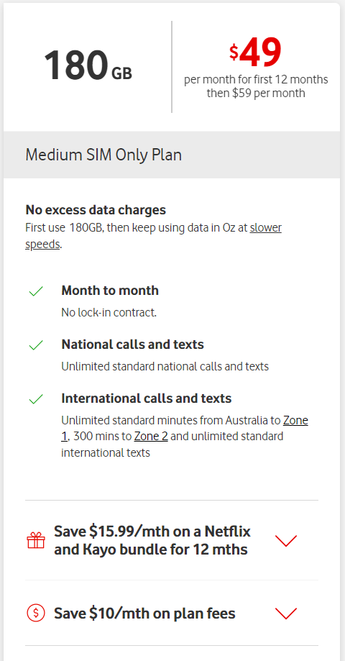
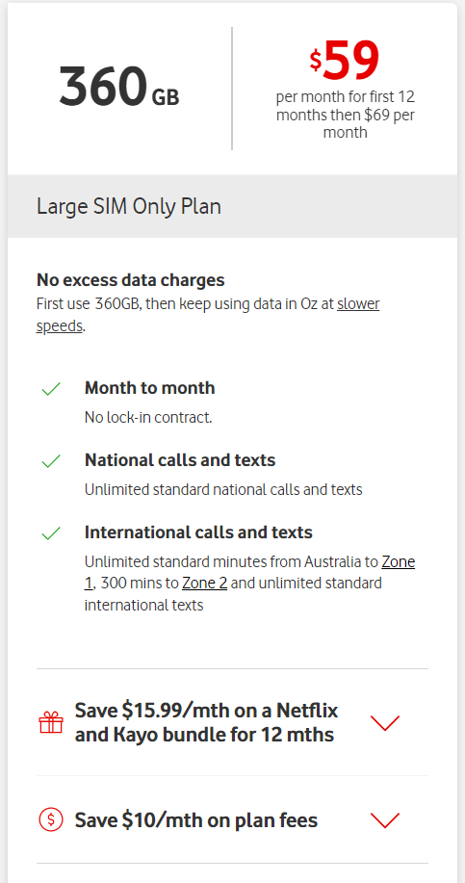
SIM Only Plans
Save $10/month on Plan Fees for 12 months
1
POINT
2
POINTS
2
POINTS
See full terms and conditions at www.vodafone.com.au

Slide 32
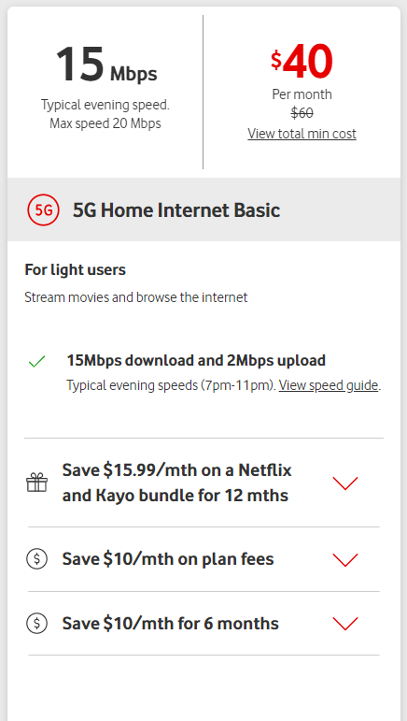
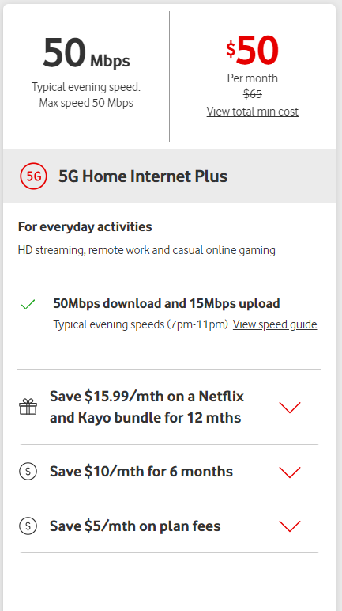
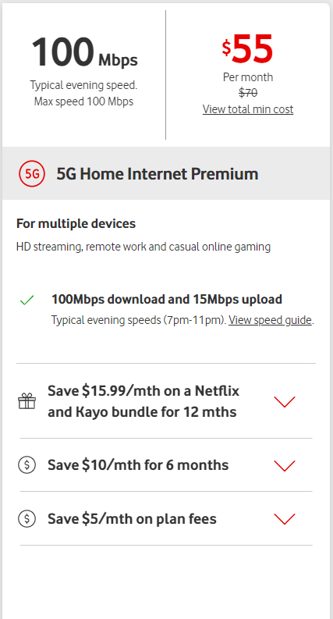
Home Internet
$10 off
(When you have a Mobile Plan with Vodafone)
$5 off
(When you have a Mobile Plan with Vodafone)
3
POINTS
3
POINTS
3
POINTS
$10 off for first 6 months
See full terms and conditions at www.vodafone.com.au
Notes:
How much do we get paid on Home Internet?
Fixed Wirless – remove NBM

Slide 33


NMI
Payment Processing for businesses

Slide 34

Why NMI?
Payment processor for small to medium sized businesses in Australia
Now partnered with Tyro the largest EFTPOS provider outside of the Big 4 to provide competitive pricing, excellent customer service and a variety of products and features to fit your customers’ needs!
Specialises in hospitality, healthcare, retail and service
Ability to accept all major cards via countertop and mobile terminals
Over 300+ Point of Sale/Practice Management Software integrations
Competitive pricing with no lock-in contracts
Low Processing Rates
Payment Acceptable Solutions
24/7/365 Customer Service
Highly Secure Processing

Slide 35




Who to Target
Restaurants
How about your favourite diner or your go-to date night restaurant?
Salons
Does your hairdresser or nail technician accept credit cards?
Automotive
Does your hairdresser or nail technician accept credit cards?
Medical
Don’t forget about your primary care physician or family specialist!

Slide 36
How it Works
Submitted a lead? Here’s what you should expect:
Lead submitted
Don’t forget to attach a merchant statement
NMI will contact your customer with a proposal
NMI’s account executive will phone/email within
2 business days
Equipment shipped,
service up and running!
Your customer will receive a welcome kit, and your terminal will be shipped

Slide 37



No Cost EFTPOS w/ Tyro Pro
$0 monthly bills
Say goodbye to bill shock with nothing to pay at the of the month.
No machine rental costs or lock-in contract for merchants doing $10,000+ per month
No Cost-EFTPOS means you can take transactions on your Tyro Pro machine without the rental fee.
Simple surcharging set up & pricing
Simply enable surcharging on your device and we’ll do the rest.

Slide 38

Vonex
Business Customer Connectivity

Slide 39

Business Phone
Lineshare + OnDesk + OnSip
Business nbn™ & Advanced Assure nbn™
The NEW
“One-Stop-Shop”
for Business Customer
Connectivity!
Business Mobile &
Business Mobile Fleet
Business 4G & 5G Broadband

Slide 40
How it Works
Submitted a lead? Here’s what you should expect:
Simply visit acnpacific.com/vonex
Fill in the online form with as much information as possible
Our dedicated Vonex Account Manager will contact the customer, explore their needs, discuss the options, provide a quote and close the deal.

Slide 41

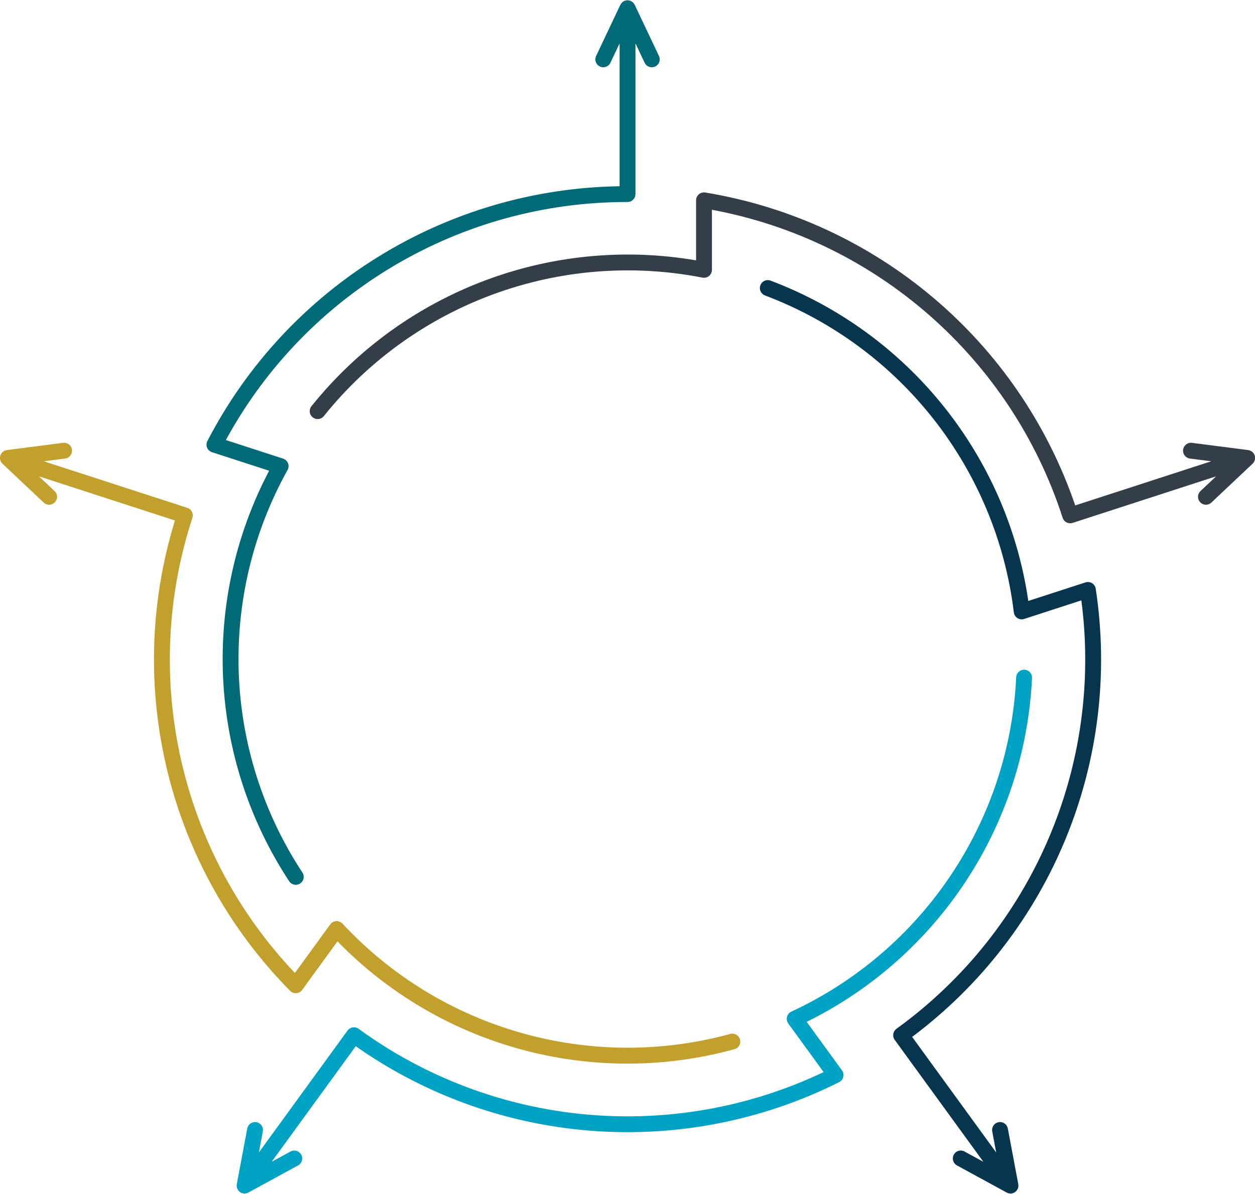




Don’t forget to like, share, follow and subscribe!
Conxxion Facebook
Conxxion Resources
The Conxxion Community
Facebook Group
Training & Resources
Conxxion YouTube
Conxxion Instagram

