Slide 1
ACN Pacific Product Overview NZ
Stepping into a meeting with your customer? Read up on our Product Partners’ Unique Selling Points and their plans/products on offer for a quick refresher.
1 December 2022

Slide 2
Truvvi Lifestyle
Travel & Lifestyle

Slide 3
Why Truvvi?
The Ultimate Travel & Lifestyle Club
Members-only discounted travel rates
Best possible deals on flights and accommodation
Exclusive booking service and 24/7 support
3 Membership levels to suit every lifestyle
Monthly, quarterly or yearly subscriptions
Price Promise – Truvvi Lifestyle is so confident in their special members-only pricing that if a member finds a lower price on another website, they will refund 110% of the difference!*
*T&Cs apply.

Slide 4
Plans
Frequent Flyer benefits
VIP Concierge service
Urgent and non-urgent medical assistance
Fast pass passport & visa processing
Airport lounge access
Flight accident insurance
Dedicated travel agent
VIP concierge service available while travelling or at home:
  Activities & experiences
  Dining
  Concerts and shows
Get special access to:
Best Price Promise*
Exclusive booking service with 24/7 support
Members-only discounted travel rates
Hotel credits
Premier
Concierge
Concierge
Essentials
Essentials
Essentials
*T&Cs apply.

Slide 5
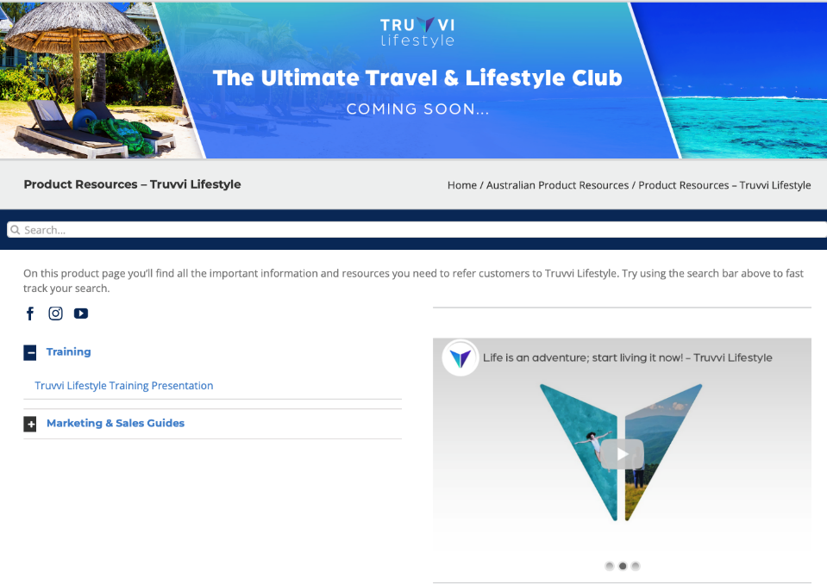
Training & Resources
Pacific Compass
  acnpacific.com/ibo/product-resources-au/truvvi-lifestyle
Social media
  Facebook
  Instagram
  YouTube
  Don’t forget to like, share, follow and subscribe!

