Slide 1





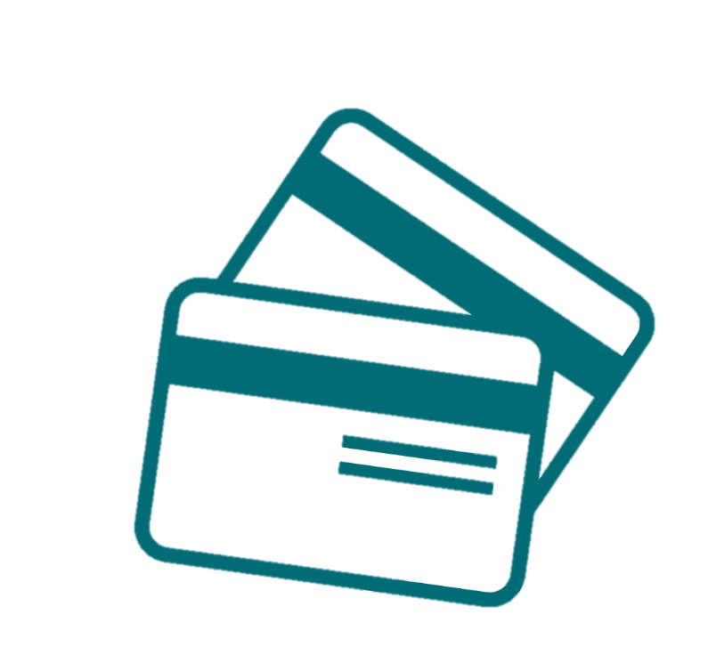
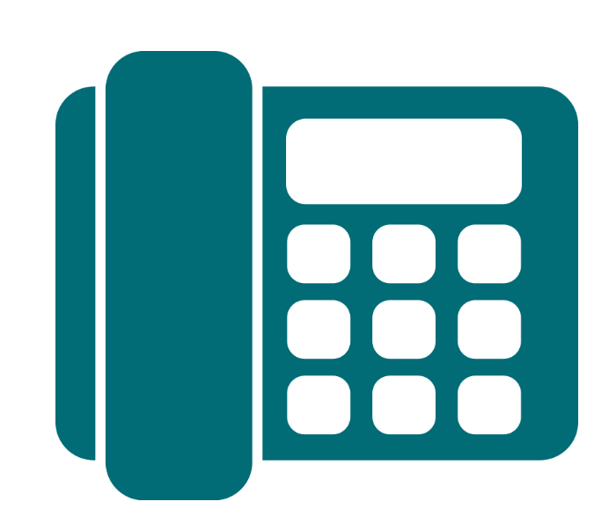
Product Overview ^{(AU)}
Stepping into a meeting with your customer? Read up on our Product Partners’ Unique Selling Points and their plans/products on offer for a quick refresher.
May 2025
Home and Content Insurance
Electricity / Gas
Mobile Service
nbn™ Broadband
Merchant Services
Cloud Phone System

Slide 2


Alinta Energy
Electricity & Gas

Slide 3







Why Alinta Energy?
Aussie-based support
Access to Alinta Energy Rewards
No credit card fees
Award winning
Switch in minutes
No lock-in contracts

Slide 4

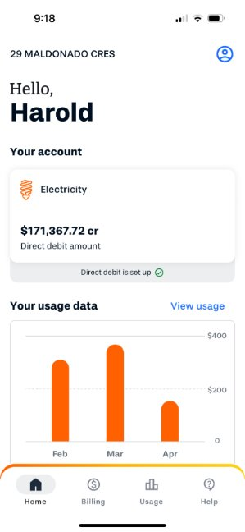
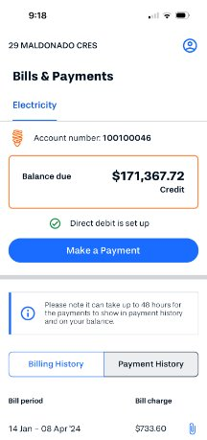




Alinta Energy New Mobile App - Managing your energy just got easier
What is the Alinta Energy Mobile App?
The Alinta Energy App allows customers to view and manage their electricity and gas usage, view and pay their bills, set up direct debit, manage their account and access their plan and rates while being seamlessly logged in.
Effortless account
management
Freedom to view and update your account details at your convenience.
Stay on top of your bills
See your current and historical bills, amount due and any credits you may have
Identify potential energy
savings
Tracking your usage in kilowatt hours and dollars to help you find savings.
Even better features to
come
Giving you access and insights to make smarter choices with your energy.

Slide 5
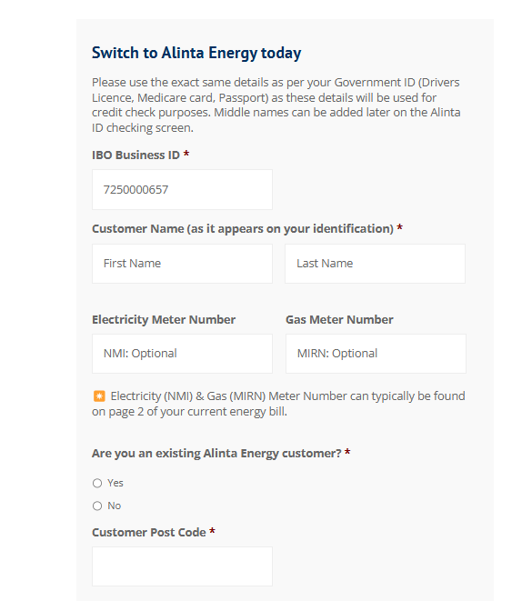
Update: Customers can now upgrade via Conxxion Storefronts
How?
Why?
1
Customer signs up through Conxxion Storefront
Quick & Easy – Complete the upgrade in just a few clicks.
24/7 Access – Upgrade anytime, no need to wait for business hours.
No Hold Times – Skip the queue and upgrade instantly
Works for new upgrades and existing Conxxion customers looking to change plans or add an address.
2
Phone upgrades still available: Call Alinta Energy Conxxion team on 1800 868 606 (Mon-Fri, 8 AM – 5 PM AEDT/AEST).
Select yes to being an existing customer
3
Customer validates themselves by using the mobile number/email address of primary account holder

Slide 6
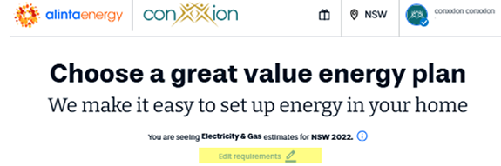
Update: Customers can now get address- specific quotes on the digital journey
What’s new?
How?
Previously: Generic single-rate tariff shown; exact tariff only revealed at final sign-up stage.
Now: Address-specific quotes provide transparent, accurate pricing upfront for a smoother sign-up process.
1
Customer signs up through Conxxion Storefront
2
Select ‘Edit requirements’
Why?
More precise and personalised quotes for customers
Easier and more accurate bill comparisons
A faster, more seamless customer journey – reducing the need to call the dedicated sales line
3
Enter address to receive a personalised quote

Slide 7


SUMO
Electricity & Gas

Slide 8
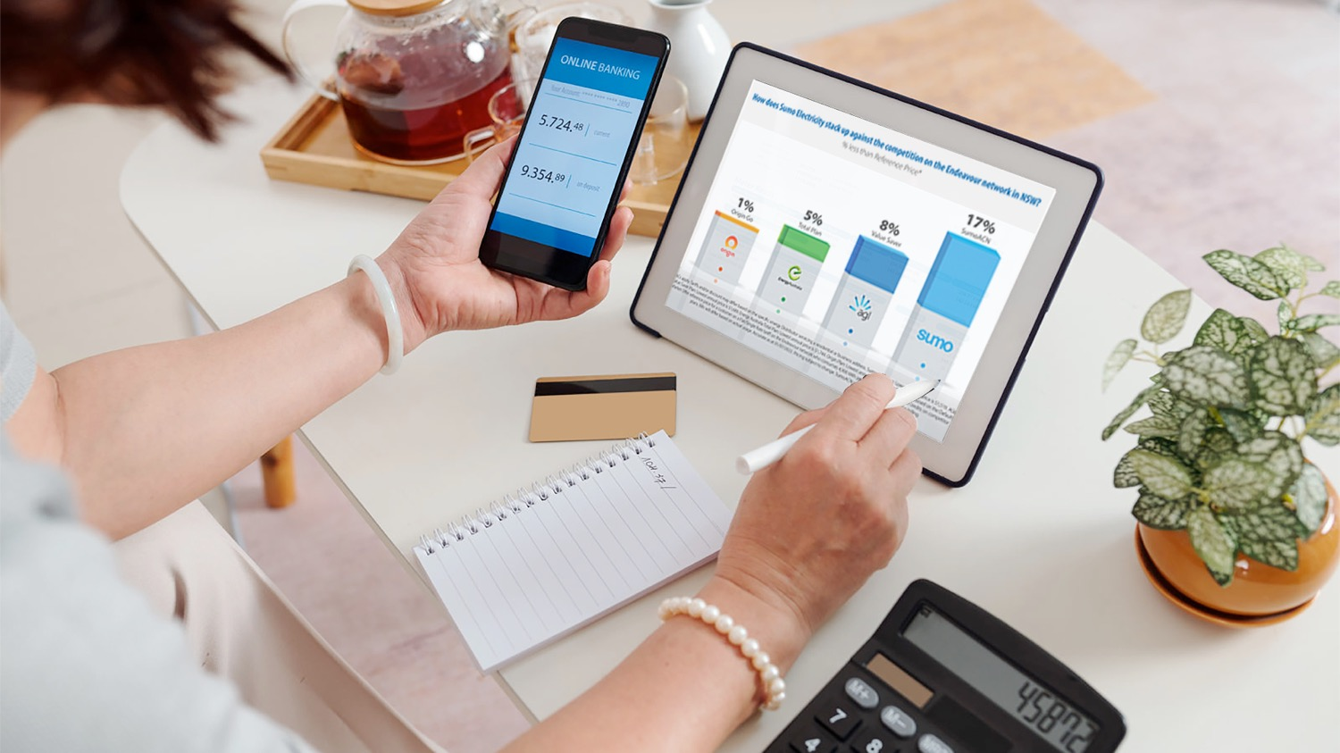
Why Sumo?
Refer your residential or small business customers in NSW, QLD and SA to Sumo’s competitive energy plans!
Sumo is local – Australian-owned and operated
Sumo is flexible – No lock-in contracts and no exit fees
Sumo is highly rated – Rated ‘Excellent’ by customers on Trustpilot
Sumo is all about choice – Choose e-billing or paper billing

Slide 9

MATE
Internet and Mobile

Slide 10




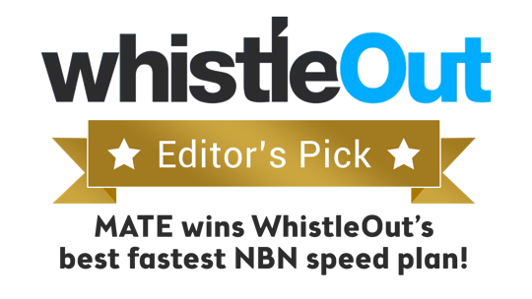
Why MATE?
AWARD-WINNING company – Winner of the 2020 International Service Excellence Award for Customer Service Team of the Year!
Best in class process for switching customers – check out what MATE customers are saying here!
The official GOLD WINNER of the 'Best Value Premium nbn™ Broadband Plan' in Money Magazine Australia’s Best of the Best 2021 Awards
100% Aussie customer service
No lock-in contracts
Uses parts of the Telstra Mobile Network, which covers more than 98.8% of the Australian population with 4G and provides coverage to at least 75% with 5G.
Bundle internet with mobile and get $10 off every month!
Some of the most competitive pricing available

Slide 11
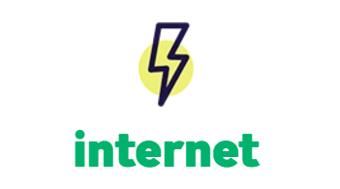
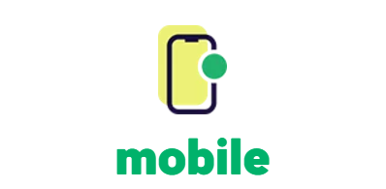
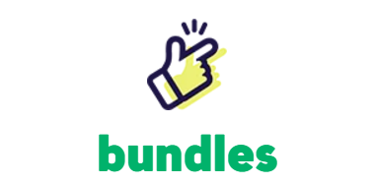


MATE Products
unlimited nbn from $40*
from $25 (eSIM available)
internet + mobile saves $10/month
*for the first 6 months, then reverts to $70/month
Notes:
Highlight save $10 a month

Slide 12

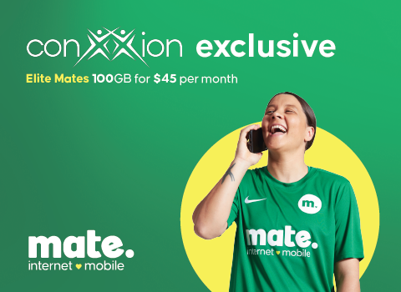
Offers
Conxxion Exclusive Mobile Offers
1
POINT
2
POINTS
5G network speeds
500GB data banking
Unlimited talk and text to standard Aussie numbers
Unlimited international calls and SMS to 15 selected countries
On the Telstra Wholesale network
eSIM available
Voice over LTE and Wi-Fi calling included
5G network speeds
1000GB data banking
Unlimited talk and text to standard Aussie numbers
Unlimited international calls and SMS to 15 selected countries
On the Telstra Wholesale network
eSIM available
Voice over LTE and Wi-Fi calling included
See full terms and conditions at www.letsbemates.com.au

Slide 13


Offers
NBN
Mobile
        Complementary subscription
      Complementary subscription
BEIN30
Use promo code BEIN30 to save $180 over 6 months on eligible internet plans:
Crikey 25/10
No Worries 100/20
You Beaut 100/40
Fair Dinkum 250/25
Flamin’ Fast 1000/50
Terms and conditions apply*
BEIN20
Use promo code BEIN20 to save $120 over 6 months on eligible internet plans:
Ripper 50/20
No Dramas Wireless
You Beaut 100/40
Fair Dinkum
250/25
Terms and conditions apply*
BEIN
Use promo code BEIN at checkout to get a complimentary beIN Sports subscription with any mobile plan
Terms and conditions apply*
$30 discount per month
for the first 6 months
$20 discount per month
for the first 6 months
See full terms and conditions at www.letsbemates.com.au

Slide 14





How does MATE NBN compare to its competitors?
Pricing as of 30/04/2025 comparing with standard pricing of competitors
Provider | nbn 25/5 | nbn 50/20 | nbn 100/20 | nbn 100/40 | nbn 250/25 | nbn 1000/50
 | $70 | $80 | $90 | $100 | $115 | $120
BEIN30/BEIN20 promo price for 6 months | $40 | $60 | $60 | $70 | $85 | $90
BEIN30/BEIN20 + bundled discount | $30 | $50 | $50 | $60 | $75 | $80
 | $89 | $105 | $110 | N/A | $130 | $150
 | $75 | $89 | $99 | N/A | $119 | $129
 | $76.99 | $84.99 | $94.99 | N/A | $99.99 | $109.99
 | $79 | $89 | $95 | N/A | $119 | $129
For IBO Training Use Only. Not for Customer Distribution.
BYO modem or pick up a premium Wi-Fi modem from MATE

Slide 15
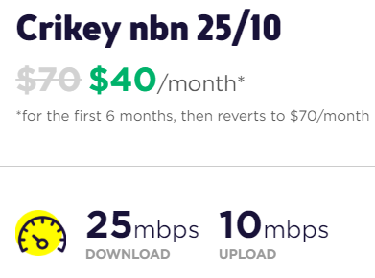
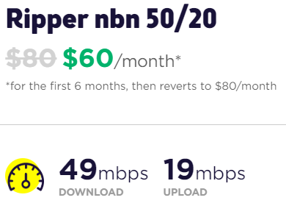
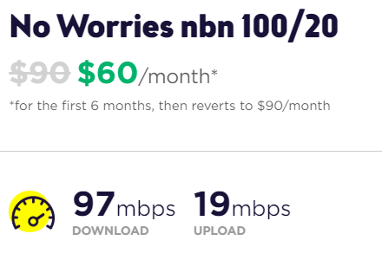
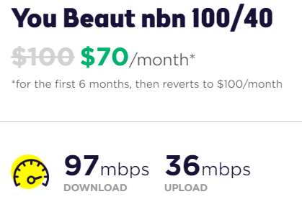
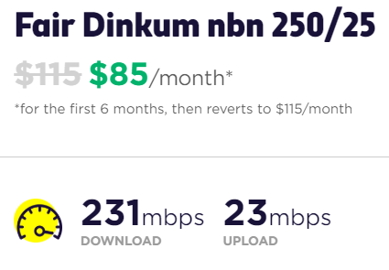
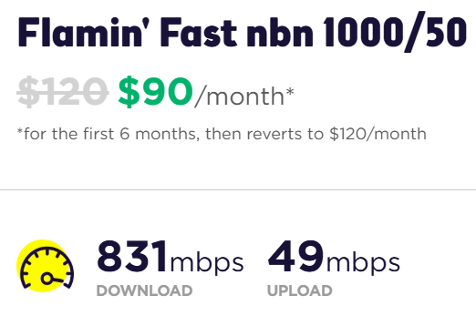






NBN Plans
2
POINTS
2
POINTS
2
POINTS
2
POINTS
2
POINTS
2
POINTS
BEIN30
BEIN20
BEIN30
BEIN30
BEIN30
BEIN30
Typical busy period speeds (7pm to 11pm)
Monthly Data | Unlimited | Unlimited | Unlimited | Unlimited | Unlimited | Unlimited
Recommended Users | 2-4 | 4-6 | 6+ | 6+ | 6+ | 8+
Video Streaming | Standard Definition (SD) | High Definition (HD) | High Definition (4K) | High Definition (4K) | Concurrent 4K | Concurrent 4K
Playing Online Games
BUNDLE WITH A MOBILE PLAN TO SAVE $10/MONTH
COMPLEMENTARY SUBSCRIPTION

Slide 16
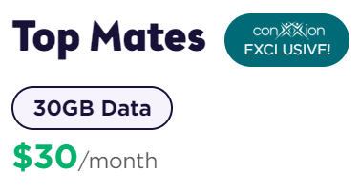
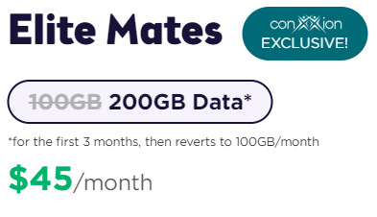
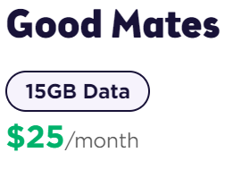
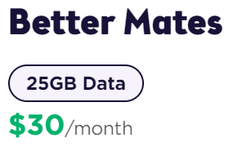
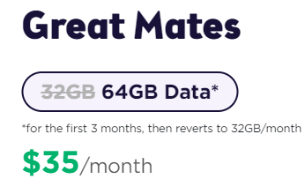
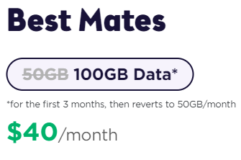
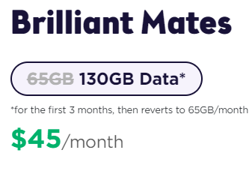
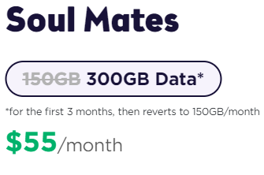
Mobile Plans
1
POINT
2
POINTS
1
POINT
1
POINT
1
POINT
2
POINTS
2
POINTS
2
POINTS
32GB Data
50GB Data
65GB Data
100GB Data
150GB Data
Regular Monthly Data | 15GB | 25GB | 30GB | 32GB | 50GB | 65GB | 100GB | 150GB
Data Bank | 500GB | 500GB | 500GB | 500GB | 500GB | 1000GB | 1000GB | 1000GB
Unlimited National Calls + SMS
Unlimited International Calls + SMS | Not Included | 15 selected countries¹ | 15 selected countries¹ | 15 selected countries¹ | 15 selected countries¹ | 15 selected countries¹ | 15 selected countries¹ | 15 selected countries¹
5G Enabled | Not Included | Not Included | Download speed capped at 100Mbps | Download speed capped at 100Mbps | Download speed capped at 100Mbps | Download speed capped at 100Mbps | Download speed capped at 100Mbps | Download speed capped at 250Mbps
COMPLEMENTARY SUBSCRIPTION (USE PROMO CODE: BEIN)
1. 15 countries are not interchangeable and include Canada, China, Germany, Greece, Hong Kong, India, Ireland, Malaysia, New Zealand, Singapore, South Korea, Thailand, United Kingdom, USA and Vietnam.
See full terms and conditions at www.letsbemates.com.au

Slide 17
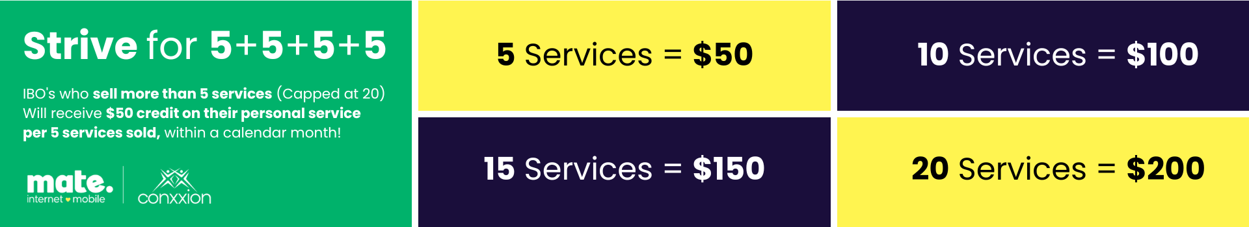




Introducing MATE new Strive for…
Promotion Period: March 01, 2025 - June 30, 2025
To qualify for the MATE Strive For 5+5+5+5 Promotion, a Conxxion IBO must:
  Acquire and activate five (5) or more ‘new’ MATE nbn or Mobile services in a single calendar month
  Ensure all services are activated within the month of acquisition or by the end of the following month
  Refer to the full T&C’s for all the details here: Strive For 5+5+5+5 Flyer
Notes:
Next slide is life-time comms, introduce first before clicking

Slide 18

amaysim Mobile
Affordable Prepaid Plans

Slide 19




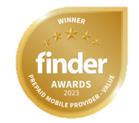
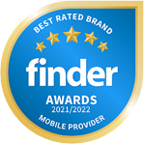

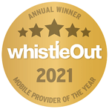



Great value for money and amazingly simple!
SIM Only Mobile Plans
Data Only SIM Plans
Handsets available
Unlimited Data Banking
eSIM & 5G on selected plans
International Roaming
No credit checks OR lock in contracts
Powered by the Optus 4G/5G network, covering 98.5% of population
Unlimited talk, text, & data banking
International Calls up to 42 countries on selected plans!
28 Day Plans
12 Month Plans
7 Day Plans

Slide 20
amaysim Products
SIM Only Plans
28 Days Plans
Long Expiry Plans
7 Days Plans
Data Only Plans
Handset Plans
(Mobile Phone + SIM Plan)
On eligible SIM Plans

Slide 21
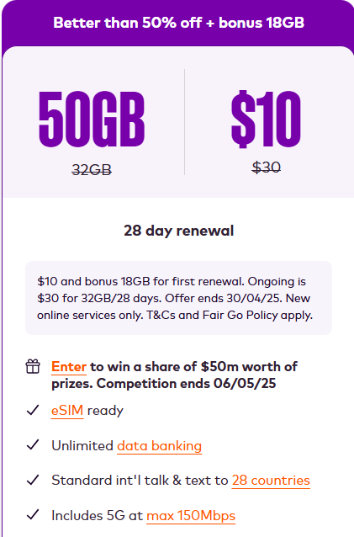
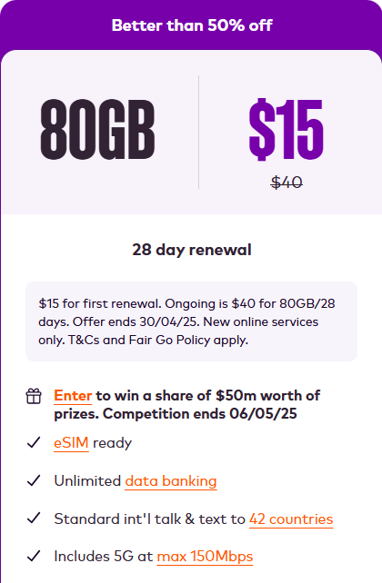
Standout Offers
SIM ONLY MOBILE PLANS
1
POINT
2
POINTS
Discount percentage applies to the first renewal only
See full terms and conditions at www.amaysim.com.au

Slide 22
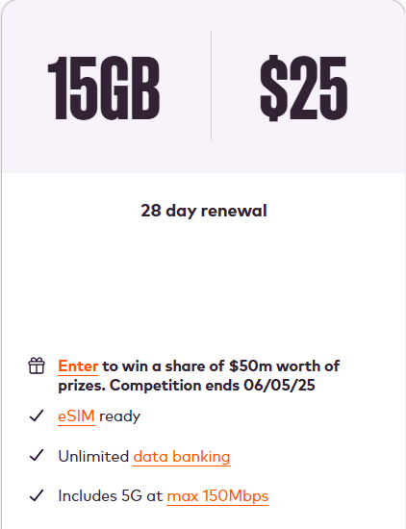
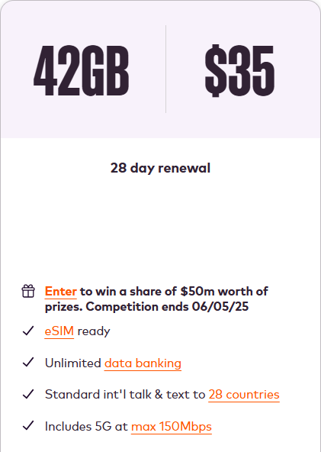
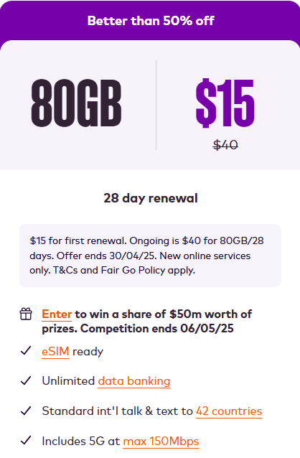
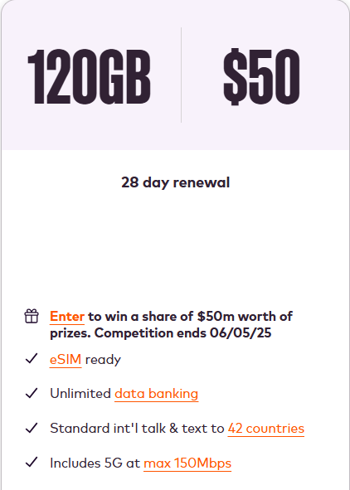
28 Days SIM Plans
5G Included
1
POINT
1
POINT
1
POINT
2
POINTS
2
POINTS
Discount percentages and extra data offers apply to the first renewal only
See full terms and conditions at www.amaysim.com.au

Slide 23
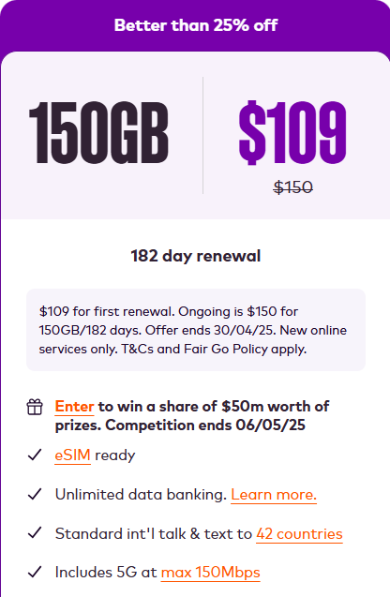
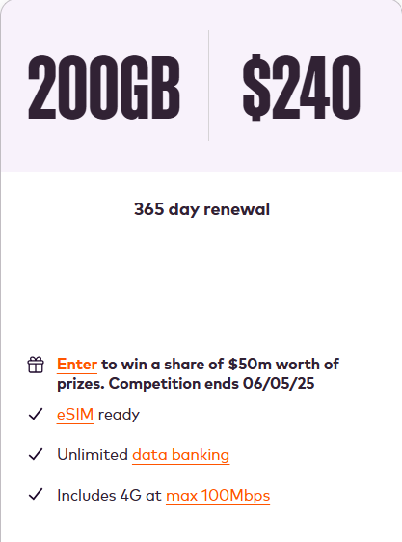
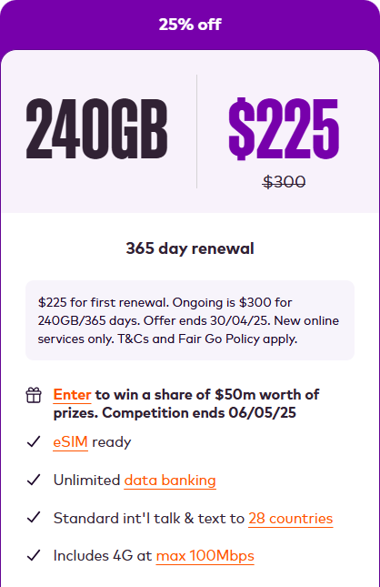
Long Expiry SIM Plans
5G Included
4G Included
1
POINT
1
POINT
1
POINT
Discount percentage applies to the first renewal only
See full terms and conditions at www.amaysim.com.au

Slide 24
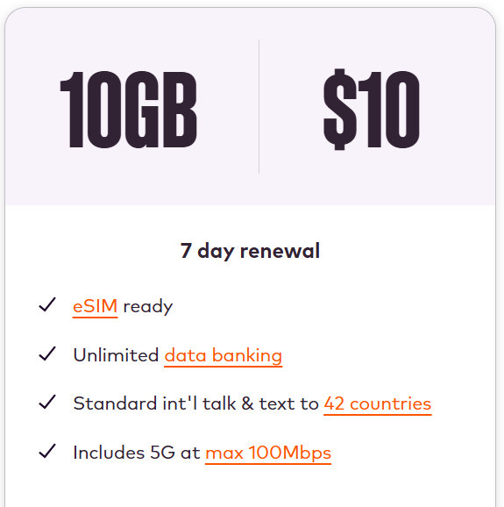
7 Days SIM Plans
5G Included
1
POINT
See full terms and conditions at www.amaysim.com.au

Slide 25
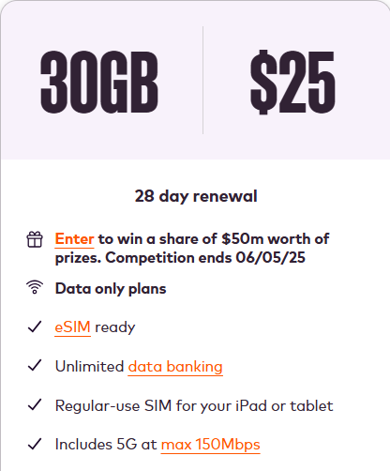
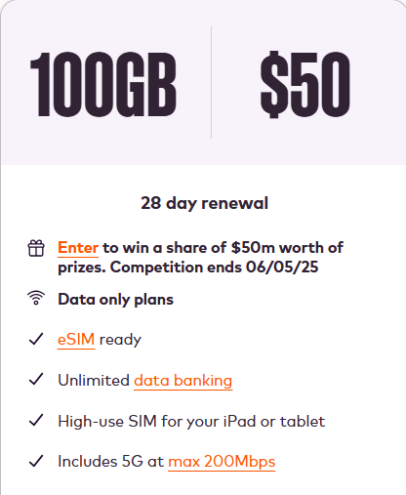
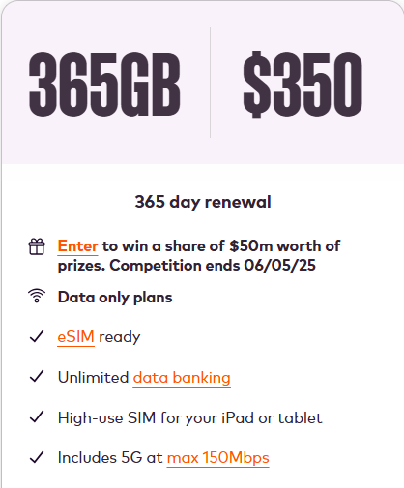
Data Only SIM Plans
DATA ONLY SIM PLANS
5G Included
0
POINTS
2
POINTS
0
POINTS
Discount percentages apply to the first renewal only
See full terms and conditions at www.amaysim.com.au

Slide 26
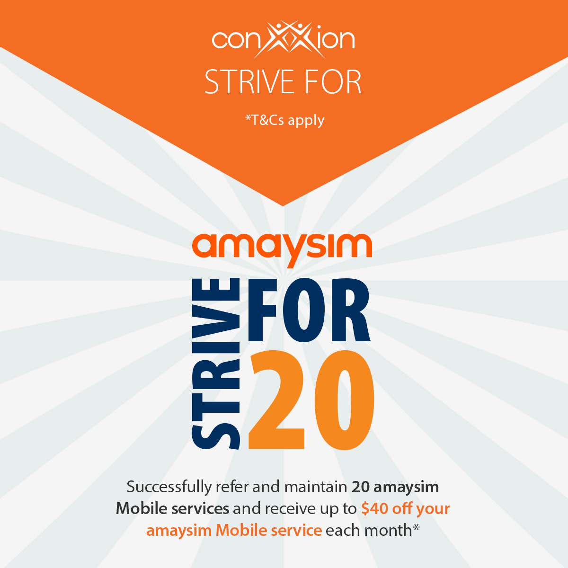
amaysim Strive for 20
Successfully refer and maintain 20 amaysim Mobile services and receive up to $40 off your amaysim Mobile service each month!*
*T&Cs apply. Download the Strive For Flyer for full Terms and Conditions.

Slide 27

Vodafone
Internet and Mobile

Slide 28





Why Choose Vodafone?
5G Network
5G network is rolling out to selected areas of major Australian cities.
Network Satisfaction Guarantee
30-day money back guarantee.
$5 Roaming
Use included data, calls and texts in over 100 countries for $5 extra a day. Excludes speed capped data.
Interest Free Handsets
Interest-free handset repayments over 12, 24 or 36 months
Concerts
Vodafone customers enjoy presale tickets access to local and global artists touring Australia.

Slide 29


Vodafone Products
SIM Only Plans
If data allocated runs out, customers can keep using data in Australia at slower speeds.
Home Internet
Save on 4G and 5G plans or get a speed upgrade on nbn® plans when you have a mobile plan with Vodafone
Handset Plans
Pay for your new phone, iPad or tablet interest free over 12, 24 or 36 months.
Notes:
Remove prepaid

Slide 30
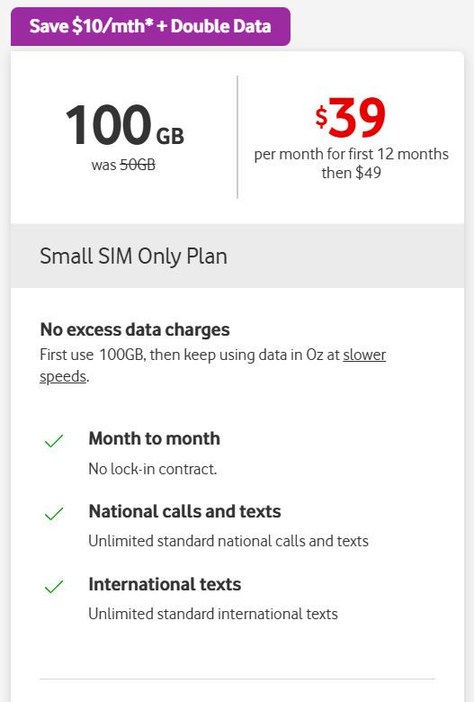
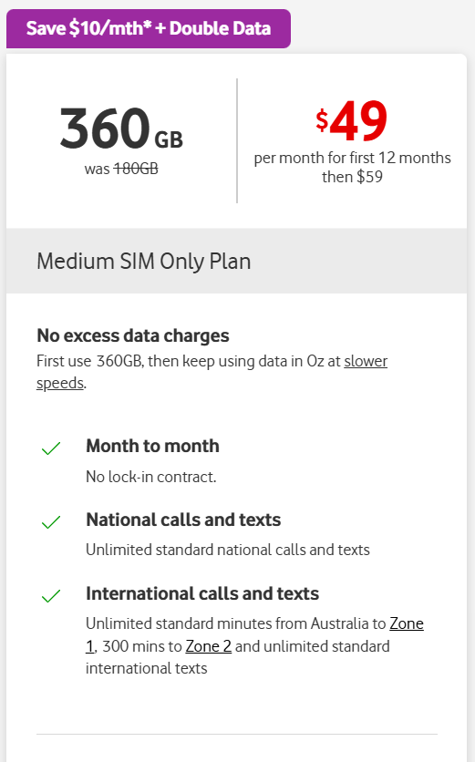
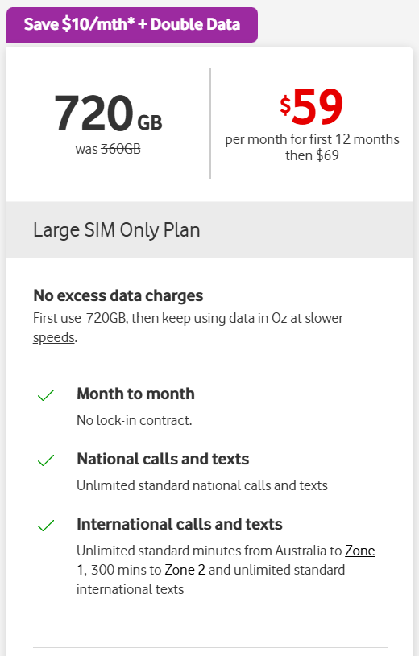
SIM Only Plans
1
POINT
2
POINTS
2
POINTS
$10 off for the first 12 months
+ DOUBLE DATA when you stay connected to the plan
See full terms and conditions at www.vodafone.com.au

Slide 31
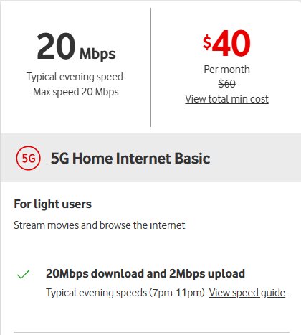
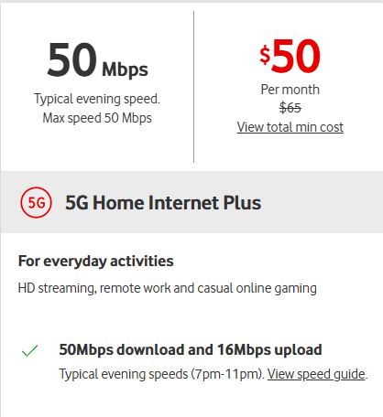
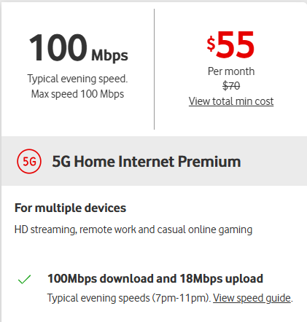
5G Home Internet
$10 off
(When you have a Mobile Plan with Vodafone)
$5 off
(When you have a Mobile Plan with Vodafone)
3
POINTS
3
POINTS
3
POINTS
+ $10 off for first 6 months
See full terms and conditions at www.vodafone.com.au
Notes:
How much do we get paid on Home Internet?
Fixed Wirless – remove NBM

Slide 32


NMI
Payment Processing for businesses

Slide 33

Why NMI?
Payment processor for small to medium sized businesses in Australia
Now partnered with Tyro the largest EFTPOS provider outside of the Big 4 to provide competitive pricing, excellent customer service and a variety of products and features to fit your customers’ needs!
Specialises in hospitality, healthcare, retail and service
Ability to accept all major cards via countertop and mobile terminals
Over 300+ Point of Sale/Practice Management Software integrations
Competitive pricing with no lock-in contracts
Low Processing Rates
Payment Acceptable Solutions
24/7/365 Customer Service
Highly Secure Processing

Slide 34




Who to Target
Restaurants
How about your favourite diner or your go-to date night restaurant?
Salons
Does your hairdresser or nail technician accept credit cards?
Automotive
Does your hairdresser or nail technician accept credit cards?
Medical
Don’t forget about your primary care physician or family specialist!

Slide 35
How it Works
Submitted a lead? Here’s what you should expect:
Lead submitted
Don’t forget to attach a merchant statement
NMI will contact your customer with a proposal
NMI’s account executive will phone/email within
2 business days
Equipment shipped,
service up and running!
Your customer will receive a welcome kit, and your terminal will be shipped

Slide 36



No Cost EFTPOS w/ Tyro Pro
$0 monthly bills
Say goodbye to bill shock with nothing to pay at the of the month.
No machine rental costs or lock-in contract for merchants doing $10,000+ per month
No Cost-EFTPOS means you can take transactions on your Tyro Pro machine without the rental fee.
Simple surcharging set up & pricing
Simply enable surcharging on your device and we’ll do the rest.

Slide 37

Vonex
Business Customer Connectivity

Slide 38

Business Phone
Lineshare + OnDesk + OnSip
Business nbn™ & Advanced Assure nbn™
The NEW
“One-Stop-Shop”
for Business Customer
Connectivity!
Business Mobile &
Business Mobile Fleet
Business 4G & 5G Broadband

Slide 39
How it Works
Submitted a lead? Here’s what you should expect:
Simply visit acnpacific.com/vonex
Fill in the online form with as much information as possible
Our dedicated Vonex Account Manager will contact the customer, explore their needs, discuss the options, provide a quote and close the deal.

Slide 40

Honey Insurance
Home, Contents and Landlord insurance

Slide 41
Why Honey?
Aussie-based support
$250 invested in your safety from day dot
Lower premium for being smarter
Award winning
Insured in 3 minutes
Get up to 8% off every year with Honey’s sensors*
* T&Cs apply.

Slide 42



Honey Insurance Products
Homeowners Insurance
Renters Insurance
Landlord Insurance
Protecting the essentials of your castle, big or small
Protecting your essentials and those things you can’t bear to live without
Protecting your investments, big or small

Slide 43

Honey Strive For 5
Refer 5 customers to get a quote with Honey in a calendar month, and you’ll receive a $50 Prezzee Gift Card!*
*T&Cs apply. Download the Strive For Flyer for full Terms and Conditions.

Slide 44

Sweet Rewards Program
Reach 25, 50, 100 or 150 active customers with Honey, you'll earn Bronze, Silver, Gold or Platinum Status and unlock Exclusive Rewards!*
*T&Cs apply. Click here for full T&Cs.

Slide 45






Don’t forget to like, share, follow and subscribe!
Conxxion Facebook
Conxxion Resources
The Conxxion Community
Facebook Group
Training & Resources
Conxxion YouTube
Conxxion Instagram

