Slide 1


How to Jumpstart July with Vodafone

Slide 2
Maximizing July Comp Plan
July is all about Multi-Service Sign Up!
Cash Bonus
Bonus Point
Additional Service Bonus Point
1st Account Service
+
2nd Account Service
Up to 4 Points!
Bonus Point Eligible!
Notes:
We’ve Got 2 Great New Promotions for July including a $25 Multi-Service Bonus & an Additional Service Bonus Point!
Transform your Earning potential and leverage these great compensation plan mechanics to take your business to the next level!
This example shows the best way to maximize your return in setting up either your own Household with Vodafone in July or even the family of one of your Warm Network!
Key things to remember:
For The Cash Bonus – You’ll only receive the $25 for the 2nd, 3rd or subsequent services signed up this month.
Cash Bonus’s eligible services can be spread across as many customers as you like!
BUT – we recommend to take advantage of the Additional Service Bonus point, you sign up multiple services per customer!
Cash Bonus Eligible Services are Contracted, either 12, 24 or 36 month terms, and ONLY Include NEW CONNECTIONS
For the Bonus Point
Services must be on the same customer Account (Under the same name, and with the same account number)
Initial service can be an upgrade, and Bonus point will still apply to any additional new connections added to that customers account!
Watch out for services with another provider like Kogan and TPG that utilize the Vodafone network, these connections are excluded.

Slide 3
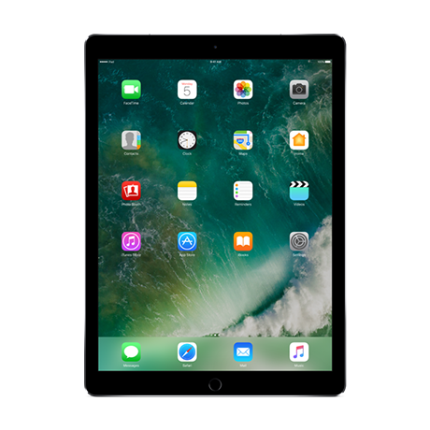
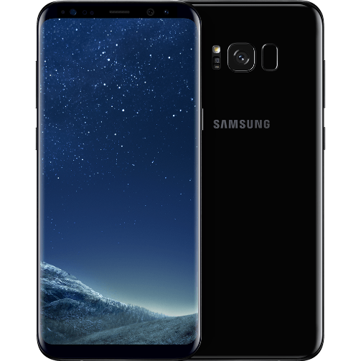
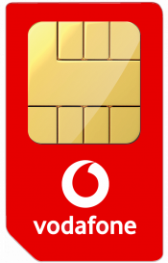
Maximising July Vodafone Comp Plan
Maximise the Comp Plan with this Package!
Total Data 41GB per month!
Total Cost $130.83 per month!
Total Discounts & Credits $847!
Refer A Friend $25
+
+
$40 Red plan + Samsung S8 = $63.25
6GB Data
$162 Loyalty Discount
36 Month term
$30 MBB plan + iPad = $31.58
10GB Data
$3 Additional Service discount
$504 Loyalty Discount
36 Month term
$40 12M Sim Plan = $36.00
25GB Data
Incl. 19GB Bonus Data
$4 Additional Service discount
Notes:
Now that we’ve run through the Bonus’s Available with Vodafone this month lets take a look at packing this up for Customers!
PLEASE NOTE – THIS IS AN EXAMPLE PACKAGE. It’s Valid on 03/07/18 but you will need to double check availability of offers before recommending to customers! The basic principles will still apply to your sign ups even if the offers are slightly different.
Step #1
So when bringing Across a Customer form Telstra or Optus, Take across their Handset service FIRST! SHOW them the $162 Loyalty discount available by selecting the Samsung S8 which will! Explain that they can leave anytime with NO-Lock in contract! Simple pay out any remaining device payments – easy.
Step #2
Then If they haven't got a Tablet already sell them in by asking ‘do you have a tablet?’ - Show them how accessible and cheap it is to now add a tablet over 36 Months! A Premium Grade Tablet like the New iPad is now just over $30 per month! Definitely a steal and will also come with a HUGE loyalty discount ($504 savings in our example). Plus if this service is added after the Handset service is activated, it will also be eligible for a 10% additional service discount offering your customers another $3 per month off fees ($108 over 36 months)!
Step #3
Now For The final Service wait until the first two services are activated, then add the Amazing Value $40 Plan (currently with 25GB of Data incl. 19GB Bonus). Because You have already signed up the first two services separately, The customer will be eligible for the Additional Service discount from Vodafone to save $4 per month off the Sim Only service!
Remember if the customer is new to Vodafone network THEY and YOU will be eligible for a once off $25 Refer A Friend Account Credit – you’ll need to follow the simple steps on the Website : https://www.vodafone.com.au/students.

Slide 4
Maximising July Vodafone Comp Plan
Maximise the Comp Plan with this Package!
Residuals earned from $110 worth of monthly Plan Fees!
IBO’s can earn 8 Points from a Single Customer & Earn $75 in Cash Bonus & Account Credits straight away!
Refer A Friend $25
+
+
Helps personal tally for EXCLUSIVE Vodafone High Performers Training!
$40 Red plan + Samsung S8
2 Points
36 Month Residual Base
Refer a Friend $25
$30 MBB plan + iPad
3 Points (incl. Bonus Point)
36 Month Residual Base
$25 Cash Bonus
$40 Sim Plan
3 Points (incl. Bonus Point)
12 Month Residual Base
$25 Cash Bonus
Notes:
So Customers have got a great deal! But as an IBO you’ll also get rewarded HANDSOMELY for signing up Vodafone services this Month
In our example package You’ll get a Refer a Friend Account credit of $25 on your personal Vodafone Account. (maximum of 10 customers can be claimed).
Plus you’ll get $25 for the Tablet Plan, and $25 for the Sim Plan as part of the Cash Bonus Promotion in July! That’s $75 straight away.
The Additional Service Bonus Points mean you’ll receive a total of 8 points Incl. 2 Bonus Points with this package
And remember – signing up these 3 services will help you gain a seat at the exclusive Vodafone High Performers Training session at the next International Event in Melbourne on 21/09/18. Money cant buy a place at this session and its usually only provided to Senior Executives at Vodafone Australia. PLUS there's a chance to win a Mystery Device!
Now – If you are a New IBO, 8 points will also help build up a significant portion of points and services needed to qualify! So simply signing yourself up, or one customer with 3 services can go a long way. If You are an existing IBO the Bonus Points & Cash Bonus is a great way to increase your billable revenue and to share with your teams to grow expand the number of services within your existing customer base!

Slide 5
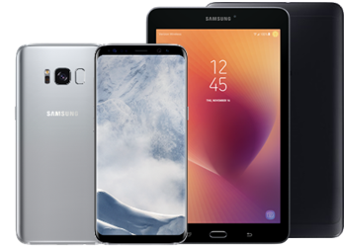
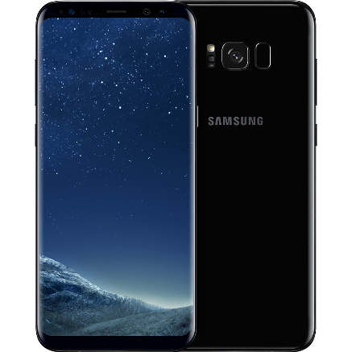

Key things to Remember!
Discounts
Handset sales
Tablet bundles
Maximise discounts
Up to 4 customer points
+
Higher plan fees
=
Better residuals and more points for faster qualification
Ask ‘Do you have a tablet?’
Opportunity to double your points & residuals for every mobile customer
Additional Service Bonus Point for July!
IBOs rewarded on undiscounted plan fee
Refer a Friend
Student discount
Loyalty discounts
Bonus data

