Slide 1
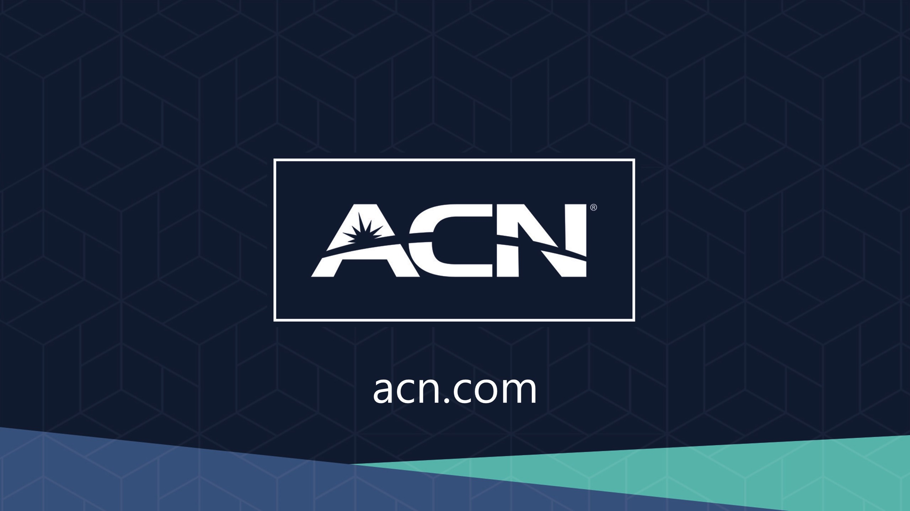
acn.com
Effective 1 August 2022

Slide 2
Refer to the ACN Compensation Plan for complete details. Earnings as an ACN IBO are based solely upon the successful sale of products to customers and their usage of those products. Individuals will incur expenses in operating their ACN business, such as the sign-up fee and monthly business support, as well as other possible operating expenses. As with any business, earnings and success at ACN are not guaranteed but depend primarily on the individual’s persistence, effort, and results of acquiring customers personally and/or through their team. Individuals will not earn income and will lose money as an IBO if customers are not acquired.

Slide 3
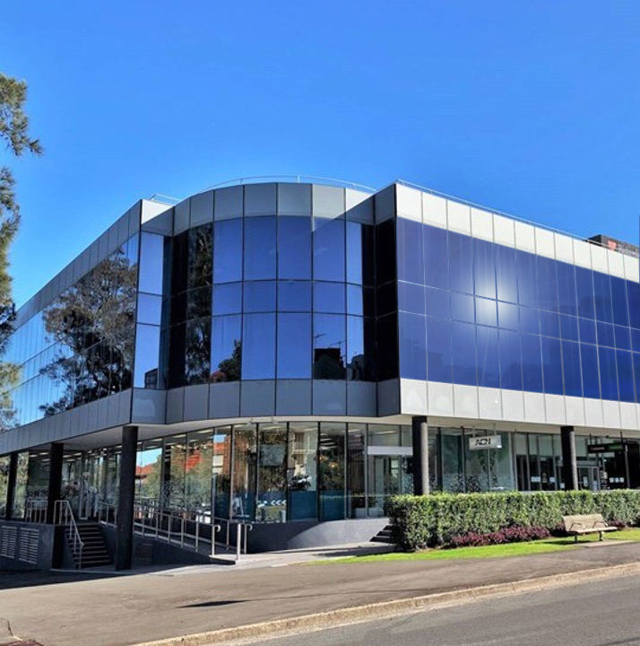




1
Company
AUSTRALIA’S LARGEST
Direct Seller of Telecommunications, Energy & Other Essential Services
Looking To The Future
Service Provider
Specialising in Customer
Acquisition
Australian Owned & Operated
Celebrating 20
Years in
Australia &
A Global Legacy
Over 1 million services sold in Australia & New Zealand and counting…

Slide 4

2
Essential Residential & Business Services
Travel & Lifestyle Membership

Slide 5










3
Our Business Model
Most Service Providers
Media & Digital Marketing
YOU
CUSTOMERS

Slide 6





4
Become an Independent Business Owner (IBO)
One off payment
of $287.50
+ $23/month Business Support Fee
Personalised Website
Complete Customer Support
Complete Business
Tracking & Reporting
Compass Online &
Marketing Tools

Slide 7
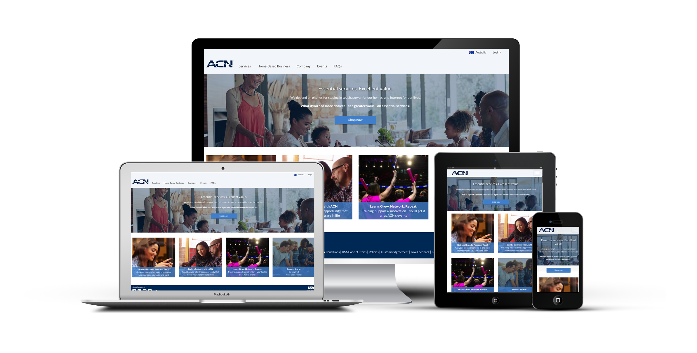

5
You Get Your Own Online Business!

Slide 8

5
Monthly Personal Customer Bonuses
Acquire Customers totaling:
3 Services = $75
5 Services = $150
Plus $100 for every
additional 3 Services
8 Services = $250
11 Services = $350
*Refer to the ACN Promotional Bonuses for complete details.
Notes:
New IBO earns $100 for every 10 Customer Points AND $100 for becoming CQ
Existing IBOs earn $200 for every 15 Customer Points*
*points for selected services

Slide 9
6
Personal Residual Income
Your Customers
3% to 20%
Monthly Commissionable Revenue*
*Refer to the ACN Compensation Plan for complete details.

Slide 10

7
Overriding Customer Acquisition Bonuses (CABs)
Your TEAM’s Customers
Opportunity to earn bonuses that are paid weekly when you and your TEAM acquires customers.*
$50 - $300
*Refer to the ACN Compensation Plan for complete details.

Slide 11
8
Overriding Residual Income
Your TEAM’s Customers
3%
Monthly Commissionable Revenue*
*Refer to the ACN Compensation Plan for complete details.

Slide 12
9
IBO Earned Positions
CQ
ETL
RD
RVP
SVP
SVP
Increased Customer Acquisition Bonuses (CABs)
Increased Residual
Reaching higher earned positions is based on the number of personal and team customers
Incentive Trips
*Refer to the ACN Compensation Plan for Complete Details

Slide 13

10
Next Steps
1
Enrol as an IBO
2
Utilise the ACN support system
3
Participate in training
4
Start acquiring customers
In Business for Yourself, but NEVER By Yourself!

