Slide 1
Welcome MATE!
Gerard Frack
Managing Director, ACN Pacific

Slide 2
Huge Opportunity for nbn™ Sales
nbn™ is now a ‘switching market’ with 10+ million homes now serviceable and many customers out of contract or on month-to-month plans
Almost all customers have gone through the pain of connecting to nbn™ for the first time
MATE have best-in-class process for switching customers and some of the most competitive pricing available
Customers switching nbn™ providers with compatible modems can be up and running in as fast as 24 hours from placing their order – and with an almost seamless transition!
Notes:
Almost all homes are now serviceable for NBN – final rollout to last customers to be finished within next 6 months!

Slide 3





MATE – Our recommended partner for best customer experience
/
4.4
5
July 2020
4.4 stars out of 5 from 1,882 reviews!
Notes:
WhistleOut have nominated MATE as best Premium NBN Speed provider for two months straight!
Comparisons: TPG - 1.7. Telstra – 1.7, Optus – 1.6, Vodafone – 2.6, iiNet – 3.0
MATE is the official winner of the 2019 Service Champion – Customer Service Team of the Year (Large) at the Australian Service Excellence Awards. Nominated again in 2020!
Australia’s premier customer service awards event, with attendees coming together each year to recognise best practice and innovation in customer service, and the and important role customer service plays in today’s business climate.

Slide 4
Product Training
Anthony Panto-Blake
Head of Product ACN Pacific

Slide 5
Launch timeframes
Accreditation requirements
Do’s & don'ts for MATE
Social media guidelines
Customer journey
Compensation & point allocation
Contact & support
ACN service shutdown and migration
Agenda

Slide 6

Launch timeline
Existing ACN Broadband & Phone Migration
July - 24 August
Customer Launch
Before September 1
IBO Soft Launch
Friday 7th August
Existing ACN Branded Products will begin purging from end of September in normal purge cycle
Purging to continue gradually over a number of months – Independent Business Owners have sufficient time to replace points

Slide 7
New MATE Service Sign-Up
Before September 1 – Phase 2 Full Launch
Sign-up of customers & IBOs
Customers allocated to IBOs in PCL
Sign-up via Personal IBO Website available
Missing Customer Claims process
7 August – Phase 1 Soft Launch
Sign-up of IBOs own services recommended
Sign-up page link provided Friday 7 August
Email notifications
Points will appear in PCL upon full launch
Feedback: IBO Survey & matesupport@acnpacific.com.au
IMPORTANT TO NOTE: Sign ups during Phase 1 won’t count towards qualification or bonuses, and for IBO remuneration purposes, all orders placed during Phase 1 will have their original order date calculated from the first day of the full launch.
Notes:
Phase 1 Soft Launch – We’re initially launching and allowing IBOs to place orders from 7 August. We will be using this initial trial period to get feedback from IBOs and customers to improve the experience and iron out any issues. During this period orders will need to be placed via a specific URL page, and your IBO ID manually entered. MATE services won’t appear in your Personal IBO Website during this initial period.
It is really important to understand that during this initial period, CUSTOMERS WON’T APPEAR IN YOUR PERSONAL CUSTOMER LIST. We will be notifying IBOs with email notifications when customers submit an order, and if for any reason they leave MATE during the trial period. We recommend that IBOs sign-up their own services during this period. Whilst we won’t stop customer sign-ups being processed, we recommend customer orders are placed during Full Launch period to ensure they receive the best possible experience.
All customer sign ups during Phase 1 Soft Launch will be allocated once we have progressed to the Full Launch period.
IMPORTANT TO NOTE: Customer sign ups during Phase 1 Soft Launch won’t count towards qualification or bonuses, and for IBO remuneration purposes all orders placed during phase 1 will have their original order date calculated from the first day of the Full Launch.
We highly encourage all IBOs to provide feedback on customer experience, or if they experience any issues, or have feedback on ways for ACN or MATE to improve by emailing our dedicated launch support team at matesupport@acnpacific.com.au during this initial period to ACN.

Slide 8




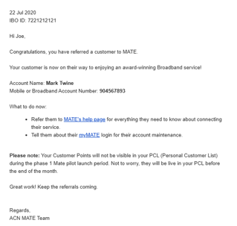
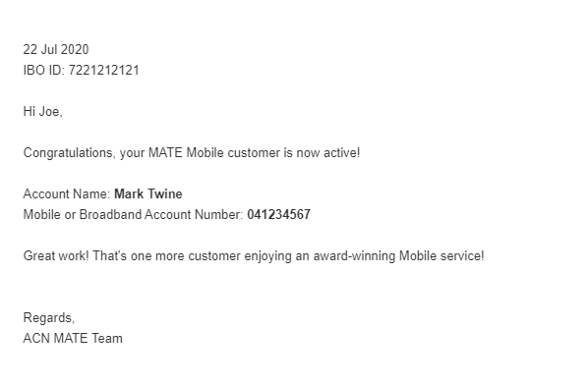
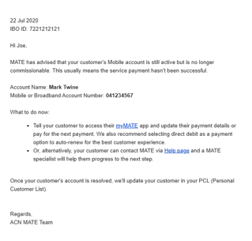
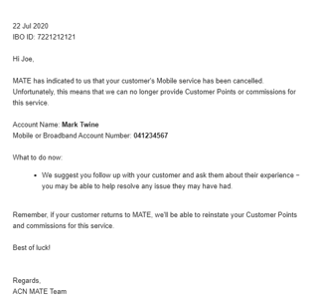
Phase 1 Soft Launch Email Notifications
Order Received & Activated
Order Issue or Disconnection

Slide 9
ACN IBOs must complete these Accreditations before referring customers:
Customer Acquisition Code and Quiz
(approx. 20 mins)
MATE Accreditation Training and Quiz
(approx. 15 mins)
Notes:
Until IBO completes both CAC & accreditation for MATE, their storefront will be blocked from MATE sign up journey. The same experience customers currently receive if they’ve not completed energy accreditation. An email will be sent to the IBO to let them know a customer has attempted to sign up and couldn't due to non-accreditation.
All IBOs must complete the AU CAC (Customer Acquisition Code) Training, along with the MATE Accreditation Training modules. IBOs must successfully complete a short quiz answering 10 questions with a 100% pass rate before referring customers to MATE If you don’t pass the quiz first time, you can re-sit as many times as you need.
IBOs must sit AU CAC (Customer Acquisition Code) Training along with MATE Accreditation Training every 12 months and/or upon annual renewal if they wish to continue referring customers to MATE.
There is a wealth of important information in the accreditation training, and we recommend all IBOs take their time in a calm environment to complete the training to fully understand the customer sign up process, correct IBO and customer behaviour, as well as our obligations to our warm network in referring them to MATE.

Slide 10
Only sell to your warm market
✓
✗
No cold marketing
DO’S
DON’TS
Only customers are to submit application
Only use the ACN MATE sign-up journey
✓
✓
Never submit orders on behalf of customers
Do not
collect or retain personal customer info
Customers must sign up themselves
✗
✗
✓

Slide 11
IBOs should not hold personal information
Personal Information is defined as “any information that can identify an individual”.
Examples include but are not limited to:
  Name
  Address
  Date of birth
  A photo of their ID

Slide 12
Social Media Guidelines
4 Golden Rules of Social Media:
Only use marketing materials provided by ACN
Do not create your own materials
Resources
Shareable social tiles
Re-share materials posted by the official ACN Pacific Facebook page, including T&Cs
Refer to the Social Media User Guide for detailed do’s and don’ts of promoting MATE
Do not modify the imagery or language provided by ACN
Only promote the MATE brand, products and promotions to your warm market
IMPORTANT
Breaking the rules can lead to sanctions, including claw back of commissions earned and/or termination of an IBO’s position
Do not use call to action with a sales implication, such as ‘order now’, ‘sale’ etc.

Slide 13




Typical Broadband Customer Sign up Journey
Online sign up
Confirmation Email & SMS
BYO modem setup
Broadband service activated
Day 1
Day 2-19
Day 2-19
Once modem set up is complete, customer is up and running.
Entire process can be complete in as little as 1-3 business days.
5-minute sign up process
Email and SMS includes MATE Code
MATE will assist with modem settings or plug and play instantly if you purchase the MATE modem

Slide 14


Typical Landline Phone Number Porting
Online sign up
Confirmation Email & SMS
MATE Request Number transfer from old provider
Number Port Completed
Day 1
Day 4
Day 4-14
5-minute sign up process
Email and SMS includes MATE Code
Number port request is actioned by MATE
Number port can take 1-6 weeks, with average ports taking less than 2 weeks

Slide 15
Keeping Landline Phone Numbers
Generally, if the customer’s landline number is ACTIVE with another provider, MATE will be able to transfer (port) this number.
Please note number transfer process only commences once your nbn™ internet service has been activated with MATE.
Exceptions:
  Customers moving from ADSL to nbn™ FTTC – for technical reasons customers usually cannot keep their existing number (Contact MATE Support for more details as there are some solutions with cost to customer)
  ADSL customers moving to MATE from Optus ADSL or TPG won’t be able to retain their existing number

Slide 16




Mobile Customer Sign Up Journey
Online sign up
Confirmation Email & SMS
SIM card shipped
SIM card arrives
Complete porting
Activate SIM card
Day 1
Day 2
Day 3-10
5-minute sign up process
Email and SMS includes MATE Code
SIM typically arrives within 2-5 business days
Online process, typically ported within a few hours
SIM card active and ready

Slide 17
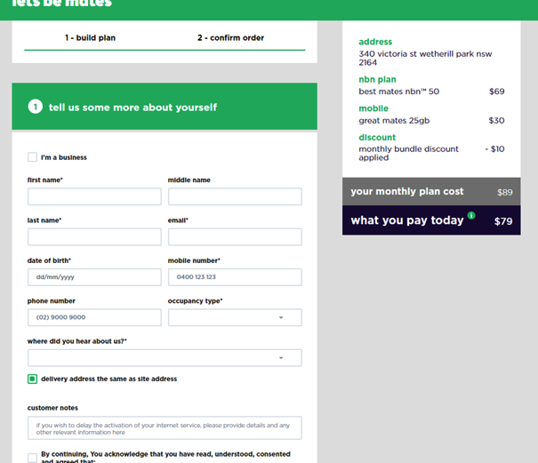
Common Application Issues
Incorrect credit card details or expired credit card
Unsuccessful payment due to insufficient funds on the credit/debit card
Incorrect porting details
Incorrect email supplied
Incorrect mobile/home phone number
Inactive number to port to MATE

Slide 18
MATE Compensation Plan
Please note: IBOs cannot sign up existing MATE services.
NEW - Mate Mobile (Post-paid)
Service Type | Order Type | Plan Contract Term | Plan Fee | Points | Monthly Commissionable Revenue | Duration of Points and Commission
Plan 20 | Post-paid | 36 Months | $20 | 1 | 50% of monthly plan fee | Up to 36 months
Plan 25 | Post-paid | 36 Months | $25 | 1 | 50% of monthly plan fee | Up to 36 months
Plan 30 | Post-paid | 36 Months | $30 | 1 | 50% of monthly plan fee | Up to 36 months
Plan 35 | Post-paid | 36 Months | $35 | 1 | 50% of monthly plan fee | Up to 36 months
Plan 40 | Post-paid | 36 Months | $40 | 2 | 50% of monthly plan fee | Up to 36 months
Mate Broadband
Plan |  | Plan Contract Term |  | Points | Monthly Commissionable Revenue | Duration of Points and Commission
All plans |  | 36 Months |  | 2 | $18.18 (ex GST) | Customer tenure up to 36 months
Ported numbers: Points count immediately following activation. New numbers: Points will count immediately following activation, and will be eligible for CQ position qualification, but will not be eligible for customer bonuses. ACN switched services: Points count following 45 days of service.

Slide 19
Points in PCL
When will customers appear in my Personal Customer List?
Once a MATE customer submits their application and the order is approved on payment
Points load into your PCL within 24-48 hours
PCLs updated twice daily
MUST complete Accreditation, otherwise the order will be marked ‘Incomplete’
Any issues contact IBO support (after 5 business days)
Customer places order
Order approved by MATE
Loaded into PCL without Points
Points loaded in PCL as ‘Incomplete’ status within 24-48 hours

Slide 20
ACN Rules
Customers must place an order themselves – an IBO cannot order on a customer’s behalf
Warm network referrals only
Never collect personal information
Always ensure your customer double checks their contact details and porting (for Mobile) or CHURN/transfer (for Broadband) details during sign up

Slide 21
MATE Support
For customer enquiries
ACN@letsbemates.com.au
For IBO enquiries (i.e. points, residuals, bonuses, etc.)
IBO Support Team via www.acnpacific.com/contact-2/
For feedback :
matesupport@acnpacific.com.au
Missing Claims:
Enter into webform on Compass
For other training, marketing and support resources:
ACN Pacific Compass

Slide 22
ACN Broadband and Phone Migration
Anthony Panto-Blake
Head of Product, ACN Pacific

Slide 23
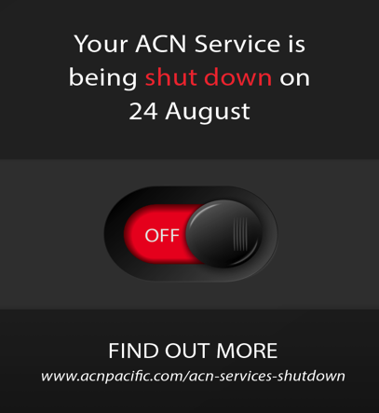
The Migration Campaign:
Touchpoints
ACN Services disconnection reminders and call to switch:
Emails
Bill message
MyAccount message
SMS
Outbound calls
Direct mail

Slide 24
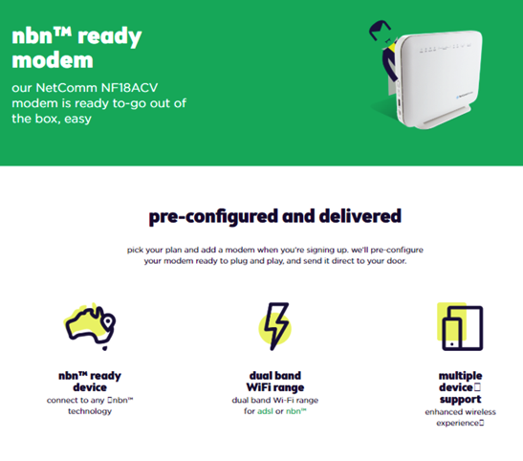
MATE Modem Compatibility
MATE has advised that ACN-supplied modems that were supplied to customers signing up to an ACN nbn™ service are compatible!
ACN ADSL Customers may be able to use their ACN-supplied modem that was used to connect their service, although, MATE cannot guarantee that this modem will work with their specific nbn™ technology.
Customers can also use a modem not supplied by ACN, provided it is not locked to the provider it was purchased from
Customers can also purchase a pre-configured, premium quality AC Wi-FI, nbn™-ready modem from MATE for $165 when you switch to MATE.
Notes:
Most MATE customer switch and use their own modem, MATE team are experts at helping to setup your existing modems. Alternatively their premium modem is AC Wi-Fi dual band.

Slide 25
Landline Phone Number Porting
ACN will look to keep VoIP (phone services) active even after broadband has been cancelled, to allow these phone services to work on the MATE Broadband service until the phone number transition to mate has completed
Online sign up
Confirmation Email & SMS
MATE Request Number transfer from Old Provider
Number Port Completed
Day 1
Day 4
Day 4-14
5-minute sign up process
Email and SMS includes MATE Code
Number port request is actioned by MATE
Number port is usually completed within 2 weeks

Slide 26
MATE Support
For customer enquiries
support@letsbemates.com.au
For IBO enquiries (i.e. points, residuals, bonuses, etc.)
IBO Support Team via www.acnpacific.com/contact
For feedback :
matesupport@acnpacific.com.au
Missing Claims:
Enter into webform on Compass
For other training, marketing and support resources:
ACN Pacific Compass

