Slide 1
Opportunity Overview
Effective March 2025

Slide 2
Refer to the Conxxion Compensation Plan for complete details. Earnings as a Conxxion IBO are based solely upon the successful sale of products to customers and their usage of those products. Individuals will incur expenses in operating their Conxxion business, such as the sign-up fee and monthly business support, as well as other possible operating expenses. As with any business, earnings and success at Conxxion are not guaranteed but depend primarily on the individual’s persistence, effort, and results of acquiring customers personally and/or through their team. Individuals will not earn income and will lose money as an IBO if customers are not acquired.

Slide 3
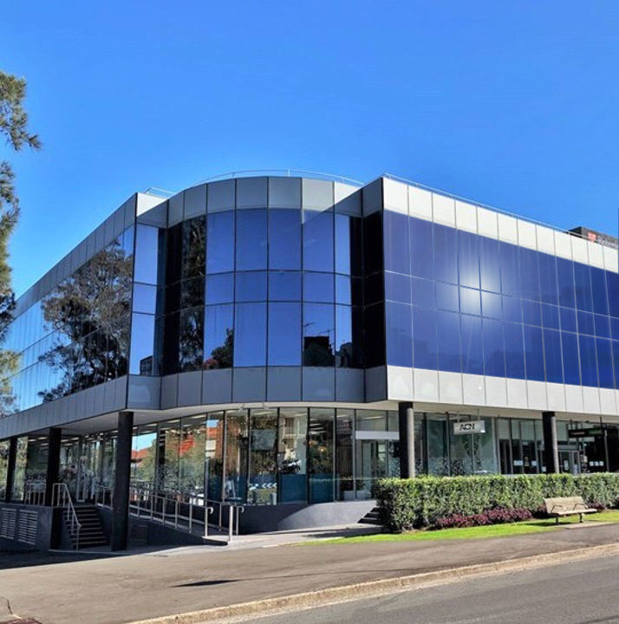




1
Company
AUSTRALIA’S LARGEST
Direct Seller of Telecommunications, Energy & Other Essential Services
Looking to the Future
Service Provider
Specialising in Customer
Acquisition
Australian Owned & Operated
Celebrating
20 Years in Australia
Over 1 million services sold in Australia & New Zealand and counting…

Slide 4













Essential Residential & Business Services
2
Mobile
Broadband
Energy
Home
Insurance
Payment
Processing
Phone
OR
=
1 new service signed up
1 new IBO joins your business
Conxxion donates one meal to Foodbank

Slide 5





Our Business Model
3
Most Service Providers
Media & Digital Marketing
YOU
Customers

Slide 6




Become an Independent Business Owner (IBO)
4
One off payment
of $329
+ $22/month Business Support Fee
Personalised Website
Complete Customer Support
Complete Business
Tracking & Reporting
Compass Online &
Marketing Tools

Slide 7
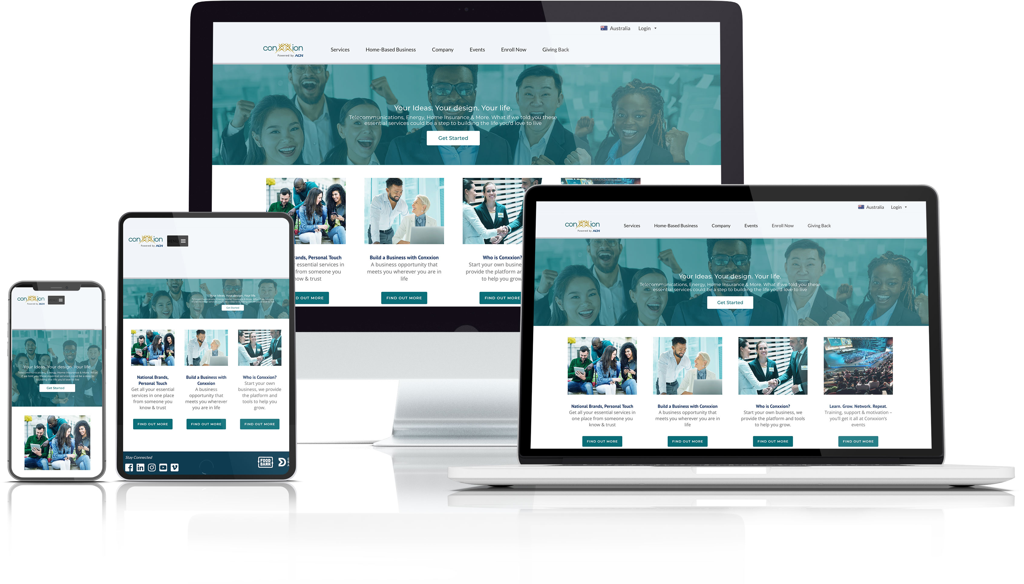
You Get Your Own Online Business!

Slide 8


Monthly Personal Customer Bonuses
5
Acquire Customers totaling:
3 Services* = $75
6 Services = $150
9 Services = $225
YOU
Plus $75 for every additional
3 Services
Refer to the Compensation Plan for point requirements and complete details.

Slide 9
Personal Residual Income
6
Your Customers
3% to 20%
Monthly Commissionable Revenue*
YOU
Refer to the Compensation Plan for point requirements and complete details.

Slide 10
Team Customer Acquisition Bonuses (CABs)
7
Your TEAM’s Customers
$50 - $350
Opportunity to earn bonuses that are paid weekly when you and your TEAM acquires customers.*
YOU
Refer to the Compensation Plan for point requirements and complete details.

Slide 11
Team Residual Income
8
Your TEAM’s Customers
Up to 3%
Monthly Commissionable Revenue*
YOU
Refer to the Compensation Plan for point requirements and complete details.

Slide 12
IBO Earned Positions
9
SVP
^{CQ}
^{ETL}
^{RC}
^{RD}
^{RVP}
^{SVP}
Increased Team Customer Acquisition Bonuses (CABs)
Increased Residual
Reaching higher earned positions is based on the number of personal and team customers*
Incentive Trips
Refer to the Compensation Plan for point requirements and complete details.

Slide 13

Next Steps
10
1
Enrol as an IBO
2
Utilise the Conxxion support system
3
Participate in training
4
Start acquiring customers
In Business for Yourself, but NEVER By Yourself!

