Slide 1
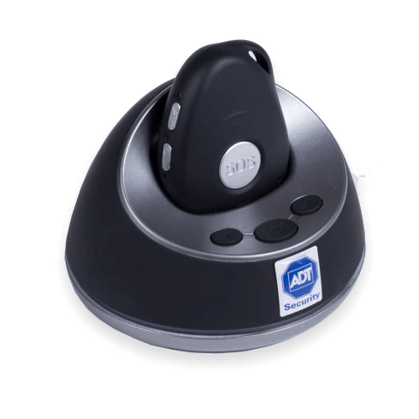
ADT Security Home Assist Product Range

Slide 2

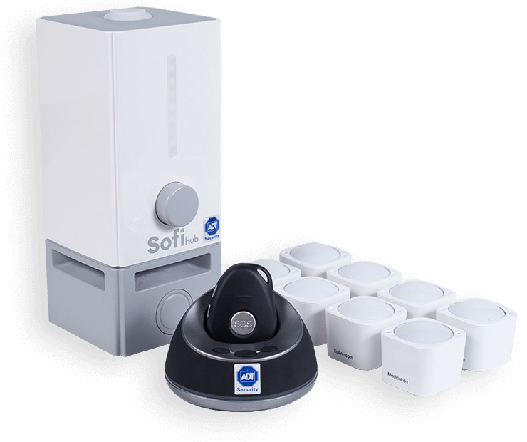
Home Security - Home Assist
1
Beacon & 8 Sensor Pack
Professional Monitoring | Self Monitoring
$406.31 Set Up $87.92 p/m 48 months | $305.65 Set Up $71.41 p/m 48 months
Wellness insights & daily activity monitor
Intelligent messaging system for reminders, birthdays and medication
Dashboard for easy monitoring
Convenient drop-in charging station
8 long-range sensors to cover the home
NEW: 100% online purchasing journey

Slide 3
Home Security - Home Assist
2
Beacon
Professional Monitoring | Self Monitoring
$125.90 Set Up $35.19 p/m 48 months | $77.40 Set Up $24.84 p/m 48 months
Wellness insights & daily activity monitor
Intelligent messaging system for reminders, birthdays and medication
Dashboard for easy monitoring
Convenient drop-in charging station
NEW: 100% online purchasing journey

Slide 4
Customer Journey – Home Assist
Self Monitoring
Order placed online through ACN Channel
Customer self-installs product
Payment received by ADT Security
Home Assist product Shipped
Home Assist Self Monitoring live
Order processed within 24 hrs
Hardware received within 3 business days
Dispatched within 24 hrs
Professional Monitoring (ADT Security)
Order placed online through ACN channel
ADT Security installs product
Payment received by ADT Security
Home Assist product shipped
Home Assist Professional Monitoring live
Order processed within 24 hrs
Hardware received within 3 business days
Dispatched within 24 hrs

Slide 5
Compensation Plan
Plan | Customer Points | Monthly Commissionable Revenue | Duration of Points and Commission
Home Assist | 2 | 50% of $30 | Customer tenure up to contract term (48 months)

