Slide 1
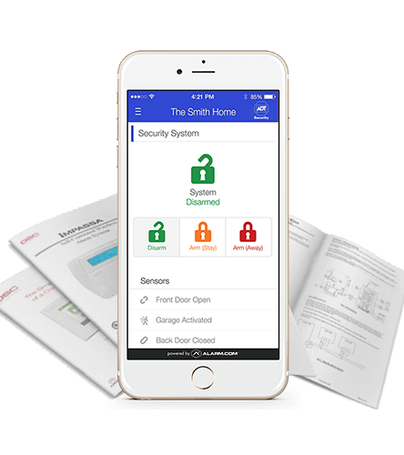
New Zealand

Slide 2

ADT Security New Zealand
Expertise
Subsidiary of Johnson Controls, 145 years of experience
Only global monitoring provider operating in New Zealand
Fast response 24/7 x 365 from highly trained NZ-based staff
Backup and overflow monitoring facilities in Australia
Partnership
Existing and established partnership with ADT in Australia
Existing range of Australian security products to be launched in NZ market
Additional product suite available in NZ market (health and lifestyle monitoring)
Footprint
Full nationwide coverage servicing both North and South Islands
Licensed installers and technicians servicing metro and regional areas

Slide 3
Accreditation
New Zealand
Customer Acquisition Code
Making representations
ACN IBOs are not authorised ADT sales agents
ACN IBOs can only refer customers to ADT
Only ADT licensed agents may provide quote information to customers and comment on government subsidies
Notes:
Important: ACN does not accredit IBOs as authorised ADT resellers or licensed security experts. ACN partnership with ADT Security is a lead referral model. Under no circumstances should an IBO assess or attempt to assess a customer’s security, automation, monitoring or health and wellness requirements.

Slide 4

Coverage
ADT Security services all regions of New Zealand
Appointments for regional areas may take longer than metro areas
Available to homeowners, renters and small businesses

Slide 5
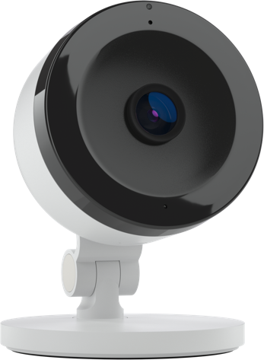
ADT Security Product Range Lead Form

Slide 6

Lead Referral Process
Remember:
Multiple products can be selected at lead submission
Contact details must be customers’ own
Customer to select their preferred contact time (hourly windows)
ADT Security will attempt contact over 5 business days
If a customer cannot be reached, ADT Security will:
Leave voicemail with call-back details
Send SMS with call-back details
Send email with call-back details

Slide 7
Security Products – Home & Business
Home Security
Interactive Security
Interactive Security with Camera
CCTV

Slide 8

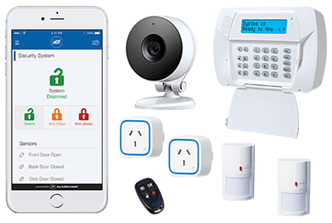
Standard Security System
$299 installed + $36.50/month
30-month minimum term
Package features:
Wireless controls
Motion detection
Entry point detection
Remote key fob
24/7 x 365 monitoring from NZ-based monitoring centre
Notes:
RES Only Package
Package includes:
Impassa wireless security control panel
Cellular communication module
2x Wireless passive infrared sensors (PIR)
1x door reed
1x 4-button key fob

Slide 9

Interactive Security System
$399 installed + $44.95/month
30-month minimum term
Package features:
Wireless controls
Motion detection
Entry point detection
Remote key fob
24/7 x 365 monitoring from NZ-based monitoring centre
Smart switches to remotely control lights and appliances
ADT Interactive Smartphone app
Notes:
Package includes:
1x NEO LCD control panel
Cellular communication module
2x Wireless passive infrared sensors (PIR)
1x door reed
1x 4-button key fob
2x smart switches
1x range extender

Slide 10

Interactive Security System with Camera
$499 installed + $54.95/month
30-month minimum term
Package features:
Wireless controls
Motion detection
Entry point detection
Remote key fob
24/7 x 365 monitoring from NZ-based monitoring centre
Smart switches to remotely control lights and appliances
ADT Interactive Smartphone app
Wireless Camera
Notes:
Package includes:
1x NEO LCD control panel
Cellular communication module
2x Wireless passive infrared sensors (PIR)
1x door reed
1x 4-button key fob
2x smart switches
1x range extender
1x indoor wireless camera

Slide 11
Customer Journey - Home & Business
Scenario 1: Sale completed over the phone
Lead submission
Customer accepts over the phone
Service activated
ADT Security contacts lead
ADT Security books installation
ADT Security technician completes installation
Call placed within 24 hrs
Site visit within 10 business days
Scenario 2: Sale completed after ADT site appointment
Lead submission
Customer books on-site consultation
Service activated
ADT Security contacts lead
Customer signs agreement on-site
ADT Security technician completes installation
ADT Security books installation
Call placed within 24 hrs
Install within 10 business days
Consultation within 5 business days
Notes:
Security
Lead
ADT Calls customer within 24 hours
Customer accepts over the phone
ADT dispatches and book an install date with the customer
ADT installs
Billing starts
(From sale to billing average time frame 10 business days)
Or
Lead
ADT Calls customer within 24 hours
Customer requests a visit from sales representative
ADT books an appointment with customer
Customer accepts sale during appointment
ADT loads agreement and book an install date with customer
ADT installs
Billing starts
(From sale to billing average time frame 10 business days)

Slide 12

CCTV
Package includes:
4x cameras
1x LCD display unit
1x HDMI cable
1x UPS (Uninterruptible Power Supply)
$0 install fee + $103.44/month
48-month rent-to-own term

Slide 13
Customer Journey – CCTV
Sale completed after ADT site appointment
Lead submission
Site appointment booked
Installation completed
ADT Security contacts lead (24 hrs)
Customer accepts sale on site
ADT Security loads agreement & books installation
Service activated
Call placed within 24 hrs
Site appointment within 5 business days
Installation appointment within 5 business days
Notes:
CCTV
Lead
ADT Calls customer within 24 hours and book an appointment
Customer accepts sale during appointment
ADT loads agreement and book an install date with customer
ADT installs
Billing starts
(From sale to billing average time frame 10 business days)

Slide 14
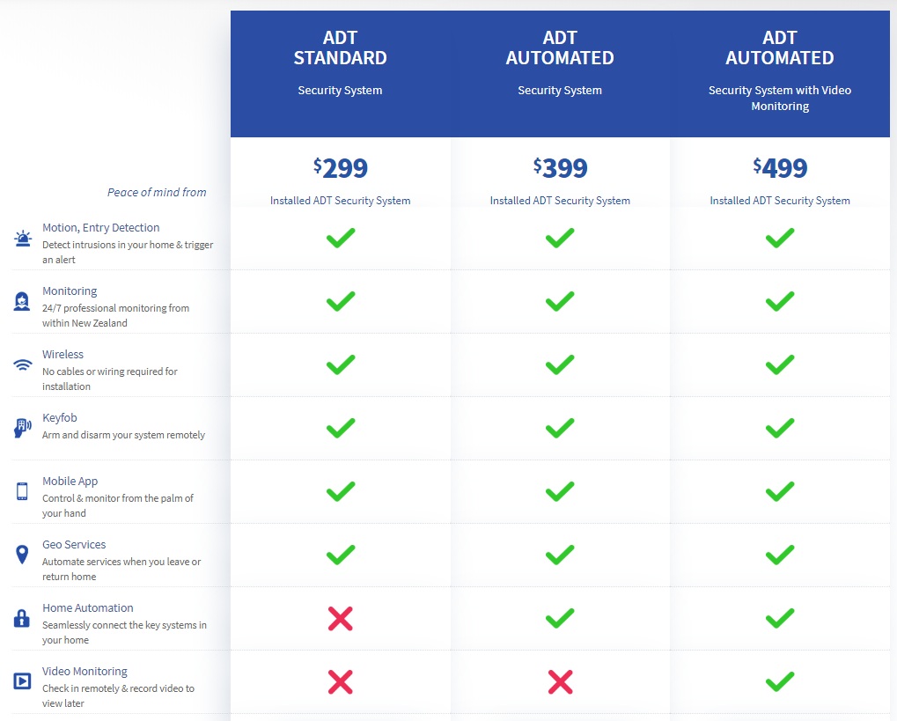
ACN-Exclusive Pricing
ACN packages can save your customers money when compared to ordering directly with ADT Security
Example:
Up to $8.45 per month saving
Up to $250 saving over 30-month term
Exclusive pricing on monitored security products
Notes:
ADT Standard
Direct: $1,647.50 over 30 months
ACN: $1,394.00 over 30 months (-$253.50)

Slide 15
ACN-Exclusive Pricing
ACN packages can save your customers money when compared to ordering directly with ADT Security
 | ADT Security Standard | ADT Security Interactive | ADT Security Interactive + camera
Installation cost | $299 | $399 | $499
ADT Security RRP | $44.95 | $44.95 | $54.95
Minimum term | 30 months | 36 months | 36 months
ACN price | $36.50 | $44.95 | $54.95
ACN minimum term | 30 months | 30 months | 30 months
ADT direct total min cost | $1,647.50 | $2,017.20 | $2,477.20
ACN-referred total min cost | $1,394.00 | $1,747.50 | $2,147.50
ACN benefit over term | $253.50 | $269.70 | $329.70
Notes:
Example
ADT Standard
Direct: $1,647.50 over 30 months
ACN: $1,394.00 over 30 months (-$253.50)

Slide 16



Security Products – Personal & Medical
Neva Alone
Emergency Call Unit
FindU App

Slide 17
Medical Monitoring Products
In 2024, 20% of NZ
will be living alone
33% of New Zealanders over 65 will fall in a given year
60% of New Zealanders
aged over 75 live alone
Notes:
Did you know?
▪One in three New Zealanders over 65 will fall in a given year.
▪In the over 65 population, a fall is 10 times more likely than a home burglary and 2,000 times more likely than a fire.
▪Falls are the leading cause of accidental death.
▪50% of people who fall require assistance to get up.
▪60% of over 75’s live alone.
▪In 2024 20% of NZ will be living alone -that is 897,000 New Zealanders.
▪People are living longer and want to stay out of nursing facilities. Every day thousands of people turn 65. Those who make it to that milestone are likely to live an additional 17 to 19 years. Many of those are relatively healthy but need some assistance to maintain independence.

Slide 18

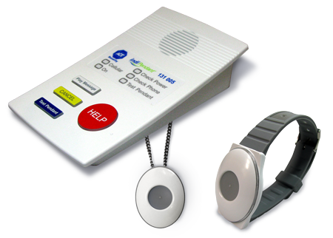
NevaAlone Private Medical Alarm
Package features:
Emergency assistance 24/7 x 365 from ADT Security’s highly-trained NZ-based support team
Long-range, water-resistant pendant operates up to 250m from the base station
40hr battery backup in case of power outages
Assistance at the push of a button
$0 install fee + $73.45/month Month-to-month agreement
Notes:
Package includes:
1x base unit
1x wireless pendant
Ambulance call-outs
ADT Patrol call-outs

Slide 19

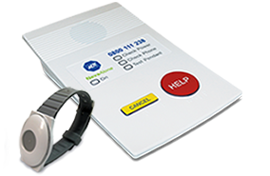
Emergency Call Unit
$0 install fee + $30.00/month
24-month minimum term
Package features:
Emergency assistance 24/7 x 365 from ADT Security’s highly-trained NZ-based support team
Long-range, water-resistant pendant operates up to 250m from the base station
40hr battery backup in case of power outages
Assistance at the push of a button
Lower-cost solution for customers unable to secure a government subsidy
Notes:
Package includes:
1x base unit
1x wireless pendant
1x Patrol call-out per calendar year
Option to add Ambulance plan for $11.95 per month.
Ambulance plan includes 2x ambulance call-outs per calendar year.

Slide 20


Customer Journey – Medical
Sale completed after ADT Security site appointment
Lead submission
Site appointment booked
Service activated
ADT Security contacts lead (24 hrs)
Customer accepts sale on site
ADT Security technician completes installation
Call placed within 24 hrs
Installation within 5 business days*
*If government subsidised, installation is within 10 business days
Notes:
Medical (NevaAlone Private or ECU)
Lead
Authorised Representative calls customer within 24 hours
Authorised Representative books an appointment with customer
Customer accepts sale during appointment
Equipment installed
ADT loads agreement
Billing starts
(From sale to billing average time frame 5 business days, if govt funding then about 2 weeks)

Slide 21

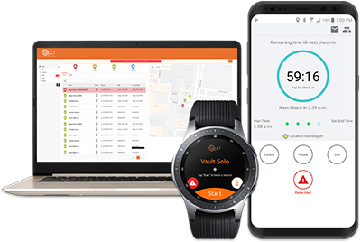
Personal Security
ADT FindU mobile app - For both Business and Residential use
Unique to ADT
Turns your smartphone into a personal security device
Includes “Journey”, “Meeting” and “Man Down” features
$26.80 p/m for 12 months
$22.40 p/m for 24 months
Notes:
Features
- Journey: track you from A to B
Meeting: arrange a safety check-in at a certain time
Man down: notify emergency response centre and nominated contacts if you fall or stop moving

Slide 22
ADT FindU - Usage
Step 1:
Activate the ADT FindU app before you begin a task, or enter a high risk area. ADT FindU will run even when the device is screen locked.
Step 2:
In the event of an emergency, either swipe or shake the device until the alarm is activated. Continue to shake to sound an alarm, and activate strobe light.
Step 3:
An alert has been activated. ADT has been notified and the emergency recording features have been activated.
Step 4:
The ADT monitoring operator receives the emergency alert (GPS location and alarm type), then follows agreed procedures.

Slide 23

Customer Journey – Personal
Sale completed over the phone
Lead submission
Customer accepts over the phone
Customer installs app via SMS URL
ADT Security contacts lead (24 hrs)
ADT Security loads agreement & activates
Service activated
Call placed within 24 hrs
Service activation within 24 hrs
Notes:
FIND U
Lead
ADT Calls customer within 24 hours
Customer accepts sale online
ADT loads agreement and activate account
Customer installs app via txt link
Billing starts
(From sale to billing average time frame 48 hours)

Slide 24
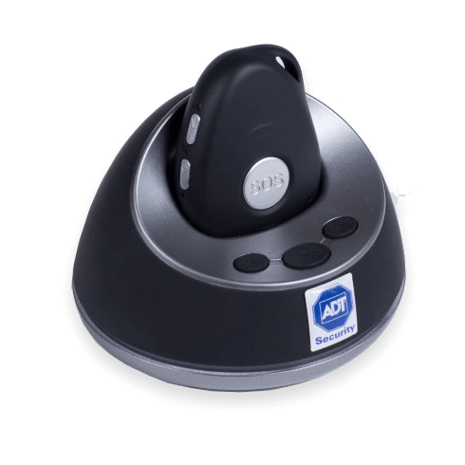
ADT Security Product Range Online Purchase

Slide 25

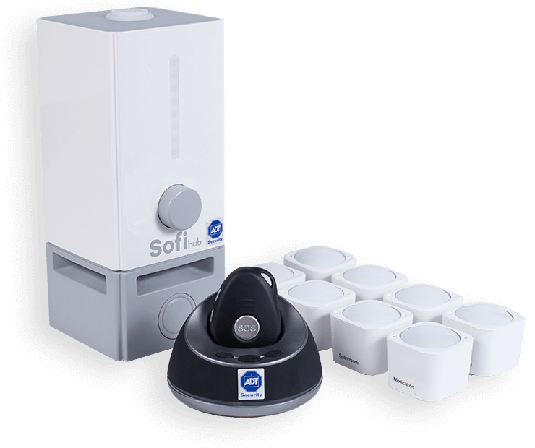
Home Security - Home Assist
1
Beacon & 8 Sensor Pack
Professional Monitoring | Self Monitoring
$406.31 Set Up $87.92 p/m 48 months | $305.65 Set Up $71.41 p/m 48 months
Wellness insights & daily activity monitor
Intelligent messaging system for reminders, birthdays and medication
Dashboard for easy monitoring
Convenient drop-in charging station
8 long-range sensors to cover the home
NEW: 100% online purchasing journey

Slide 26
Home Security - Home Assist
2
Beacon
Professional Monitoring | Self Monitoring
$125.90 Set Up $35.19 p/m 48 months | $77.40 Set Up $24.84 p/m 48 months
Wellness insights & daily activity monitor
Intelligent messaging system for reminders, birthdays and medication
Dashboard for easy monitoring
Convenient drop-in charging station
NEW: 100% online purchasing journey

Slide 27

Customer Journey – Home Assist
Self Monitoring
Order placed online through ACN channel
Customer self-installs product
Payment received by ADT Security
Home Assist product shipped
Home Assist Self Monitoring live
Order processed within 24 hrs
Hardware received within 3 business days
Dispatched within 24 hrs
Professional Monitoring (ADT Security)
Order placed online through ACN channel
ADT Security installs product
Payment received by ADT Security
Home Assist product shipped
Home Assist Professional Monitoring live
Order processed within 24 hrs
Hardware received within 3 business days
Dispatched within 24 hrs

Slide 28
ADT Security New Zealand Compensation Plan

Slide 29
Compensation Plan
Plan | Customer Points | Monthly Commissionable Revenue | Duration of Points and Commission
Monitored Security Systems | 2 | 50% of Monthly Plan Fee | Customer tenure up to 30 months
CCTV | 2 | 20% of Monthly Plan Fee | Customer tenure up to 48 months
ADT FindU | 1 | 50% of Monthly Plan Fee | Customer tenure up to 12 months
NevaAlone Private Medical Alarm | 2 | 50% of Monthly Plan Fee | Customer tenure up to 12 months
Emergency Call Unit | 2 | 50% of Monthly Plan Fee | Customer tenure up to 24 months
Home Assist | 2 | 50% of $30 | Customer tenure up to contract term (48 months)
CCTV – longest commissionable period of any ACN product in NZ

Slide 30
Points in PCL
Customer submits lead
ADT Security contacts customer
Agreement signed and installation booked
Points loaded to PCL within 3-4 business days
Customer loaded to PCL ‘incomplete’
Within 24 hours
Notes:
Initial applications will show in PCL within 24 hours of entry
Leads will be contacted by ADT the following business day
Once activated, points will reflect in PCL within 3-4 business days

Slide 31
Best Practice – dos and don’ts
Leads:
Good quality leads
Lead referrals must be customer information only (not IBO information)
Warm network marketing only
Cold marketing is prohibited
IBOs found to be engaging in cold marketing will be suspended and may be subject to termination.
Online Purchases:
Good quality customers
Online purchases must be customer information only (not IBO information)
Warm network marketing only
Cold marketing is prohibited
IBOs found to be engaging in cold marketing will be suspended and may be subject to termination

Slide 32


Who to Contact and When
IBO feedback and enquiries
Customer support
Contact IBO Support via:
Enquiry form: www.acnpacific.com/nz/contact
Webchat: www.acnpacific.com/nz/contact
11:00am – 8:00pm NZST/NZDT Mon to Fri
Pre-sign up: Contact IBO
During sign up: Contact IBO/Nominated ADT Security agent
Post-sales support: Contact ADT Security Support on 0800 111 238

Slide 33



Training & Resources
Pacific Compass
FAQs
NZ CAC Accreditation Training
Product flyers
Social tile
Feedback
Contact IBO Support with any enquiries or feedback

