Slide 1
PAYMENT PROCESSING

Slide 2
WHAT IS PAYMENT PROCESSING?
Merchant processing enables a business to accept a transaction payment through a secure channel using the customer’s credit card, debit card or NFC/RFID enabled device.
CARD PRESENT
ONLINE
MOBILE
MOTO
Think “add to cart”
Swipe and Chip In Person
On-The-Go Transactions
Key Entered Over the Phone

Slide 3
WHAT DO WE OFFER BUSINESSES?
LOW PROCESSING
RATES
PAYMENT ACCEPTANCE SOLUTIONS
24/7/365 CUSTOMER SERVICE
HIGHLY SECURE PROCESSING
Notes:
Highly recommending that we move away from cash
Cash flow is an issue

Slide 4
THE OPPORTUNITY
1 MILLION EFTPOS MACHINES IN AUSTRALIA
©2019 Sphere. All Rights Reserved. Confidential and Proprietary.

Slide 5
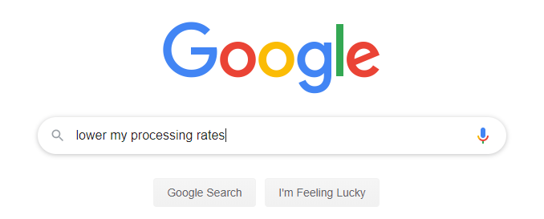
There are 3 different categories of merchants we see:
BUYING DECISIONS
GRAND
OPENING
New Businesses
Businesses Looking to Switch
Existing Businesses

Slide 6
WHO SHOULD I TARGET?
Focus on local small & medium sized businesses
Avoid large businesses/franchises: McDonalds, Starbucks etc.

Slide 7
OUR TOP BUSINESSES
RESTAURANTS
How about your favorite diner or your go-to date night restaurant?
SALONS
Does your hairdresser or nail technician accept credit cards?
AUTOMOTIVE
Where do you get your car serviced or your oil changed?
MEDICAL
Don’t forget about your PCP or family specialist!

Slide 8
YOUR KEY SELLING POINTS
$
PRICE
Consultative Approach; Transparent and
Competitive pricing
PRODUCT
Variety of product solutions for any environment; with a simple transition process
SECURITY
COMPANY
Committed to your success; ACN’s partner within the Payments Space; Group buying power
SERVICE
Dedicated Account Executive; knowledgeable & responsive

Slide 9
INTRODUCING TYRO
Like businesses, not all banks are the same. Tyro is shaking up the business banking world, with smart technology that could save businesses time and money.
Founded in 2003
First transaction went live in 2006
Sought to differentiate through offering better, industry-specific leading payment features
Granted full Banking License in 2015
Tyro Payments Limited ACN 103 575 042 AFSL 471951 (Tyro) is the issuer of its own financial products. As Tyro does not take into account your personal circumstances, please consider if these products are suitable for you. You can contact Tyro on 02 8907 1700 or tyro.com and access Tyro’s dispute resolution process at tyro.com/complaint-resolution-process/.
Sphere Payments Pty Ltd is an authorised representative of Tyro Payments Limited ACN 103 575 042 AFSL 471951

Slide 10
TYRO BENEFITS
Today, Tyro’s goal is to set businesses free to get on with business by simplifying payments and banking
A team of more than 490 dedicated staff nationally
More than $20.1 billion in transactions processed in FY20
Australia’s largest EFTPOS provider of all ADIs outside the big four¹
More than 32,000 businesses with Tyro
300+ POS/PMS integrations
Customer NPS Score of 43²
¹ As per the statistics detailed in Authorised Deposit-taking Institutions Points of Presence June 2019 issued by APRA in November 2019. Excludes EFTPOS providers who are not ADIs.
² Based on Tyro Net Promoter Score Survey, May 2020

Slide 11
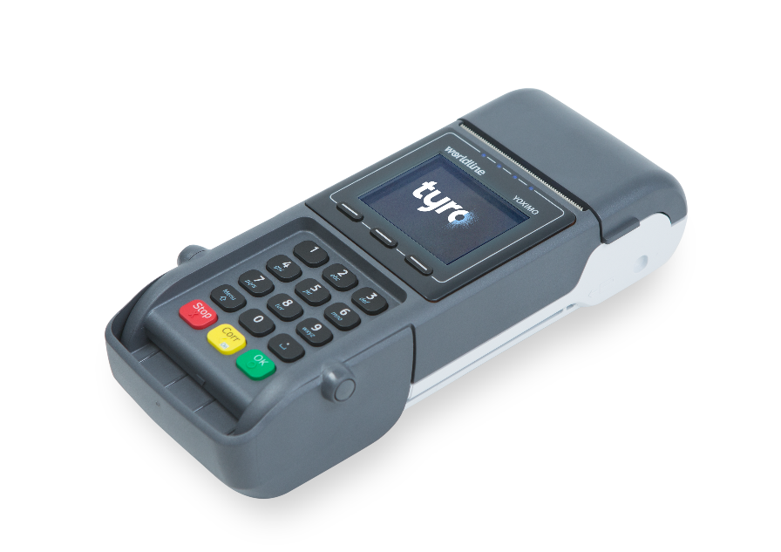
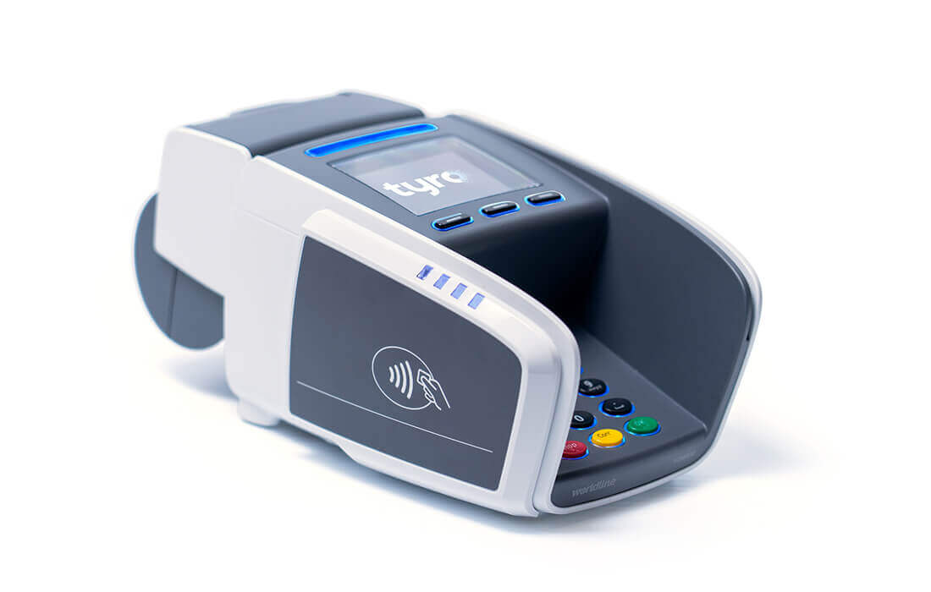
TYRO EFTPOS MACHINES
CounterTop EFTPOS
Mobile EFTPOS
3G or Ethernet connectivity
Fast transaction speeds <1.6 seconds
Tap & Go contactless payments
Inbuilt thermal printer
Machines can be used standalone or integrated. Can integrate with 300+ POS/PMS systems
3G or WIFI connectivity
Fast transaction speeds <1.6 seconds
Tap & Go contactless payments
Inbuilt thermal printer
Machines can be used standalone or integrated. Can integrate with 300+ POS/PMS systems

Slide 12
Hospitality specific features
Tipping
Discreet and easy tipping experience for your staff and customers
Pay@Table
Pay, split, tip, and surcharge at the table, automatically reconciled and integrated with your POS. Pay@Table helps free-up your till and gives customers a premium payments experience¹
BarTabs
Pre-authorised amount set by your customer – no need for your customer to leave their card behind the counter and allows for easy management of multiple bar tabs. This allows staff to continue taking orders and decreases queue times
¹ The split billing function on Tyro EFTPOS machines is only available with Tyro’s Pay@Table feature where the POS/PMS supports
the integration.

Slide 13
NEW MARKETS TO TARGET
Primary Health
Integrated with Practice Management Software
Integrated Medicare EasyClaim
Multi-Merchant
Allied Health Health
Integrated with Practice Management Software
Integrated Tyro HealthPoint for fund claiming
Multi-Merchant
Ask us whether your merchant is eligible!

Slide 14
Health specific features
Tyro HealthPoint¹
On the spot private health claims in just under 4.5 seconds
Patient only pays the gap
Medicare EasyClaim¹
On the spot patient paid and bulk billed Medicare claiming
Eliminates batching
Multi-Merchant
All practitioners, multiple bank accounts, one EFTPOS machine
All payments are integrated into PMS
Less double-handling, and less risk of administrative error

Slide 15
HOW TO APPROACH A MERCHANT
“Most of my clients have seen increases in their credit card processing costs lately; have you noticed this as well? ”
“I work with an amazing, knowledgeable Account Executive at Sphere; if we were able to reduce your processing costs would you be open to making a change?”
“Each year Visa & MC increase certain rate categories; have you reviewed your merchant statement lately for increases? ”
“Reducing your costs on your credit card processing; how would that impact your business? ”

Slide 16
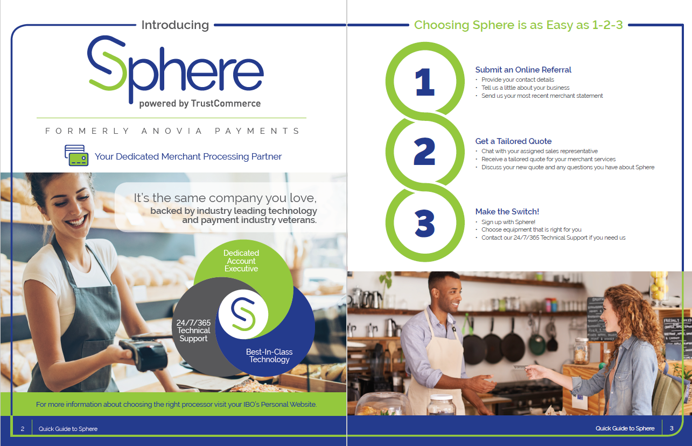
RESOURCES: MARKETING DOCUMENTS
ACN COMPASS

Slide 17
WORKING WITH SPHERE

Slide 18
RESOURCES: ACCOUNT EXECUTIVES
EXPERIENCED PAYMENTS VETERANS
Chat With Us
Call Us
Email Us

Slide 19
HOW WE HELP YOU BUILD YOUR BUSINESS
Sphere offers residuals for the Life of the Customer
3 Customer Points for merchants processing ≥$10k per month*
1 Customer Point for merchants processing <$10k per month*
Dedicated Account Executives to assist IBOs with customer acquisition
3
* See ACN AU Compensation Plan for more information

Slide 20
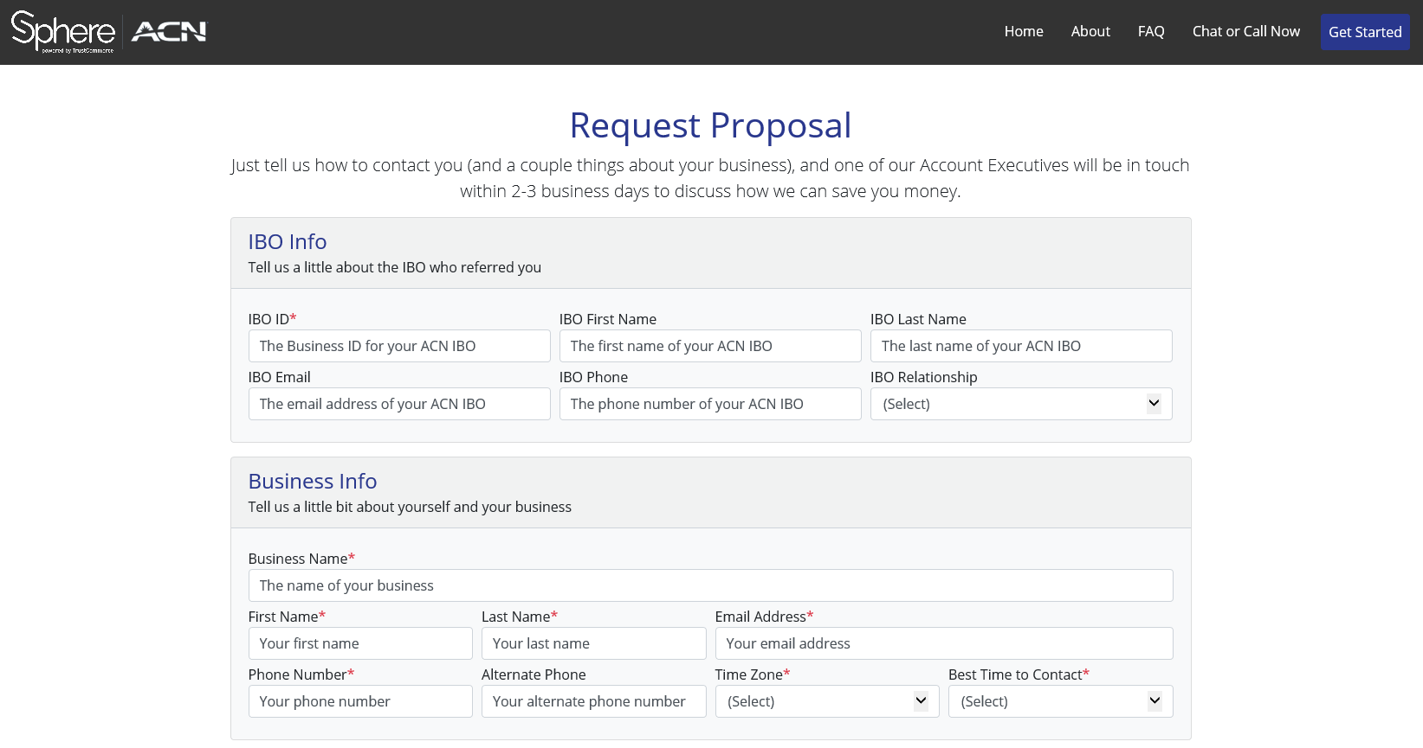
SUBMITTING A LEAD
BUILDING YOUR BUSINESS
STEP 1: Access the Sphere site via your Personal Website
STEP 2: Fill out the online form with as much information as possible
STEP 3: Attach their recent credit card processing statement

Slide 21
WHY DO WE ASK FOR STATEMENTS
Speeds up the Sales Process
Custom Proposal / Best Pricing / Maximum Savings
Faster Approval Process
$

Slide 22
THANK YOU!
If you have any questions don’t hesitate to reach out!

