Slide 1


Slide 2





Who is Sumo?
Sumo is a competitive energy retailer based in Melbourne, Australia. Sumo has been operating since 2014 and currently provide Electricity, Gas and Internet to over 60K Australians across VIC, NSW, QLD and SA.
2020
2021
Launched Sumo Assure product.
Service agents upskilled in sales.
Biggest news of the year… Sumo launches partnership with Conxxion!
Sumo launch new Quote Tool for Conxxion IBOs.
Energy launched in Regional NSW.
Standalone Gas launched in VIC.
Electricity launched in SA!
2019
Launched new website.
Launched new Energy Products:
- Sumo Lite
- Sumo Saver
- Sumo Select
Sumo welcomes new CEO, Dominic Drenen!
2018
Telco products launched.
Acquired 60K customers across Energy & Telco products.
2017
Gas products launched in Victoria.
Electricity products launched in NSW.
2015
2014
Public launch of residential Electricity products in Victoria.
Acquired Victorian Electricity Retail Licence.

Slide 3


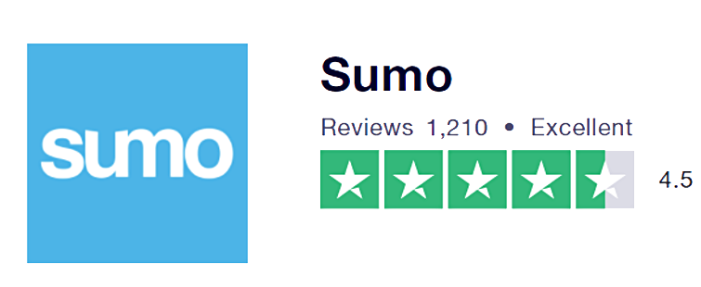
Aussie Customer Champions
100% Aussie based support, trained on Conxxion to ensure best possible experience for our customers!
Rated 4.6 out of 5
Based on 1133 reviews

Slide 4






Product Availability
In development
Retailer | Class | NSW | VIC | QLD | SA
Previous Conxxion Energy Partner | Residential
 | Small Business
 | Residential
 | Small Business

Slide 5
Key Product Features
Conxxion Exclusive Plans – equal to or better than regular rates
Additional value with Direct Debit!
Monthly billing for customers with smart and analogue meters
Quarterly billing for customers with a manually read interval meter – no instalment billing
Flexible Bill Options via post or email!
Flexible payment options: Direct Debit, Online, BPAY, over the counter at AusPost, Telephone payment, & Centrepay

Slide 6

Agenda
Launch timeframes
Accreditation requirements
Do’s and Don’ts
Customer journey
Compensation and allocation
Contact and support

Slide 7
Launch Timeline
Announcement & Soft Launch
17 December
Full Launch
Early January 2021
Sign up of maximum 4
fuels (2 customers)
Available in Personal IBO Website
Email notifications
Feedback to IBO Support and sumoenergysupport@acnpacific.com.au
Sign up of all customers accepted
Customers allocated to IBOs in PCLs
Please Note – Click Energy Customers that switch to Sumo will not count towards Bonuses or Qualification

Slide 8
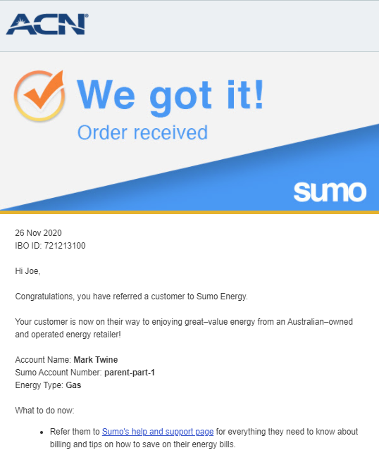
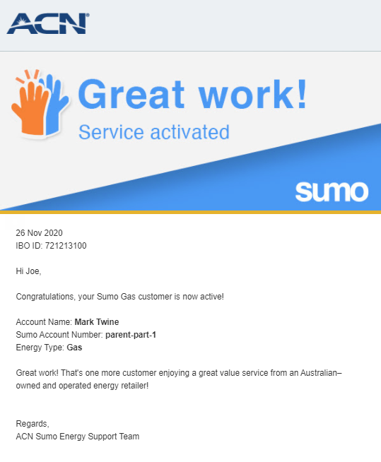
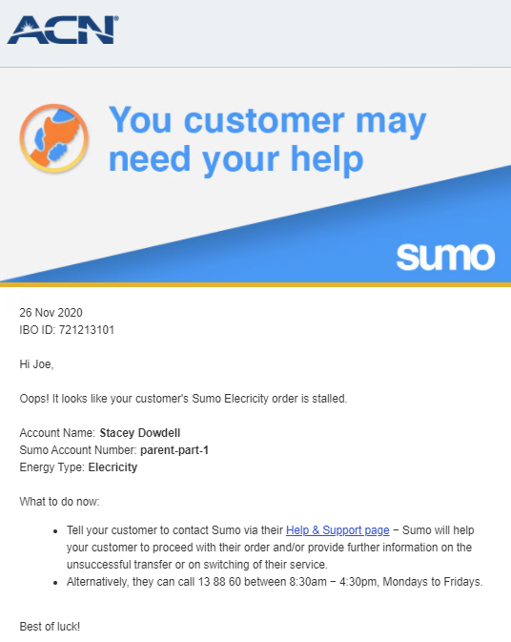
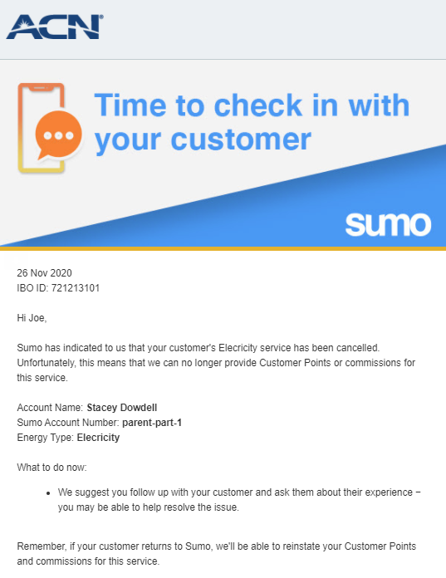
Phase 1 Soft Launch Email Notifications
Order Received and Activated
Order Problem or Disconnection

Slide 9
Accreditation Rules
All IBOs must be accredited before referring customers to Sumo
Customer Acquisition Code and Quiz
  Required at commencement of IBO Agreement
  Must be re-sat every 12 months ongoing
Sumo Accreditation Training and Quiz
  Required prior to referral of customers to Sumo
  Must be re-sat every 6 months ongoing

Slide 10
Compensation
Energy – Sumo
Product | Customer Points | Monthly Commissionable Revenue | Duration of Points and Commission
Residential Electricity | 2 | 50% of $50 is commissionable at standard rates | Up to 48 months
Residential Gas | 2 | 50% of $30 is commissionable at standard rates | Up to 48 months
Business Electricity | 3 | 50% of $80 is commissionable at standard rates | Up to 48 months
Business Gas | 2 | 50% of $40 is commissionable at standard rates | Up to 48 months
Service Type: Connect: Points count immediately following order acceptance. Conxxion Switched: Points count after 45 days from complete order. Not eligible for Bonus or Qualification
Conxxion Switched: These services are currently active Conxxion energy services in PCL, or services that have been active with a Conxxion energy partner within the last 90 days prior to the Sumo energy application.
Please Note: Sumo does offer broadband services, however IBOs will not be compensated for any customers that choose to sign-up to broadband with Sumo. Broadband plans will also be hidden from customers throughout the energy sign-up journey.

Slide 11
Points in PCL – Full Launch (Early January)
When will customers appear in my Personal Customer List?
Once a Sumo customer submits their application and the order is approved.
Points load into your PCL within 24-48 hours
PCLs updated twice daily
MUST complete Accreditation, otherwise the order will be marked “Incomplete”
Any issues contact IBO support (after 5 business days)
Customer places order
Order approved by Sumo
Order Loaded into PCL
Status updated to Active once application is complete

Slide 12
Only sell to your warm market
✓
✗
No cold marketing
DO’S
DON’TS
Only customers are to submit application
Only use the Conxxion Sumo sign-up journey
✓
✓
Never submit orders on behalf of customers
Do not
collect or retain personal customer info
Customers must sign up themselves
✗
✗
✓

Slide 13

IBOs Should Not store Personal Information
Personal Information is defined as “any information that can identify an individual”.
Examples include but are not limited to:
  Name
  Address
  Date of birth
  A photo of their ID
  Credit card details etc.

Slide 14
Protecting the Opportunity & Our Partners
IBOs
Self Policing
Team Responsibility:
Conxxion Corporate
Compliance Regime
Sumo
More Welcome Calls
Enhanced Credit Checks
Personal IBO Website
Educating Team
Asking Questions
Regular order review
Enhanced ID Checks
Increased Order Review
Collaboration with RVPs

Slide 15
Your Responsibilities as a Conxxion IBO
To thoroughly read and understand all Sumo Accreditation content
To correctly inform Conxxion if you are currently a Real Estate Agent or Property Manager as part of the Sumo accreditation module.
Ensure that all customer orders placed through your Personal IBO Website are known to you:
  Make sure you’ve talked-to/met all customer referrals prior to their sign-up.
Let customers know they can expect a welcome call from Sumo, and that their application may be delayed until contact is made.
Ensure all customer applications contain accurate customer contact details and not your own (unless it’s a service in your name).
  Your Customer will need their own email and mobile number to sign up.
In the event of a penalty/fine from an energy industry regulator for misconduct, or fraudulent activity, IBOs will be liable. Fines are typically $20,000+ per service.

Slide 16
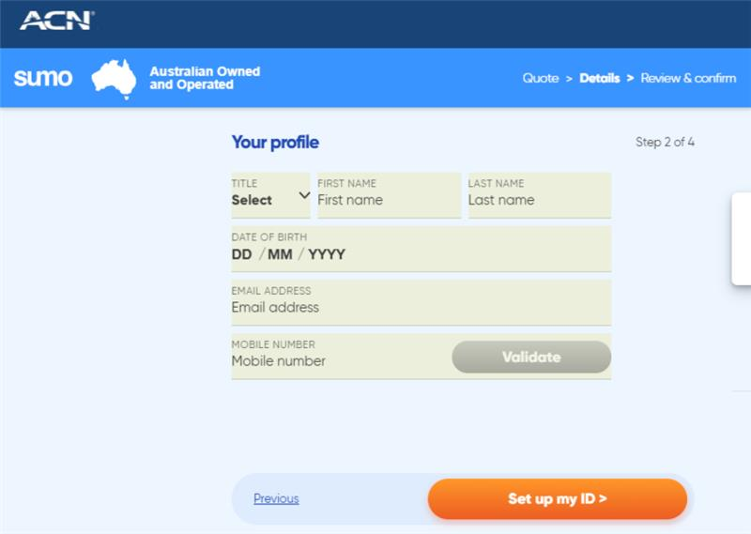
Common Application Issues
Incorrect credit card details or expired credit card
Unsuccessful payment due to insufficient funds on the credit/debit card
Incorrect meter details
Incorrect email supplied
Incorrect mobile/home phone number
Name on order must match name on ID, exactly

Slide 17





Sumo Customer Sign up Journey
Online sign up
Confirmation Email & SMS
10 business-day Cooling Off Period
Welcome Pack
Service switched
Day 1
Day 2-10
Day 11
Day +11
5-minute sign up process
Application ID provided to Customer
Sumo Welcome Calls Placed during this period to validate customer orders
Welcome pack delivered via Post or email based on customer selection
Service Successfully transferred to Sumo
!
Beware of win-backs:
A customer’s old energy company will try to offer your customer a better deal in their 10-day cooling off period – prepare your customers for this call!

Slide 18
Huge Opportunity for Energy Sales
Energy is a ‘switching market’ with 10+ million homes now serviceable and most customers out of contract or on month-to-month plans
Sumo is hugely competitive and their prices are in direct competition with the Tier 1 market leaders; EnergyAustralia, AGL and Origin Energy.
Sumo has a best-in-class process for switching customers and some of the best trained sales support staff – all located in Australia!
Sumo is staffed by a number of people who have worked closely with Conxxion in the past, who understand Conxxion and the needs of both IBOs and your customers!

Slide 19
Sumo Support
For customer enquiries
sumoenergysupport@acnpacific.com.au
For IBO enquiries (i.e. points, residuals, bonuses, etc.)
IBO Support Team via www.acnpacific.com/contact
For feedback:
sumoenergysupport@acnpacific.com.au
Missing Claims:
Enter into webform on Compass
For other training, marketing and support resources:
Conxxion Pacific Compass

