Slide 1
Feeding everyday people in need throughout Australia
Scan QR Code to Donate
www.foodbank.org.au/acn-fundraiser-for-foodbank

Slide 2
Giving Back
Over $100,000 raised and over 200,000 meals have been donated to people in need.
OR
=
1 new service signed up
1 new IBO joins your business
Conxxion donates one meal to Foodbank

Slide 3
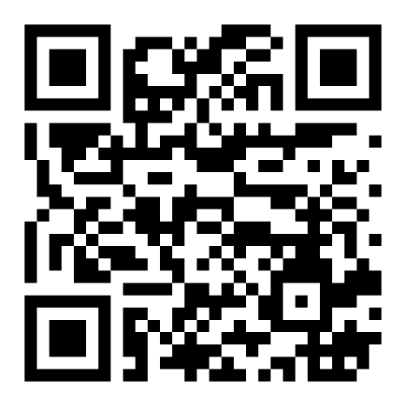
Foodbank heavily relies on volunteers like YOU
Volunteering at your local Foodbank distribution centre is a great way to give back, bond as a team, and see Conxxion’s impact firsthand.
Scan QR to Discover Volunteering Opportunities Near You
www.acnpacific.com/giving-back/

